Slide 1




The qr code payments landscape A LEVEL ONE PROJECT PERSPECTIVE JUNE 2023
THE LEVEL ONE PROJECT IS AN INITIATVE OF THE BILL AND MELINDA GATES FOUNDATION
GLENBROOK PARTNERS

Slide 2
CONTENTS
This is a landscape review of QR Payments models around the world, with an emphasis on developments in emerging economies that enable instant push payments.
In this report, we describe the various models, with particular attention to QR code design choices and how QR code implementations connect with the underlying payments systems used to process the payments.
We also assess how the various models and QR code design choices are aligned with low-income end user requirements, as articulated by the Level One Project.
For this report we looked at the following market developments:
Asia’s GrabPay
Brazil BR Code
China’s Alipay
India BharatQR and UPI QR
Mexico CoDi
Nigeria QR Framework
Singapore SGQR
Tanzania TANQR
Thailand Standardized QR Code
This document provides an update on QR code models in market today, providing new market examples and detailing attributes of QR that enable financial inclusion and is a continuation of prior research on QR codes for the Level One Project. It is a refresh to the previous report, “QR Code Payments Landscape: Oct 2019”.

Slide 3
CONTENTS
5 | INTRODUCTION
10 | QR CODE MARKET MODELS
26 | A LEVEL ONE PERSPECTIVE
47 | MARKET LANDSCAPE
68 | FRAUD MANAGEMENT
77 | FUTURE DIRECTIONS
80 | APPENDIX: QR CODE DATA FORMATS

Slide 4

Executive Summary
QR Codes used to enable instant, merchant push payments continue to rapidly gain traction, particularly in emerging markets. These payments in general support Level One Project goals of growing the digital ecosystem: those that work in conjunction with interoperable payments systems are particularly well-aligned. As more countries develop national QR standards, it is important to consider key design choices for QR codes which can create the foundation for a safe and ubiquitous QR code payment market.
The low barrier to entry for QR code payments and increasing smartphone adoption offers the promise of unlocking high volume merchant payments, and achieving goals important to financial inclusion. These goals include making digital money usable for consumers, and providing the high volumes necessary for low cost systems.
Early implementations are largely using a Shared QR Code model implemented with EMVCo standards.
Other models are emerging in the marketplace as well. Single QR Codes, used with either interoperable or closed-loop payment systems, are gaining dramatic share in countries such as China. The Appendix provides an overview of the various approaches to QR code formatting.
As QR codes increase in usage for payments, we are likewise seeing a rise in QR code related fraud. Robust security features and strong design choices can help to mitigate the rate of fraud in QR code initiated payments.

Slide 5
INTRODUCTION

Slide 6
QR Codes Are A Key Enabler Of Merchant Payments
QR code-enabled merchant payments can bring critical transaction volumes to the underlying payments system, thereby lowering transaction processing per unit costs.
The ease of use of QR code payments – for both the consumer and the merchant - are helping to open up the merchant payments market in many countries. This has been an intractable problem in the past – with neither merchants nor consumers being interested in paying electronically.
Without a developed card acceptance infrastructure, emerging economies have generally not had a means of converting cash merchant payments to digital payments. Some of these countries, however, do have the “rails” of a real-time retail payment system in place. These rails to date have been used primarily for person-to-person payments.
In countries with an instant payments system in place, QR codes can be an “overlay” on those systems – the means to easily initiate payments that are cleared and settled over those rails.

Slide 7
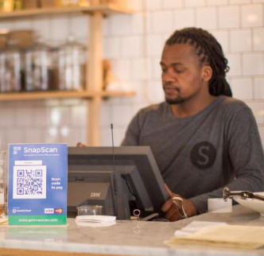
Merchant Payments are Critical for Financial Inclusion
Enabling merchant payments makes digital money “spendable” for every day needs and purchases, and can reduce the need to always cash out digital balances.
Enabling merchant payments is critical for a number of reasons. Making digital money “spendable” is necessary if we want consumers to leave some money in their transaction account – rather than cashing-out upon receipt of digital funds. This can lead to a state of “digital liquidity” – where a consumer (or a merchant!) will be content to leave their funds in digital form.
With “spendable money” in a transaction account, consumers and merchants can develop a transaction history that can lead to the use of other financial services, including borrowing and investing.
A consumer who is using their transaction account for merchant payments will also be better positioned to participate in the developing digital economy – they are enabled to purchase a wide range of government and commercial services.

Slide 8
QR Codes Support Rapid Transaction Volume Growth
Annual Payments per Adult
QR enabled after launch of payment system
2019
CAGR
2022
India, Kenya, and Thailand, while still maturing as payments markets, are each undergoing transformational change and rapidly moving from cash based to digital payments.
With the payment infrastructure in place, QR codes for payment initiation are enabling usage of the instant payment systems for a wider variety of use cases.
Merchant payments, a critical use case and a key source of transaction volume, are still gaining traction in these markets, yet are already providing significant transaction volumes to the respective instant payment systems.
Kenya mPesa
mPesa launched in 2007; QR enabled in 2023
59%
95
379
QR enabled at launch of payment system
India UPI
UPI launched with QR in 2016
10
88%
71
Thailand PromptPay
PromptPay launched with
QR in 2017
79%
43
245
All figures annual
Source: Bank of Thailand, NPCI, Safaricom Results Booklet

Slide 9
QR CODE MODELS

Slide 10


QR Code Payment Models In Market
There are multiple different QR code models that are either live or in implementation in markets across the world.
Shared QR Code Multiple Payments Systems
This multi-tenanted approach allows multiple schemes to initiate payments on their own “rails”, using a single QR code. The schemes may include both interoperable and closed-loop systems.
Single QR Code Interoperable Payments System
One QR code enables payments on a single interoperable payment scheme. Consumers and merchants using different participating DFSPs can send and receive payments using the QR code.
Single QR Code Closed-Loop Payments System
One QR code enables payments in a closed-loop payment system. These enable payments only for the payment system that provides them and requires both consumers and merchants to participate directly in the scheme.

Slide 11
A Note on Payments System Terminology
“Open-loop” and “closed-loop” are terms used to describe different types of payments systems. An “open-loop” system can also be described as an interoperable system. We use the term “scheme” to specify a payment system with its own business and operating rules, which bind participants in the system.
Closed-Loop Payments Schemes
Open-Loop Payments Schemes
In a closed-loop scheme, each customer and merchant has a direction relationship with the scheme.
In an open-loop system, digital financial services providers belong to the scheme, and deliver interoperable payments transactions through the scheme to their consumer and merchant customers.
Digital Financial Services Provider
Merchant or Consumer
C
Consumer
M
Consumer
DF
DF
Scheme
C
Scheme
M
C
M
C
DF
DF
M
C
M
C
DF
DF
M
Merchant or Consumer
The scheme may access open-loop, or other closed-loop schemes, as funding sources for its customers.
Depending on regulation and scheme rules, an open-loop system may allow both banks and licensed non-banks to be digital financial services providers and participate in the scheme.

Slide 12

“QR Code Interoperability”
It is common to hear “QR Code Interoperability” as an objective. But what does that mean?
The understandable goal is to avoid having multiple QR codes at a merchant’s counter: this can create a cluttered, confusing experience for consumers and extra work for merchants. The term “QR Code Interoperability” is used to to describe ways to address this issue. The term, however is a misnomer: payments systems, not QR codes, interoperate.
In market, the term “QR code Interoperability” can refer to either a Shared QR Code used by multiple payments systems or to a Single QR Code for an Interoperable Payments System. Depending on the implementation, either approach can address the issue of point-of-sale clutter.
Two approaches to fewer QR codes at the Point of Sale
Shared QR Code Multiple Payments Systems
Single QR Code Interoperable Payments System

Slide 13
The Shared QR Code Model
This model is the most common seen in market today.
In this model, the QR code data string contains a block of common data along with a “stack” of scheme-specific payments addresses. The common data block contains data that persists between schemes, such as the merchant’s name, while the stack contains data that is only necessary for each individual scheme, such as the merchant’s payments address.
The scanner reading the QR code reads the encoded data objects to pull the common data required, and then interrogates the stack and extracts the scheme-specific data.
Shared QR Code Multiple Payments Systems
Common Data
Scheme 1 Data
Scheme 2 data
Scheme 3 data
The Shared QR Code Model is in use in Brazil, India’s Bharat QR, Nigeria, Singapore, Tanzania, Thailand
Scheme 4 data

Slide 14
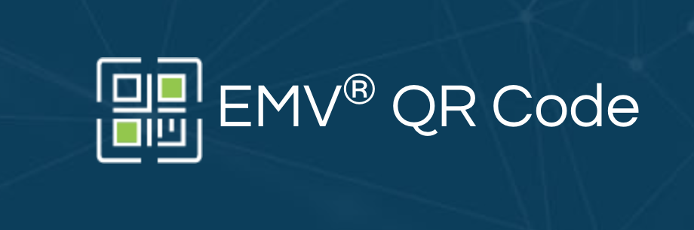
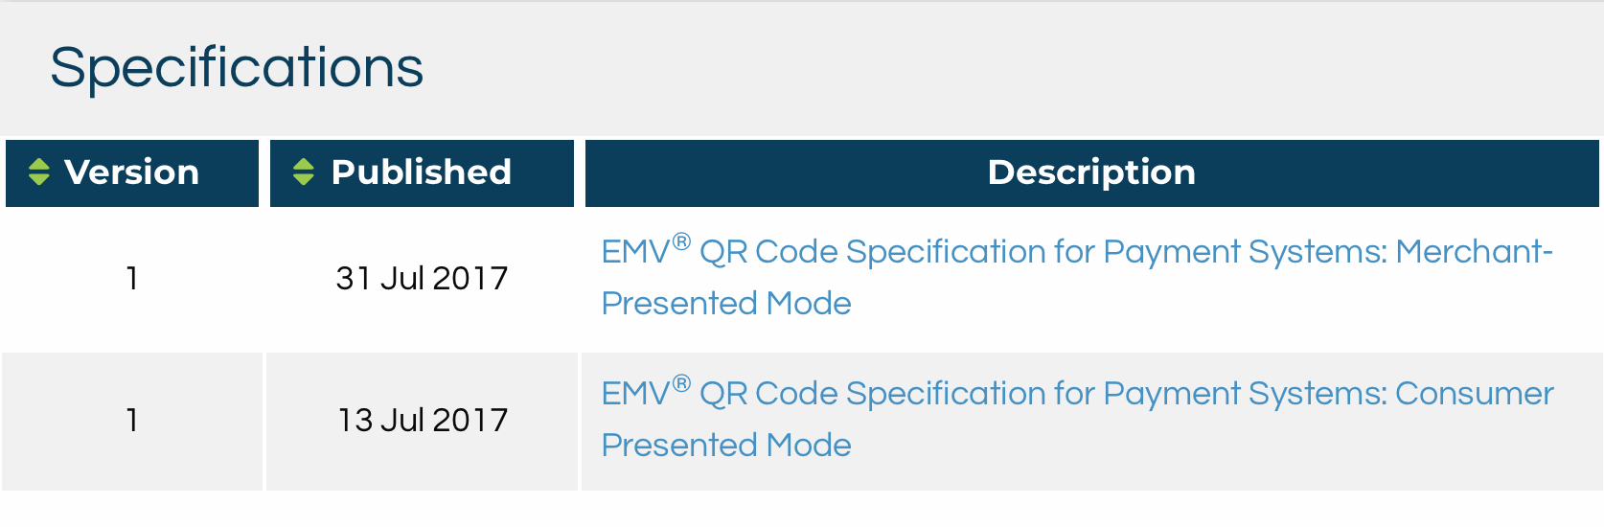
The Shared QR Code Model and EMVCo Specifications
The EMV QR code standard is the way that most of shared QR implementations are choosing to format the QR code data.
Shared QR Code Multiple Payments Systems
The EMV specifications provide details of the formatting of the QR code and the payment address data in the “stack”. Each shared QR arrangement may customize the standard to some degree.
Most of the implementations we see in market are merchant-presented, static QR codes. The EMV specification supports dynamic QR codes as well; this is discussed in the “Future Directions” section.
The EMVCo specification covers consumer-presented QR codes as well as merchant-presented. Merchant-presented is the more common model in the emerging economies, so that is what we discuss in this report.

Slide 15
Shared QR Code: Business Relationships
QR Code “Stack”
Data
Provisioning
The Shared QR code contains a “stack” of merchant payment addresses, one for each scheme that the merchant accepts payments from.
This model relies on a merchant having a business relationship with a DFSP or payment service provider for each scheme it supports. In some markets, one DFSP may represent several schemes to a merchant.
The term “scheme” as used here could be an instant payment credit transfer system, a card system, or a wallet of some sort.
Common Data
Scheme 1 Data
Business Contracts
DFSP/
PSP
Scheme 2 data
Scheme 3 data
DFSP/
PSP
Merchant
Scheme 4 data
DFSP/
PSP
Digital Financial Services Provider (DFSP): financial institution and non-financial institution entities that provide transaction accounts, payment initiation and other financial services
Payment services provider (PSP): entity authorized to support payment enablement (including payment initiation), but does not hold transaction accounts

Slide 16
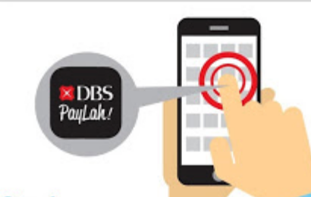
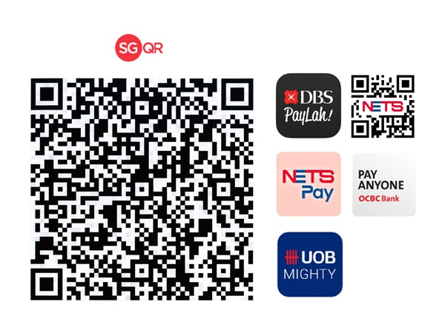
The Shared QR Code Model: Consumer Experience
This model relies on the consumer to choose the payment method used, based on the methods the merchant is accepting. This implies that the QR code display (physical or digital) needs to show the payment methods accepted.
1
2
3
The consumer chooses which payment app she wants to use.
She scans the QR code using the payment app she chose.
The consumer’s chosen payment app interrogates the stack encoded into the QR code, which contains the merchant’s payment address at each of the schemes they accept. If the app finds a compatible scheme payment credential in the QR code, it will begin the payment initiation process.
How the payment process works depends on the specific scheme. Some schemes are “pull payments”, such as card payments; others are “push payments” – such as instant payment systems.

Slide 17
The Shared QR Code: Merchant Provisioning
How does the merchant get this multi-tenanted QR code?
Common Data
Scheme 1 Data
The merchant has separate business agreements with various DFSPs, aggregators, or wallet providers. In a single (non-shared) QR code scheme, the merchant would simply get the QR code from the DFSP or payments services provider. In a shared QR code model, there are a variety of options:
One DFSP is chosen as the lead; they create the QR code including data from other DFSPs. There are obvious challenges here – who chooses the “lead” DFSP? Who ensures that the other DFSPs are correctly shown in the QR code?
Each new DFSP provisioned can create the ”full stack” QR code, reading the old QR code to get the existing data. This model also has issues: how are changes managed, how do you delete inactive merchant relationships, etc.
The most common model is to use a central entity that tracks all of the payment methods accepted by each merchant, and is involved in some way in the generation of the QR code or the data string that is used to generate the QR code. For the purposes of this study, we are referring to this as the “QR Code Repository”.
Scheme 2 data
Scheme 3 data
Scheme 4 data

Slide 18
A Shared QR Code Variation:
Multiple Payment Methods, but a Dominant National Instant Payment System in the “Stack”
Common Data
Scheme 1 Data
Major National IPS
In some countries, there is a single instant payment, credit-push platform with strong government support behind it. Although the QR code approach enables a “stack” of payment acceptance possibilities for a merchant, it may turn out that the platform is the dominant system used.
This is particularly likely in situations where the government is playing a role in setting merchant and consumer payment fees – in some cases, requiring them to be zero.
Thailand appears to be an example of this approach. It is using the shared QR code EMVCo standard. However, Thailand’s PromptPay payment scheme has strong government backing and is showing rapid growth. It appears possible that the system will become the default system for most merchants.
Scheme 2 data
Scheme 3 data
Scheme 4 data

Slide 19
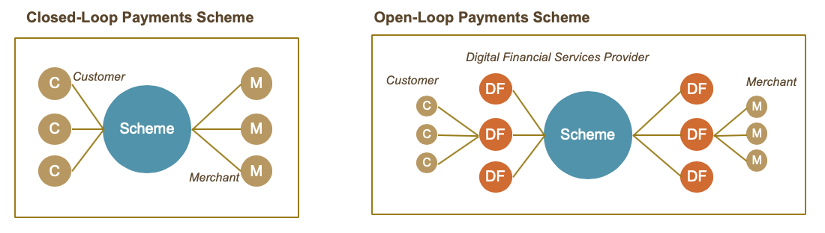
Implications of the Shared QR Code Model
This model promotes competition among schemes.
Each scheme enabled by the shared QR code has its own operating and business rules.
The QR Code Repository may become a “meta-scheme”, with repository rules that may over-write some of the underlying rules of individual schemes sharing the QR Code.
This approach may be the most appropriate in markets with already well-developed electronic payments ecosystems.
In emerging economies without such developed ecosystems, it may provide a degree of choice – and concomitant confusion for consumers and merchants – that could slow adoption.
A repository working with multiple closed-loop and open-loop payments systems within a country
QR Code Repository

Slide 20
Challenges with the Shared QR Code Model
The EMVCo standard uses what we call “in-code” payment credentials – the actual payment data is in the QR Code data string. Any change requires re-provisioning a QR code – a burden when used with static, paper-sticker QR codes. Other approaches use a “referred” model, in which the consumer payment app is directed, once the QR Code is scanned, to another location in order to find the payment data. While this usage may require somewhat more data, this approach may prove more flexible in the future.
The shared QR model inherently requires users to navigate to their preferred payment app in order to choose which payment scheme they would like to use. This could be perceived as an area of friction for the end user.
This shared QR code approach also requires a consumer to use a smart phone: it does not easily accommodate the “QR Code plus pay-to till number” that some single-scheme approaches use.
Cross-scheme fraud control is possible, particularly if there is a strong QR Code Repository function: but this is more complex and difficult than with the single-scheme approaches.
Shared QR Code Multiple Payments Systems

Slide 21
The Single QR Code Model
Single QR Code Closed-Loop Payments System
Implemented with a Closed-Loop Payments System
This has been the predominant method used in early implementations of QR code payments: a single, closed-loop wallet provider offering QR codes for ease of payments. These remain in place in a number of markets.
These closed-loop systems work equally well in consumer-presented and merchant-presented mode: and consumer-presented codes can work with a printed sticker on a feature phone.
By definition, these implementations tightly couple the QR code protocols and rules with the rules of the underlying payment system.
In recent years, attention has focused primarily on China, where the duopoly of WeChat Payments and Alipay have accomplished broadly adopted QR code payments.
Closed-Loop Payments Scheme
C
Customer
M
Scheme
C
M
C
Merchant
M
The Single QR Code Model is used in China and by Asia’s GrabPay

Slide 22
Implications of the Single QR Code Model
Implemented with a Closed-Loop Payments System
Single QR Code Closed-Loop Payments System
This model promotes competition among schemes.
In some respects, these implementations are easier to implement than are shared QR implementations. The closed-loop payment scheme can make unilateral decisions about formatting and related issues.
However, success depends on penetration of this underlying closed-loop payments scheme. Although China shows clear success with this model, it is questionable whether or not this is replicable in other markets where there are multiple wallet providers.
Single QR Code, closed-loop implementations are also free to use proprietary formatting approaches – some of which leverage the URI* and URL structures which arguably will provide greater flexibility, in the long term, than the relatively static in-code approaches, such as that demonstrated by the EMVCo standard.
Like with single QR code models for an open loop system, if other QR codes are used in any given market, multiple single scheme QR codes likely create clutter, and possible confusion, at the checkout.
*see Appendix for more information on URI

Slide 23
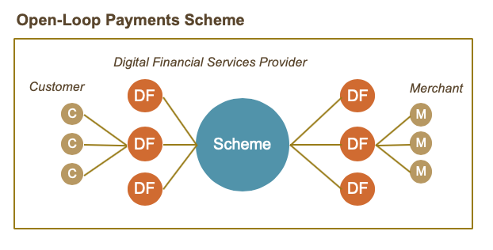
Single Scheme QR Code Model
Single QR Code Interoperable Payments System
Implemented with an Open-Loop Payment System
This model can best be thought of as QR Code-enabling an existing interoperable payment system.
The rules, processing capabilities, and fee structures are an extension of those that exist in the underlying payment system.
The payment system can use whatever data formatting approach it favors: there is no need to use the shared QR code capabilities provided for in the EMVCo standard.
QR code enablement of payments over an open-loop scheme is a relatively simple addition to existing form factors, whether those be card or mobile payments.
This model is used in Mexico by CoDi and India’s UPI QR
QR code rules are added to existing scheme rules

Slide 24
Implications: Single QR Code Model
Single QR Code Interoperable Payments System
Implemented with an Interoperable Payments System
This model promotes competition among providers within the single scheme.
It enables tight coupling of QR code rules and payment system rules.
Logically, it requires a centralized merchant registry, or at a minimum centralized control over merchant payment addresses. This centralized authority can be an active participant in transaction processing, when that is required – for example, this may come into play with dynamic QR code implementations.
Lastly, if other QR codes are used in any given market, multiple single scheme QR codes likely created clutter, and possible confusion, at the checkout.
This approach appears to be used in countries where the primary objective of regulators (or payments authorities) is to build a single national payments platform.
Concentrating volume on a single platform can provide economic efficiencies and reduce marketplace confusion.
Note that shared QR code implementations with a dominant instant payment system share some characteristics of the Single-Scheme implementations.

Slide 25
QR CODES: A LEVEL ONE PERSPECTIVE

Slide 26
The Level One Project
This landscape review is done from the perspective of the Level One Project. The Level One Project, an initiative of the Bill & Melinda Gates Foundation, is a vision for a new digital payments platform that supports inclusive, interoperable digital economies. The QR payments models discussed in this report will be evaluated against the concepts that are central to this vision.
Design Principles
Open-loop
Real-time, push payments
Irrevocable, same day settlement
Pro-poor governance
Tiered KYC
Cost-recovery model
Shared investment in fraud detection
Key Concepts
A collaborative/competitive spectrum
Low to no end user fees
Multiple use cases
Government support
Interoperable
Low cost user devices
3rd Party Providers
Fraud management
User Requirements
Accessible
Reliable
Valuable
Affordable
Profitable

Slide 27
THE LEVEL ONE PROJECT VISION
What is the Level One Project Vision?
The Level One Project is focused on enabling financial inclusion by meeting the needs of low-income users—both individuals and merchants—as well as the DFSPs that serve them. These goals guide the Level One Project thinking, including the origination of the Level One Project Design Principles—a set of principles to guide countries, regions, or commercial organizations working to create inclusive instant payments systems that are designed to meet the needs of low-income consumers
The QR code design categories are organized by the following L1P end-user requirements plus one additional requirement - Governance – which was included to recognize the importance of strong governance in QR code and inclusive instant payments system design
Accessible
Affordable
Users can easily acquire and use DFS services
End users are willing and able to pay for the cost of preferred product and receive value in excess of cost
Reliable
Profitable
Users’ money and information are secure and available for use; systems help deter usage for money laundering and terrorist financing
DFSPs that support low-income consumers earn sustainable margins through product and service innovations
Valuable
Governance
Increase the value proposition for low-income consumers to use DFS rather than cash or other traditional services
Clear articulation of requirements and responsibilities in the rulebook.

Slide 28

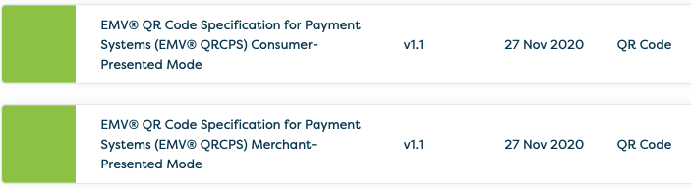
QR Code Specification Standards and Presentment Mode
Accessible
Valuable
Reliable
Affordable
Profitable
Governance
Foundational design choices support QR code payments to be aligned with the low-income end-user requirements.
L1P aligned system: The QR code specification utilizes the EMVco standards
Standard specifications bring clarity and enable merchants to accept QR code payment solutions from various providers in a standardized way
Consumers benefit as well from a more uniform experience that offers greater convenience and familiarity
Merchant QR code presentment is enabled first. Consumer QR code presentment can be introduced when reasonable
Merchant QR code presentment eliminates the need for merchants to purchase expensive POS infrastructure to accept electronic payments
Merchant presented mode works with pure Push Payments. Customer-presented QR codes require additional capabilities (Request to Pay), as the QR code essentially acts as an alias, sharing necessary account data for the receiver to initiate a payment request.
Many modern QR-enabled POS terminals can both generate and scan QR codes enabling businesses to support both modes.

Slide 29
Applicability of QR Code
Accessible
Valuable
Reliable
Affordable
Profitable
Governance
A shared QR code involves all participants in the financial ecosystem ensuring the reach and ubiquity of the solution.
L1P aligned system: A single QR Code is shared among all schemes which are using QR codes as a payment initiation channel
A shared QR code simplifies the interaction for the merchant, by enabling the merchant to display on a single QR code, and for the consumer as well since they need to scan only this one QR code.
Requiring all participants to use the shared QR code ensures that the solution is made widely available and becomes ubiquitous in the market.
The EMVco standard is designed to support the Shared Model and it allows multiple schemes to initiate payments on their own “rails”, using a single QR code.
Shared QR Code Multiple Payments Systems

Slide 30
App Functionalities and Support for Basic Phone Payments
Accessible
Valuable
Reliable
Affordable
Profitable
Governance
Foundational design choices support QR code payments to be aligned with the low-income end user requirements.
L1P aligned system: Feature/basic phones are supported by the QR code
Including provisions in the QR code specification, such as requiring a merchant ID using a specific structure to be included in the QR Code display in order to support feature/basic phones to make payments expands digital payments to those who don't own a smart phone
Although less digital, this ability is essential for the majority of potential users
QR code supports major local languages
Supporting all major local languages in the QR code enables the local population to engage in digital commerce to use the same app while traveling in the region
App functionality and user experience minimum requirements are included in app certification procedures
App functionalities aim to support features that make it easier to use and consume QR code payments (e.g. copy & paste functionality for e-commerce)
Schemes that seek to ensure a specific user experience need to ensure these requirements are in the Rulebook

Slide 31
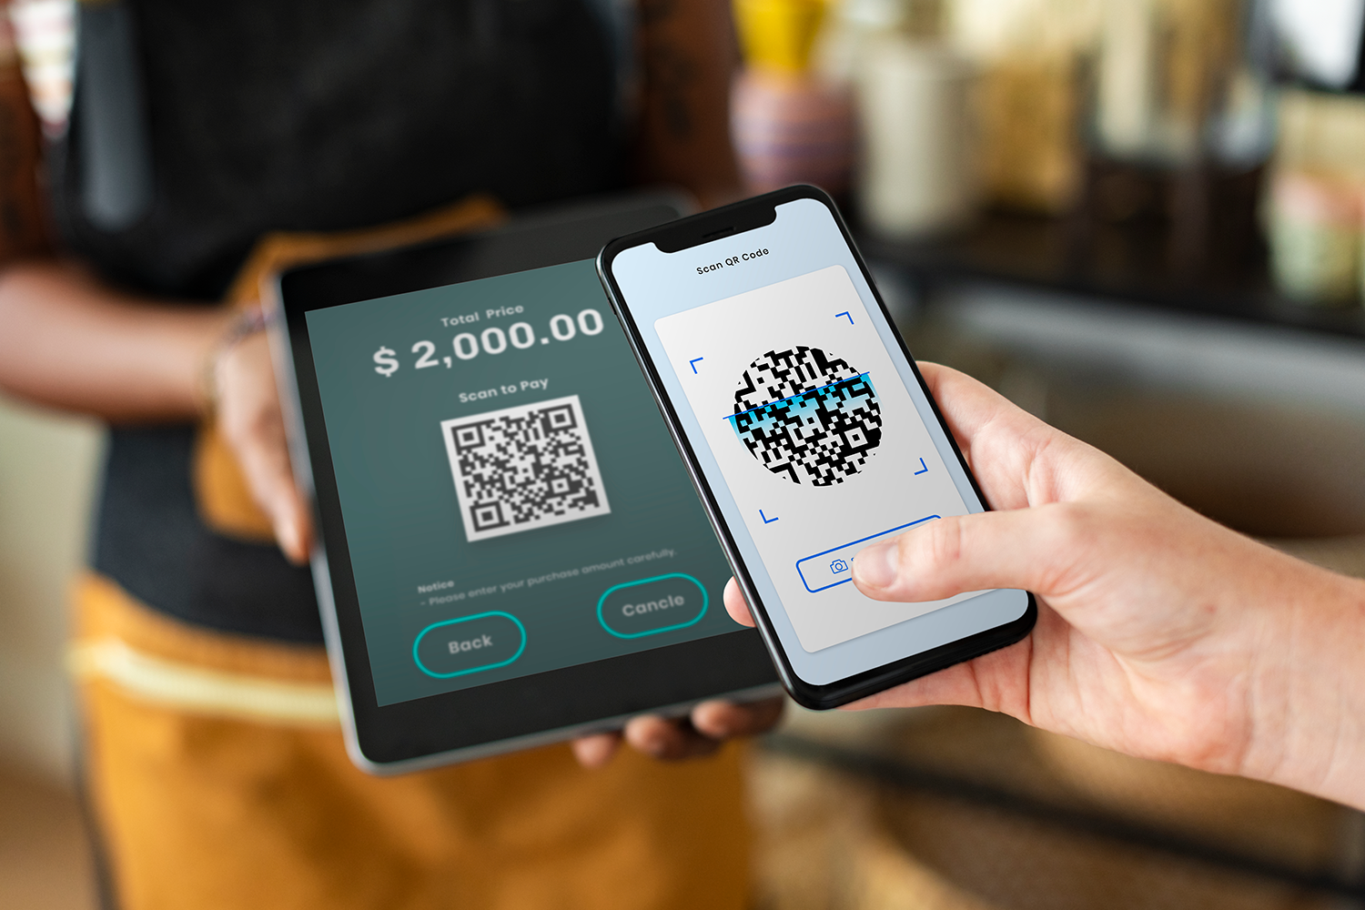
Dynamic QR Code Capability
Accessible
Valuable
Reliable
Affordable
Profitable
Governance
Supporting dynamic QR code capability provides additional value to merchants and extra security
Dynamic QR codes offer a better experience to the merchant who can issue multiple codes for different items and enjoy greater control over the payment amount
Dynamic QR codes are also more secure than static codes as they are harder to counterfeit, have a limited life span, and can be used for a limit number of scans
L1P aligned system: Supports dynamic QR Code

Slide 32
Proper Use of URL/URI and Rich Data Capabilities
Accessible
Valuable
Reliable
Affordable
Profitable
Governance
Supporting rich data capabilities (information beyond merchant ID, transaction ID, transaction value) through a URL/URI provides additional value to merchants and increases security
Using URLs/URIs for redirecting may inadvertently train the user to click on links, which can open the door to fraud through malicious links
Using URLs/URIs for redirecting can provide a simplified user experience. However, requiring the user to click on links risks their going to websites that install malware or use social engineering to perform first party fraud. As a result, redirecting should only be used when additional value is provided
L1P aligned system: Use URL/URI to support privacy and rich data, but not for redirecting to websites
Storing rich data in the URL keeps the size of the QR code manageable regardless of the amount of the information maintained
This method of storing data in the URL is also more secure since the data is not stored in the QR code, which is visible to anyone with a QR reader, but instead stored at a secure protected location
Usage of rich data allows merchants to compete on offering value added services like loyalty or suggested tipping, among other items. Other rich data enables additional use cases such as payments with a future date, installment payments, or other value-added capabilities of IP that can be leveraged in QR codes
Rich data is stored in URL at a trusted source (DFSP/PSP, RPPS), not in QR code data fields

Slide 33
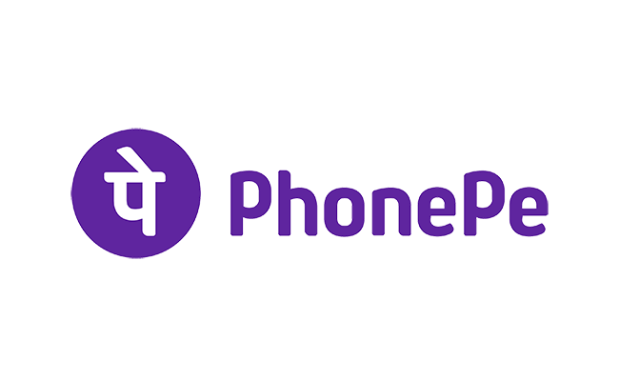

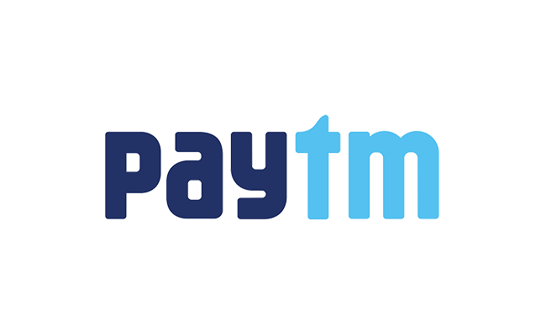
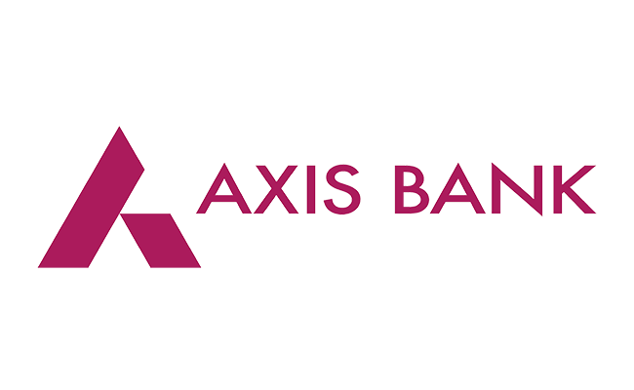
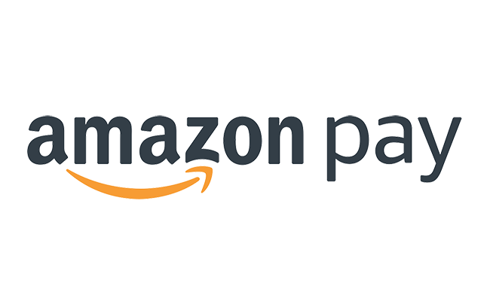
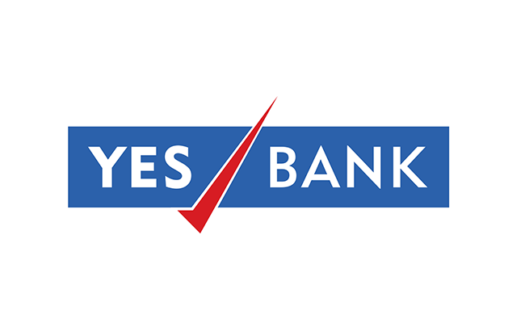
Party Providing Dedicated Reader App
Accessible
Valuable
Reliable
Affordable
Profitable
Governance
A robust payments ecosystem with multiple apps in the market encourages competition for customer accounts
Use of a dedicated app for payment initiation safeguards the customer against malicious QR codes that take the user to a fraudulent website
Additionally, allowing fintechs to offer payment initiation apps leads to a more vibrant and inclusive ecosystem. This is seen most notably in India where a robust ecosystem of payment initiation app providers compete in the market for customer accounts
L1P aligned system: Multiple dedicated reader apps in the market are preferred
India’s Payment Initiation App Providers
*Providers shown are the largest in the market. Additional apps are available in the market.

Slide 34
Generating Party of QR Code
Accessible
Valuable
Reliable
Affordable
Profitable
Governance
Strong governance regarding QR code generation supports security of the QR code and privacy for the end-user
Security of QR codes through ensuring that they do not contain malware or compromise the information/process, and privacy of end-users through protection of PII information to prevent capture or misuse in the process, are critical in QR code initiated payments
Governance on the party generating the QR code must ensure that all needed standards are observed, and is one of multiple important design choices that helps to support these goals
L1P aligned system: DFSP/PSP or other certified entity generates the QR code on behalf of the merchant or consumer end-user

Slide 35
Use of Merchant Registration / Identification
Accessible
Valuable
Reliable
Affordable
Profitable
Governance
Having a merchant registry (logically separate from alias directory) allows for a more formal security process than that for a payee
Since merchants collect and keep the money, it is appropriate that they and their websites undergo a higher degree of validation than a payor
Merchants, particularly large merchants, have more sophisticated token/alias needs than a consumer as they may have significantly more aliases to track or are reserving/blocking adjacent aliases. Hence additional sophistication is required that is not necessary for the simple alias directory
This type of merchant registry is frequently used to define how the merchant can be paid including the method of payment(s) accepted and the associated DFSPs
Business-to-business (B2B) e-invoicing/ remittance registry supports business payments. B2B registries can support a variety of data lookups, including information on the routing of e-invoices and payment details, such as where and how to send payments. The registry would allow a business or its service provider to discover important information about the e-invoice processing capability of a recipient, including what types of documents the recipient can receive, in what format, and with which service provider
Multiple IDs for a single recipient can be beneficial, for example, if one of their IDs is unusable, e.g. because the corresponding DFSP is down, then an alternate ID can be used by the payer or such mapping can be done at the backend too
L1P aligned system: Merchant registries are beneficial once a level of maturity in B2B payment volume is reached

Slide 36

Verification of the QR Code and the Party Presenting the QR Code
Accessible
Valuable
Reliable
Affordable
Profitable
Governance
Verifying that the QR code has not been altered and verifying the party presenting the QR code are important security measures to prevent fraud
Information in the QR Code is secure and tamper-proof as it is digitally signed
The app reading the QR code needs to be able to validate digital signatures in real time. The increased amount of data to encode reduces the area to encode actual data. This may require data to be stored outside of the QR code and be accessible via a URL
L1P aligned system: Digital Signing for dynamic QR code
Effective security & fraud prevention requires "defense in depth" - the approach in which several independent layers of security controls are used so that if one fails another will be operative
Example: the user validates that the name of the merchant from the QR code is as expected
The DFSP/PSP sends the name of the merchant (and other relevant aliases) from their Core Banking solution – to eliminate name spoofing
All involved parties take appropriate action

Slide 37
QR Code Payments Pricing to Fee to DFSP/PSP
Accessible
Valuable
Reliable
Affordable
Profitable
Governance
Having zero fees to DFSP/PSP for QR code initiated payments encourages provision for free to end-users.
QR codes support more convenient payment initiation. Providing this service for free to DFSP/PSPs supports the DFSP/PSPs to provide QR code payments for free to end-users
L1P aligned system: No charge to DFSP/PSPs for QR code generation and initiation of instant payments. The payment system seeks to make money by providing additional value-added services to the DFSP/PSPs
Scheme fees, including Platform fees and Scheme Management fees, are paid by participants (DFSP/PSPs) to the Payment System
$0.0
$0.0
End Users ‘Clients’
DFSP/
PSPs
Payment
System
DFSP/
PSPs
End Users ‘Clients’

Slide 38
QR Code Payments Pricing to Consumers and Merchants
Accessible
Valuable
Reliable
Affordable
Profitable
Governance
Having zero end-user fees for QR code generation and initiation of instant payment is a foundational goal of the Level One Project vision.
QR codes support more convenient payment initiation. Mandating that this service is provided for free through restrictions on charges to end-users encourages market adoption and digital payment usage.
In most countries, the fees charged to consumers or merchants for payments transactions are most typically set by the providers themselves: the DFSP who is serving each customer.
In some countries, however, payments authorities are looking at the potential of QR enabled merchant payments and taking steps to set limits on these fees, in the hopes of encouraging adoption.
In these countries the effective price to both the merchant and the consumer for low-value QR code enabled payments is zero. This may be accomplished by government mandate, by agreement among a group of providers, or simply by market practice.
L1P aligned system: No charge to end-users for QR code generation and initiation of instant payments. Providers seek to make money by providing services that are adjacent to payments: these may be either financial adjacencies (lending, investment, etc.) or commerce adjacencies (margins on selling goods and services online, enabled by electronic payments.

Slide 39
Articulated Rules for Governance of QR Code Payments
Accessible
Valuable
Reliable
Affordable
Profitable
Governance
Strong governance of QR code payments supports market adoption and the usefulness of QR code initiated payments.
L1P aligned system: All stakeholders contribute to education and awareness
Education and awareness campaigns about QR codes and their features and use cases helps to drive adoption in the market
The payment system has clear documentation of rules and procedures
Clear documentation of rules and procedures encourages a robust payment ecosystem and the protection of end users (consumers and merchants), which builds trust in the ecosystem.
The payment system ideally requires reporting: data on source of transaction initiation
Knowing the source of transaction allows for the data collection specific to QR code channel (fraud, usage, etc.) This information can be used to benchmark against peers and to continuously improve the operation.

Slide 40
QR Codes and Related Fast Payment System Design Decisions

Slide 41
Privacy Features
Accessible
Valuable
Reliable
Affordable
Profitable
Governance
Use of Aliases for payment initiation protect consumer privacy
It is widely recognized in law that privacy is a right. Therefore, QR codes should comply with the applicable privacy laws
Where permissible by law, dynamic QR Codes can include 3rd party tracking plugins such as Google Analytics or a re-targeting pixel by Facebook when a QR Code is scanned. Those external tracking services store a third-party cookie on the user's device
The broader impact of regulation in EU countries (General Data Protection Regulation - GDPR) and the State of California (California Consumer Privacy Act - CCPA), which require express consent from a user if third-party cookies are to be stored on their device, is the extension of this treatment to all applications
L1P aligned system: Privacy measures are employed (e.g., use of Aliases)
To support confirmation of payee, a directory is required
Directories, which are informational databases that support the exchange of payment information, could allow for more end-user convenience, easier fraud mitigation techniques, greater payment routing accuracy, easier switching of service providers, and faster exchange of e-invoices and remittance information
Alias directories can support payments to / from both consumers and businesses, though sometimes merchant directories perform this function for businesses
Alias directory is utilized

Slide 42
Fraud Management
Accessible
Valuable
Reliable
Affordable
Profitable
Governance
A shared fraud fighting model contributes to effective security & fraud prevention through "defense in depth”
All payments systems and payment methods are targets for fraudsters, particularly as they become more established.
A key design principle of Level One is that the scheme provides tools with the goal of raising the bar on fraud management by all DFSPs. The idea is fraud mitigation should not be a competitive advantage, rather the quality and effectiveness of fraud mitigation improves when it is done by everyone.
Level One supports scheme-level fraud management in addition to provider-level fraud management.
An arrangement where all parties operate tools that are complementary would be most effective as fraudsters understandably work across DFSPs; complementary tools enable detection of fraud that is not possible from the perspective of a single DFSP, benefiting participants and their customers.
In looking at the various QR Code implementation models, it is clear that centralized fraud management is possible – and planned for – in the single-scheme model. In a shared QR implementation, the central QR repository (if there is one) could become the place for centralized fraud reporting, at least on an after-the-fact basis.
L1P aligned system: Scheme provides a shared fraud management utility and scheme rules include procedures to share security information between participants and the scheme

Slide 43
Security
Accessible
Valuable
Reliable
Affordable
Profitable
Governance
Verification of the QR code reading application and requirements for DFSP/PSP due diligence of QR accepting merchants support a safe digital payment ecosystem
It is common for fraudsters to release applications that pretend to be QR readers. To protect consumer trust, they should be able to identify verified and trusted apps
Example requirements include:
Ensure appropriate configurations on QR Code Payment applications that use QR codes for payments in conformity and compliance with requirements of QR Code regulations;
Deploy necessary updates and patches on its QR Code Payment application and ensure the customer is unable to initiate transaction through the older version of the application where the customer fails to apply the update within 14 days of the availability of the update or patch
L1P aligned system: All apps are verified against security and usability requirements
A significant number of small merchants will be enabled to accept digital payments for the first time. This will create new opportunities for fraud. Therefore, strong governance regarding merchant due diligence is a prudent and necessary component of QR code roll out
Strong due diligence includes, for example: Business License/Registration copy, Identity Proof of the Owners/Authorized Signatory, and Company Address Proof
Existing customer onboarding procedures are generally adequate. Governance is needed to determine when a merchant who is already a customer needs to be re-certified
DFSP/PSP perform due diligence of merchants during onboarding and an ongoing basis

Slide 44
Security
Accessible
Valuable
Reliable
Affordable
Profitable
Governance
These are generic security requirements in an Instant Payment Scheme. However, if they are not present, introducing the QR code is a logical and opportune time to revisit the topic
QR codes are inherently more secure because one party must have a mobile device, which improves security through device identification, MFA, and geolocation
However mobile devices had been known to be vulnerable to various transaction level attacks (e.g. Man in the middle)
To guard against these risks proper transaction level security must be mandated and enforced
Potential transaction level security measures include:
Shared responsibility for transaction authorization between acquiring and issuing banks
Multi-factor authentication (including use of customer PIN or the Bio-metrics as the 2nd factor of authentication)
Secure channel for PIN and use of PKI encryption
L1P aligned system: Transaction level requirements are specified: the security of the transaction in any 3rd party app matches those already defined for the DFSP/PSP apps (e.g. for making an instant push payment)
Reasonable processing restrictions (e.g. transaction limits, daily limits, velocity checks) are in place to prevent fraud in the payment system
Limits can support the prevention of fraudulent or illegal actions including kidnappings, inundation of fraudulent requests for payment, etc.
Scheme defines safe addressing requirements through directory and alias requirements
Requirements around timeframes for reusage of alias and restrictions around similarly spelled aliases provide extra security to the use of Aliases

Slide 45
QR CODES: MARKET LANDSCAPE

Slide 46
Table of Contents
Most countries are introducing Shared QR codes that support multiple payment systems, including an interoperable payments system.
Shared QR Code Multiple Payments Systems
Single QR Code Interoperable Payments System
Single QR Code Closed-Loop Payments System
Singapore SGQR
Nigeria QR Framework
Tanzania TANQR
Brazil BR Code
India Bharat QR
Thailand’s Standardized QR Code
India UPI QR
Mexico’s CoDi
China’s Alipay
Asia’s GrabPay
Mojaloop, an open-source software for financial services companies, government regulators, and others supports a variety of models for QR based payments.

Slide 47
Singapore SGQR
Shared QR Code Multiple Payments Systems
A Shared QR Code Approach
Country Payment System Overview
Singapore has a highly developed payment system, with a mostly banked population. Card penetration is extensive, and there are multiple mobile payment applications and FinTechs in market.
In 2014, Singapore’s banks introduced FAST, a real-time credit push electronic transfer system.
Singapore’s central bank, The Monetary Authority of Singapore (MAS) oversees the payments ecosystem in the market. MAS has a Payments Council to drive the adoption of e-payments, and foster innovation and collaboration in the industry
QR Code Market
Singapore has had many QR solutions in market, fueled by relatively high smartphone penetration.
MAS’s Payments Council has stepped in to help streamline the multiple QR solution by launching SGQR, a shared QR code that combines the data elements necessary to conduct payments with multiple providers.

Slide 48
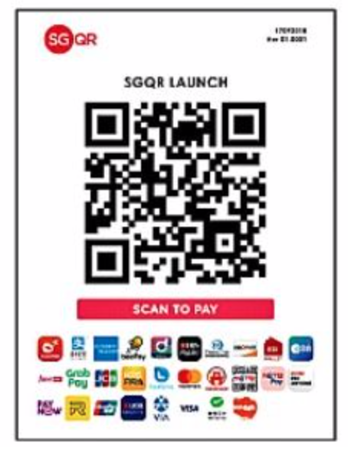
Singapore SGQR
A Shared QR Code Approach
When the shared QR code is printed out on a paper sticker, it carries the brand icons of all of the payment schemes supported by that merchant. That helps the consumer choose what payment app to open.
SGQR is an implementation led by the central bank – the Monetary Authority of Singapore.
SGQR is a shared QR code implementation using the EMVCo QR code specification.
MAS contracted with BCS – a payments services operator – to operate the QR code repository
The initial implementation is for merchant-presented, static QR codes only
SGQR is not involved with payments processing, nor with the business agreements between merchants and payments providers
As of 2023, the Monetary Authority of Singapore is considering introducing a fee structure model for SGQR Members. The proposed fees are intended to cover the operating costs of the Central Repository to ensure that SGQR is financially self-sustaining national e-payments infrastructure.
The initiative is apparently a reaction to a proliferation of single-scheme, closed loop QR codes offered in the market – which were creating clutter and confusion at merchants.

Slide 49
Nigeria QR Framework
Shared QR Code Multiple Payments Systems
A Shared QR Code Approach
Country Payment System Overview
Nigeria is currently developing its digital payment systems and has a high portion of its population with no access to formal financial services - only 45% of the adult population have a formal account at a financial institution or with a mobile money service provider.
The Central Bank of Nigeria (CBN) overseas payments systems and sets QR Code standards in Nigeria.
In 2011, CBN introduced Nigeria Instant Payments (NIP), a real-time inter-bank account-to-account Electronic Funds Transfer (EFT) payment scheme.
QR Code Market
All QR code payments implementation in Nigeria are mandated to support account, wallet, card and token based QR Code Operations. However, currently each switch has its own implementation of the standards resulting in QR codes in the market that are not yet interoperable.
Smartphone penetration in Nigeria is low at around 36% in 2018, hindering usage of QR Code initiated payments.

Slide 50
Tanzania TANQR
Shared QR Code Multiple Payments Systems
A Shared QR Code Approach
Country Payment System Overview
Tanzania is currently developing its digital payment systems and has a high portion of its population with no access to formal financial services – only 52% of the adult population have a formal account at a financial institution or with a mobile money service provider.
The Bank of Tanzania (BoT) overseas payments systems and sets QR Code standards in Tanzania.
In 2022, BoT introduced Tanzania Instant Payment System (Tips), an interoperable payment system that enables real-time money transfers between banks and other digital providers of financial services.
QR Code Market
TANQR is a Shared QR code that is used by all banks, Electronic Money Issuers, and PSPs when issuing QR codes to their merchants in the country
Notably, Tanzania uses a merchant registry that includes additional information about merchants to improve security and enable value-adding features
To simplify the user experience for QR code payments, BoT required that all proprietary payment QR codes be phased out: “All existing Quick Response (QR) codes issued to merchants in the country prior to the effective date of this circular shall continue to be used for a period of one (1) year from the date of issue of this circular. During this period, all FSPs shall migrate their existing QR codes to conform with TANQR Code Standard 2022.”

Slide 51
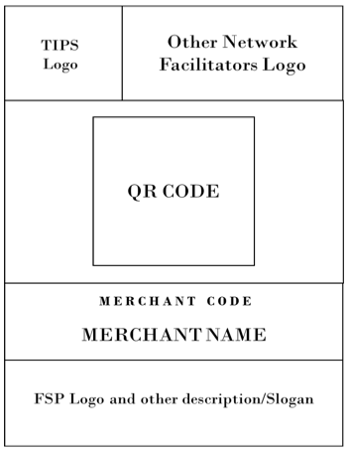
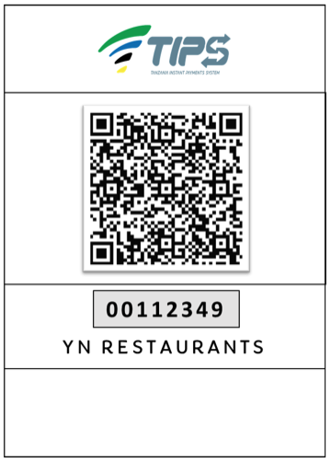
Tanzania TANQR
A Shared QR Code Approach
TANQR requires a specific structure of merchant ID to be included in the QR Code display so that payees who use feature phones can make payments

Slide 52
Brazil BR Code
Shared QR Code Multiple Payments Systems
A Shared QR Code Model with a Dominant Instant Payment System (Pix)
Country Payment System Overview
The Central Bank of Brazil (BCB) oversees the domestic payments market and issues national standards for QR Codes as well as Open Banking.
Recently, BCB implemented Pix, an interoperable, instant payment system. Supported by mandates for large banks to offer Pix, no charge to consumer end-users and low cost for merchant payment acceptance, Pix has seen rapid adoption in the market.
Pix transaction volume has increased at a monthly average of 13% since launch while average Pix transaction value has been decreasing, indicating usage of Pix for everyday purchases.
Quite impressively, given the recent introduction of Pix to the market, already 77% of Brazil’s adult population has either made or received a Pix transaction.
QR Code Market
Pix rules contain highly prescriptive minimum user experience requirements, including various aspects of QR code payment such as the timing and information to be notified to payees, the placement of a button to generate static or dynamic QR codes, and the ability to “copy & paste” QR code contents.
DFSPs and Pix both take a role in verifying the validity of the dynamic QR codes
DFSPs are responsible for: 1) providing the URL for the payee and ensuring its security and availability, 2) checking the name field, obtaining the public key and associated certificates, verifying security certificates and validating the digital signature

Slide 53
Brazil BR Code
QR codes are increasingly used for payment initiation, with dynamic QR growing in popularity
Alias identifiers are by far the most popular method to make payment while QR codes are gaining momentum
Both static and dynamic QR codes are in use with the increase in dynamic QR likely being driving by the growth in P2M payments
Source: Pix Forum, September 2022

Slide 54
India
Multiple QR Code Approaches in a Country With Strong National Payments Systems
Payments Systems
India has a well-developed, broadly available set of payment systems. Most are operated by the National Payments Corporation of India (NPCI), a non profit company owned by a consortium of major banks. NPCI has led the charge in fostering innovation and building out the national digital payments infrastructure.
NCPI has two instant payment systems: the IMPS system for interbank transfers and the UPI system. UPI, notably, allows non-bank, non-transaction account providing PSPs to initiate payments orders that transfer money from one bank account to another. This has allowed so-called “technology giants” (Google, as one example) to play a major role in payments systems initiation.)
QR Market
NPCI introduced both Bharat QR and UPI QR to reduce the problem of multiple QR codes. Bharat QR is a Shared QR Code Model with a dominant underlying instant payment system (UPI) while UPI QR is a Single QR Code Interoperable Payment System model, intended primarily for P2P and P2B payments.
UPI QR dominates payment acceptance channels in India (in Millions) - Nov 2022
Source: RBI

Slide 55
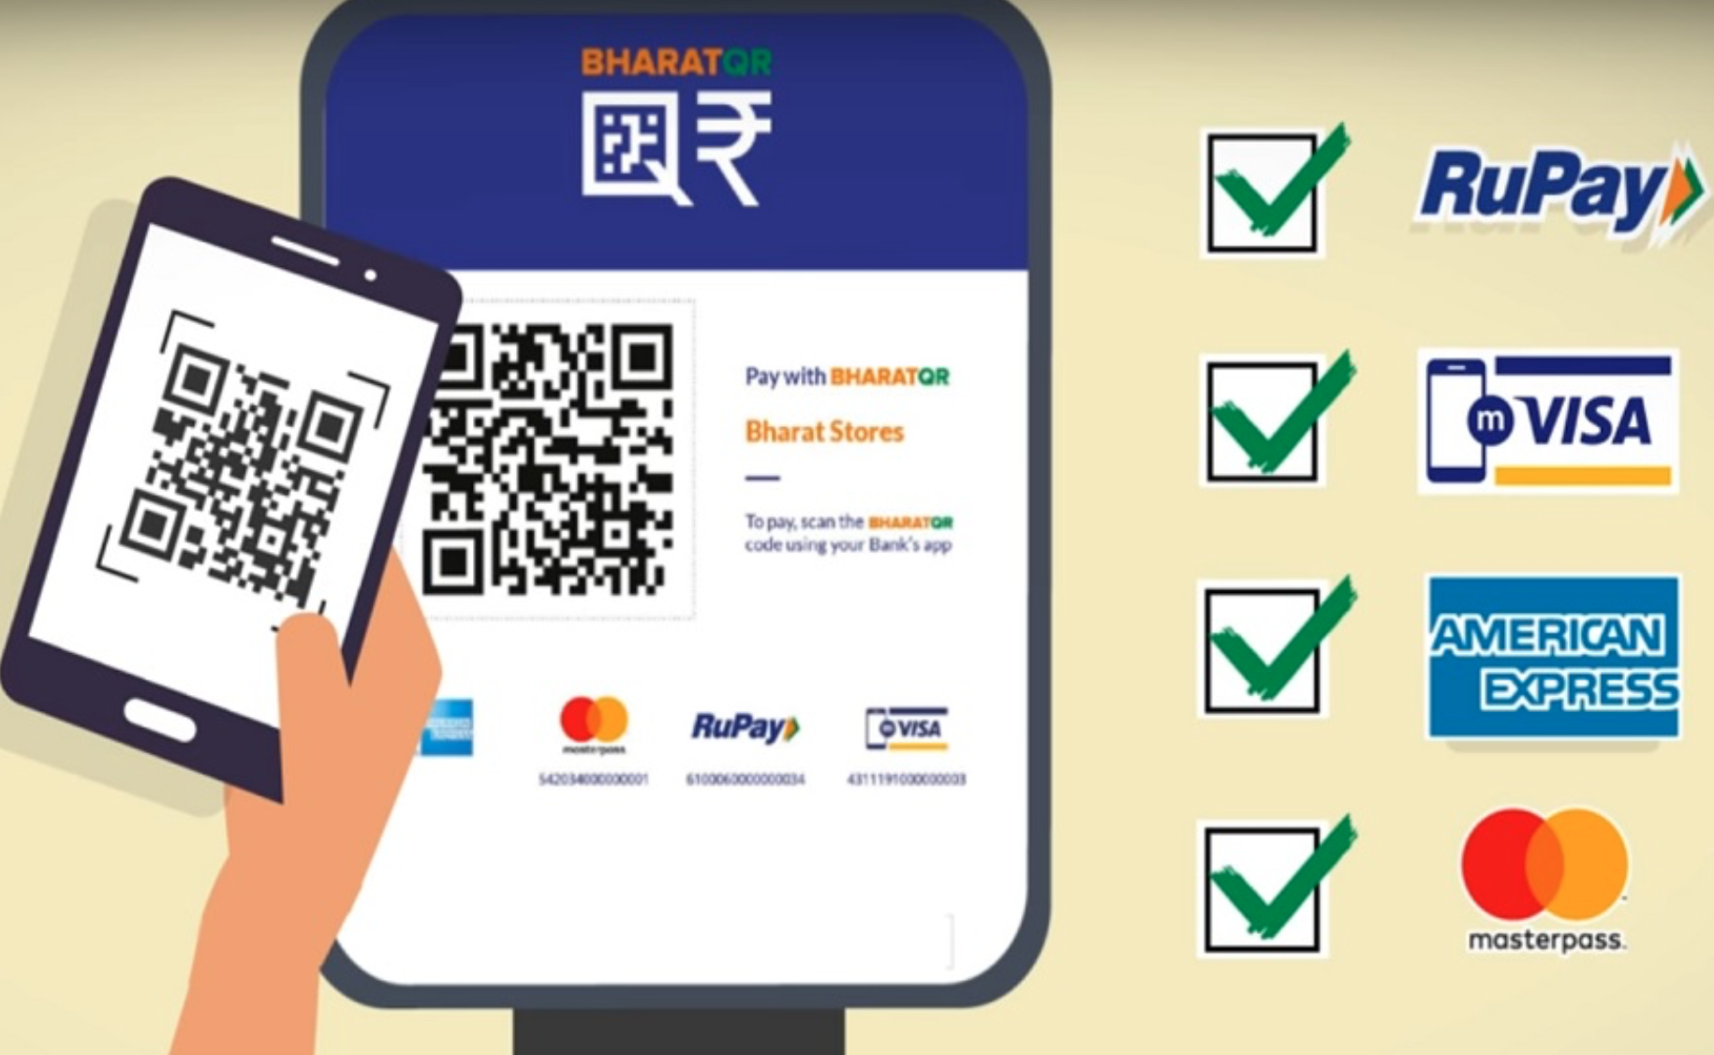
India: Bharat QR
Shared QR Code Multiple Payments Systems
A Shared QR Code Model
BharatQR is a shared QR code implementation, using the EMVCo QR Code specification
Bharat QR supports static and dynamic QR codes and both push and pull payment schemes. It appears to be used primarily with merchant-presented QR codes.
It was launched in 2016, in cooperation with global card networks and the domestic RuPay card, operated by NPCI.
NPCI appears to be operating the “Repository” function for Bharat QR
It remains to be seen if the most popular payment method used with Bharat QR will be RuPay Debit Cards or UPI. Both debit a consumer’s bank account. UPI payments are less expensive to the merchant, but there are more RuPay enabled bank accounts.

Slide 56
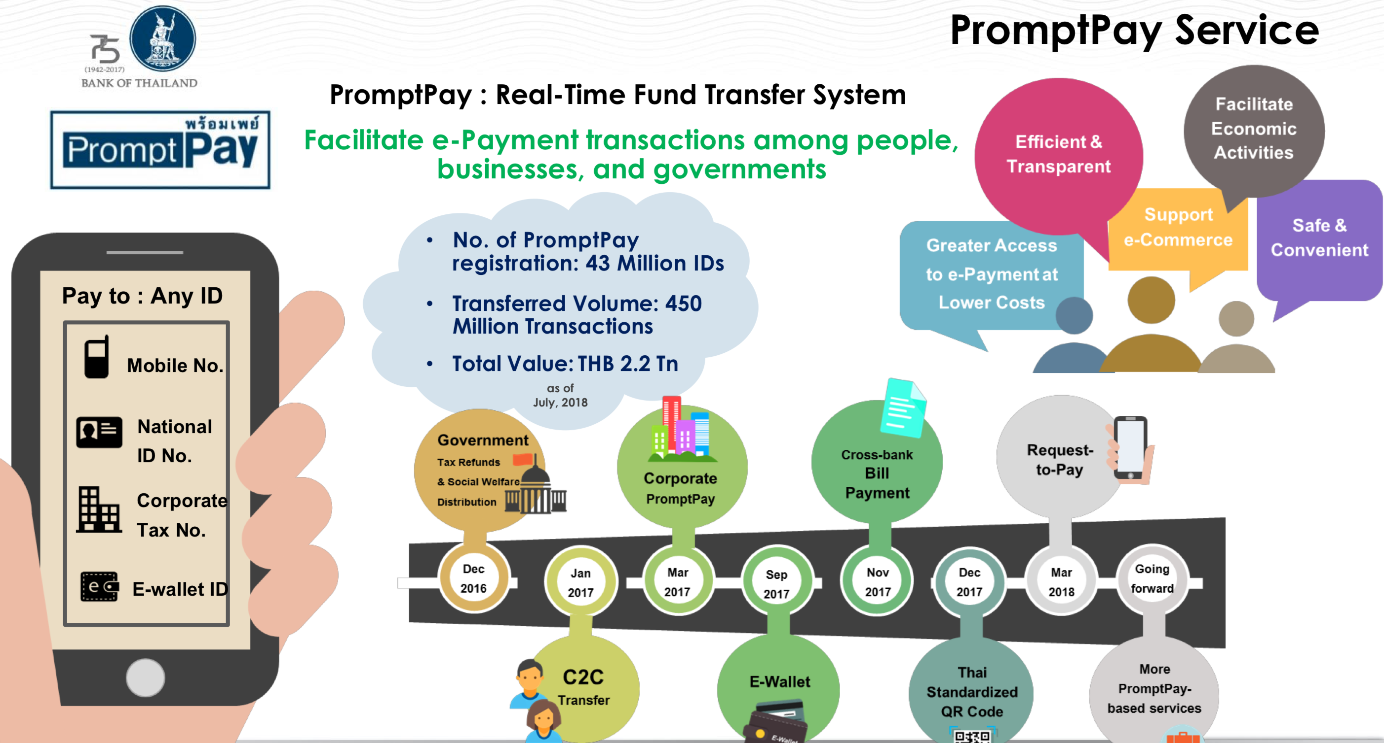
Thailand’s Standardized QR Code
Thailand has a thriving economy and, at 95% a very high rate of adults with financial accounts.
The Bank of Thailand (BoT) oversees payments systems and regulation in the country, and maintains a National e-Payment Master Plan.
In 2017, BoT launched PromptPay, an electronic retail payments system, to enable real time payments between users. The open-loop system uses a social token, such as a phone number or national identification number, as a payment alias.
The Thai government has encouraged adoption of PromptPay by paying out government benefits using the system.
Bank of Thailand’s PromptPay Vision
Includes multiple use cases and multiple payments addresses

Slide 57
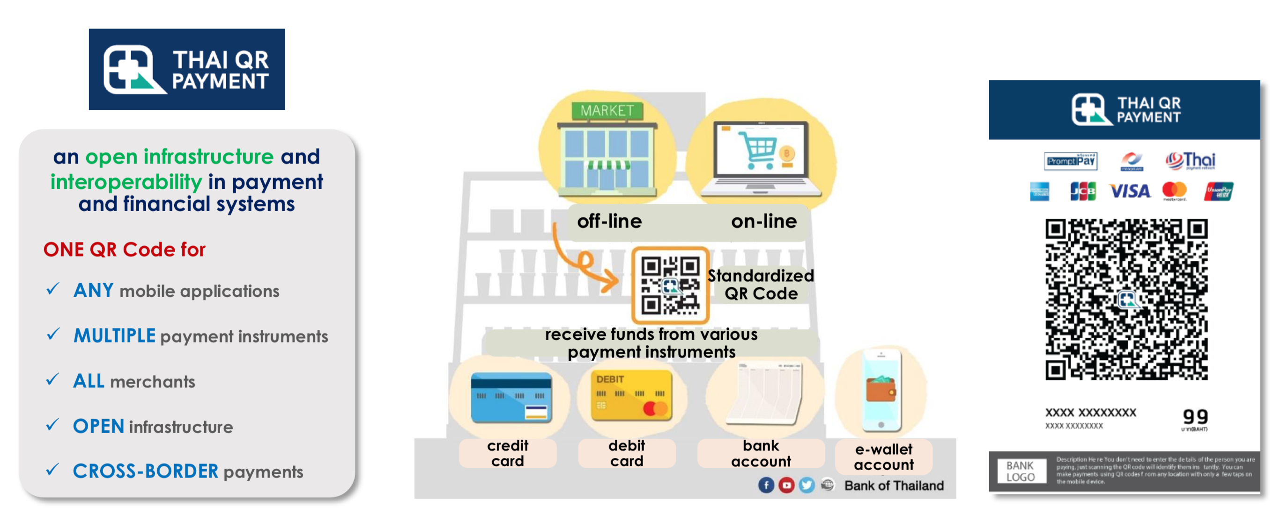
Thailand’s Standardized QR Code
Shared QR Code Multiple Payments Systems
A Shared QR Code Model with a Dominant Instant Payment System (PromptPay)
Thailand launched a shared QR code payment system in 2017, operated by the Bank of Thailand. This implementation uses the EMVCo Merchant Presented Standards. All information is formatted using TLV and is readable to any scanner.
The implementation is for merchant presented QR codes, with both static and dynamic modes supported, as well as the ability to create a request for payment tied to an invoice.
Although the system does not rely on any single payment rail, it does enable payments via PromptPay, Thailand’s real time retail payment system. PromptPay is expected to become the dominant underlying payment mechanism used with the QR code implementation.
Bank of Thailand’s QR Code Vision
All payments forms, remote and point-of-sale

Slide 58
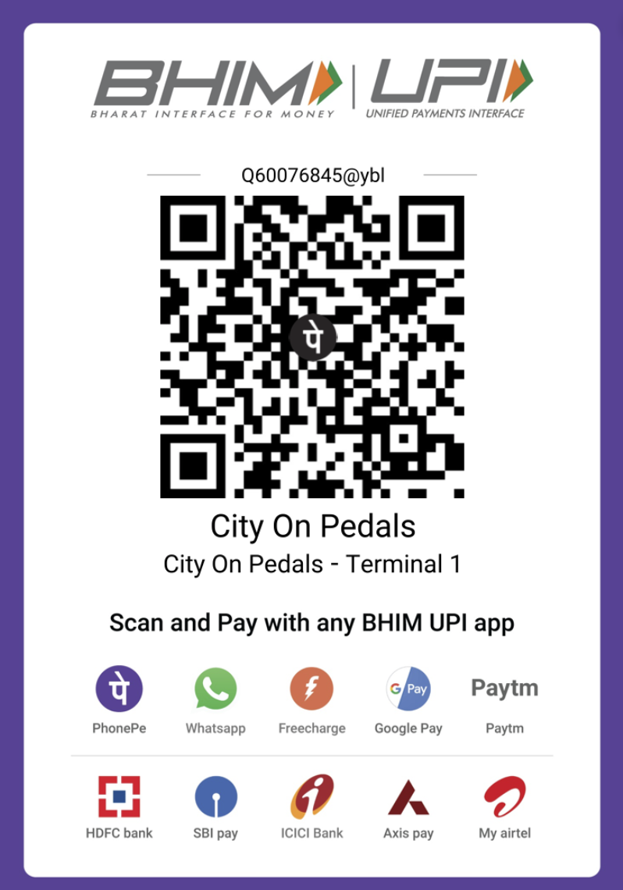
India: UPI QR
Single QR Code Interoperable Payments System
A Single QR Code Model Implemented with an Interoperable Payment System Model
UPI QR is intended to be used by consumers to initiate P2P and P2B payments over UPI.
UPI QR Codes can be created within an application and either displayed digitally or printed out.
UPI QR Codes are used for payment only on the UPI interoperable payment system.
100% UPI = 7,309 txns
53%
47%
Source: RBI, NPCI

Slide 59
Mexico’s CoDi
Single QR Code Interoperable Payments System
A Single QR Code Model Implemented with an Interoperable Payments System
Payments Systems
Banco de México, Mexico’s central bank, oversees the country’s domestic payments systems.
In 2004, Banco de México launched SPEI, an open-loop instant payment electronic funds transfer system. The system is owned and operated by the central bank.
SPEI’s participants can transfer Mexican pesos by own account and on behalf of their accountholders, in near real-time, 24 hours per day, every day of the year.
QR Market
Banco de México began trials of its QR and NFC Cobro Digital (CoDi) electronic payment system in 2019. The system works by using QR codes to initiate electronic transfers on SPEI rails.
Participation in CoDi is mandatory for all Mexican banks above a certain size.
The initial pilot was conducted with employees of financial institutions including BBVA Bancomer, Citibanamex, Santander, Banorte, Banregio and Fincomun.
A handful of wallet providers, such as Mercado Pago, have also introduced closed-loop payment QR codes.

Slide 60
Mexico’s CoDi
A Single QR Code Model Implemented with an Interoperable Payments System
Single Scheme, Open Loop
Mexico’s CoDi QR payment system runs on top of the instant payment “rails” of Bank of Mexico’s SPEI system, which has been in operation since 2004
SPEI is both the RTGS wholesale payment system and the retail real-time payment system. Transactions are credit-push, real-time, and use gross settlement.
The Bank of Mexico provides the notification service for all QR payments, including on-us transactions.
Proprietary Data Format
Data objects contained in CoDi QR codes are formatted using specific, proprietary rules. They do not follow any international standard. All information contained in the QR code is encrypted; Banco de Mexico provisions shared symmetrical keys with the relevant parties.
This means that every CoDi payment message must pass through Banco de Mexico.
CoDi is part of a major initiative to reform and extend the financial sector in general:
The project, which touches on technology, services, market incentives, fees and financial inclusion, is the product of months of discussions between the heads of Mexico's private financial institutions, the central bank and the incoming finance ministry.
BN Americas, January 2019

Slide 61
Mexico’s CoDi
Single QR Code Interoperable Payments System
CoDi is Merchant Presented, with Dynamic and Static Capabilities
The merchant’s CoDi app either generates payment message with full transaction details (amount and reason for payment) – OR – presents a static QR code to consumer.
Banco de Mexico serves as as the CoDi “Administrator” and requires certification for merchants and service providers. It also maintains a legal agreement with merchants on CoDi usage.
NOTABLE:
All banks participating in SPEI with > 3,000 deposit accounts must have app certified and in market.
The central bank of Mexico, as operator of the system, prohibits banks from charging merchants or consumers for transactions below a set value. Bank of Mexico has indicated that suppliers of the CoDi functionality will be allowed to charge customers for additional or associated services.
CoDi includes integration of NFC payments: this enable consumers to “tap to pay” as well as “scan to pay”

Slide 62
China and QR Codes
Payments Systems
China’s population is heavily banked, and the national payments systems are well developed and tightly regulated.
The People’s Bank of China (PBOC), the country’s central bank, passed reactive regulation in 2017 requiring all cross-bank transactions to clear through its platform, Wanglian. This data flow allows the government to monitor domestic money movement.
QR Market
China is arguably one of the most heavily penetrated QR markets globally, particularly in its urban centers. 70% of the population regularly use QR codes as a channel for merchant payment initiation.
Alipay and WeChat pay are the dominant QR payments systems in China, and both offer closed loop wallets. WeChat pay and Alipay have more than 90% of the market share of mobile payments and more than 1 billion users.
China lacks a QR code standard, resulting in separate QR codes for closed-loop payment systems. When making purchases, customers can choose which QR code to scan with their phone. Closed loop wallets are funded by transfers from bank accounts, using the Wanglian platform.
In 2018, the PBOC passed additional QR payment regulations and enacted daily transaction limits, encryption and verification requirements, data protection, and transaction verification controls
Future of QR codes in China
In their FinTech Development Plan (2019–2021), PBOC called for operators to promote interoperability of barcode payment services and achieve mutual recognition of QR codes

Slide 63
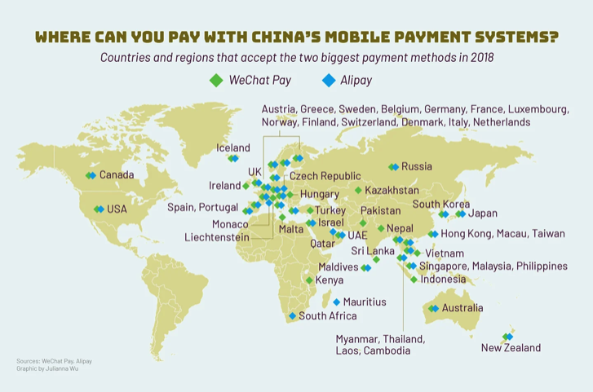
Chinese Closed-loop Wallet Providers Expand Globally
Penetration and usage of Alipay and WeChat pay in China are so high that merchants outside China are clamoring to enable Chinese tourists to use the payments systems to shop while abroad.
Source: Tech in Asia, 2018

Slide 64
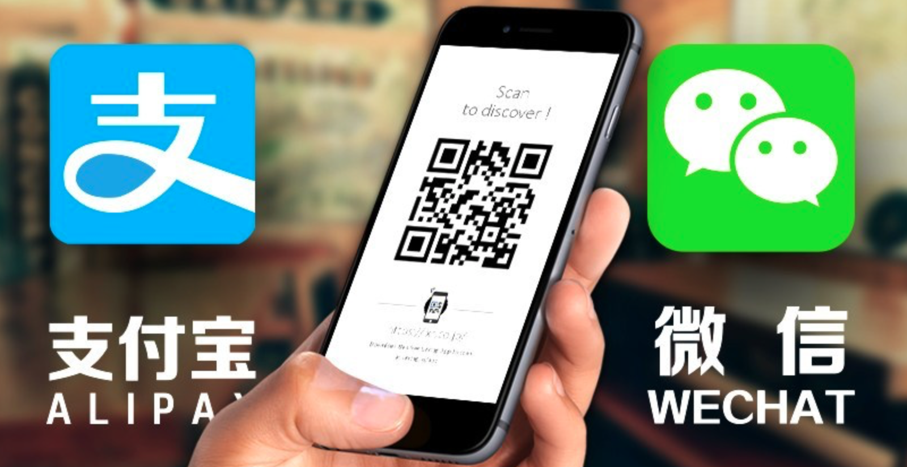
China’s AliPay
Single QR Code Closed-Loop Payments System
A Single QR Code Model, Implemented with a Closed-Loop Payments System
Alipay, a payment service owned by Ant Financial, works as a closed loop wallet. The service is run by Ant and only uses national payments rails/infrastructure to load funds in and out of the service.
Alipay also provides additional financial services ranging from bank account management to insurance.
QR Codes are mostly merchant presented, although consumer-presented is also supported. QR Codes can be implemented on either a static or a dynamic basis.
The Alipay QR code contains only a URL; only the company can resolve an encoded web address into a payment instruction. Conveniently, any QR scanning application can read and direct the user to the encoded web address, which then summons the correct screen within the Alipay app.
Most merchants in China reportedly have both WeChat Pay and Alipay QR codes displayed. The consumer chooses which app to pay with.
Famously, both payment apps are embedded in consumer “Super Apps” which provide multiple other services – financial and non-financial.

Slide 65
Asia’s GrabPay
Single QR Code Closed-Loop Payments System
A Single QR Code Model implemented with a closed-loop Payments System
A closed-loop wallet introduced by a ride hailing platform
> 4 million merchants enabled
8 markets
~34 million active monthly users
Static QR code, Merchant presented or Dynamic QR code that is either Merchant or Consumer Presented
Cash-in can be done electronically, or by Grab drivers that essentially function as an agent network
Partner with local wallets in some geographies to reduce licensing burden
Grab evolving to super-app model with additional financial services including offering loyalty, credit, and even investing
Grab’s vision is to ultimately create a “single ASEAN eWallet that will deepen financial inclusion for the region’s growing middle-class consumers and micro-entrepreneurs.” Grab currently offers local wallets in 8 countries in Asia, and launched a remittance offering in 2018. This wallet-to-wallet product allows users to send money to other countries, with instant receipt and access for receivers.

Slide 66
A Mojaloop Perspective on QR Codes
Mojaloop is open-source software for financial services companies, government regulators, and others taking on the challenges of interoperability and financial inclusion.
Mojaloop offers secure, reliable transaction clearing and settlement between financial institutions.
The Mojaloop community is building on this to create additional capabilities in support of schemes’ needs to achieve scale. These include a number of “value add” capabilities, such as including merchant payments using QR codes
Mojaloop supports a variety of models for QR based payments focused heavily on enabling various person to merchant use cases. The mechanism to deliver QR code based payments is generally a fintech (third-party payment initiation provider) initiated, whereby a QR code is effectively used to generate a request-to-pay message
Although merchant payments can be made to the merchant’s mobile phone number, the recommended approach is to use Mojaloop’s aliasing technology to facilitate merchant registration and the use of merchant IDs, for all but the smallest merchants
The Mojaloop Community is in the process of developing merchant registration services for use by merchant acquirers, in support of a QR code merchant payments scheme
The Bill & Melinda Gates Foundation has funded the initial development of Mojaloop code, and continues to support its ongoing development by a community of software and implementation partners.

Slide 67
A Mojaloop QR Code Payment Flow
This shows a static QR Code, merchant presented implementation. Rather than using EMVCo specifications, this approach uses URI formatting to effect payment.
Consumer
Consumer DFSP
Level One Scheme/ Switch
Merchant
DFSP
Merchant
The consumer has a smart phone app that is enabled for QR code payments for the scheme.
The scheme supports centralized merchant registration.
The merchant has a scheme payment address and a QR code for display which embeds this.
Consumer App Scans Code
URI-formatted Message Sent to Consumer DFSP and on to switch
Merchant ID Validation process occurs at switch
Consumer Enters Amount, payment request is sent by Consumer DFSP to switch
Mojaloop Quote Process confirms with Merchant DFSP that merchant’s account is ready to receive funds
Consumer approves purchase
Transfer of funds is initiated by Consumer DFSP
Switch manages transfer and settlement process
Consumer and Merchant receive confirmations

Slide 68
QR CODES: FRAUD MANAGEMENT

Slide 69

Mitigating Fraud Risk in QR Code Payments
All payments involve a level of fraud risk; QR code payments are no exception.
All payments systems and payment methods are targets for fraudsters, particularly as they become more established. Fraud is harmful to the entire payments ecosystem. For low income and women end users, fraud is particularly detrimental to their well-being.
Most QR code fraud attempts seen in market to date are, at their core, similar to fraud vectors that are present more broadly in instant payments systems. As a result, principles and best practices to mitigate fraud in instant payment systems also apply to QR code payments.
The Bill & Melinda Gates Foundation’s Level One Project team has developed a set of Fraud Mitigation Principles and best practices that provide inclusive instant payments systems an actionable starting point towards effective fraud mitigation. The Fraud Principles and best practices apply to QR code payments. For more information, please refer to the L1P: Fraud Mitigation Principles for IIPS report.
The remaining slides in this section showcase how fraud can be perpetrated with a QR code and the unique QR features that can help bring Fraud Mitigation Principles and best practices to life.

Slide 70
Fraud in QR Code Payments: Misdirected Payments
Though QR codes can certainly increase some aspects of transaction security, they also present some security challenges. The two-dimensional matrix format was not designed to be readable to the human eye and could allow bad actors to avail themselves of novel fraud vectors.
In static QR codes, bad actors can simply cover a “good” QR code with a fraudulent QR code that directs payments to them, rather than the intended merchant, or, if the data objects are available in a readily manipulated format, the fraudster could alter the payload to include the real merchant’s name with the fraudster’s address.
This type of fraud requires more technical sophistication to enact in a dynamic QR code environment. Fraudsters must gain control of the merchant device to redirect the payment.

Slide 71
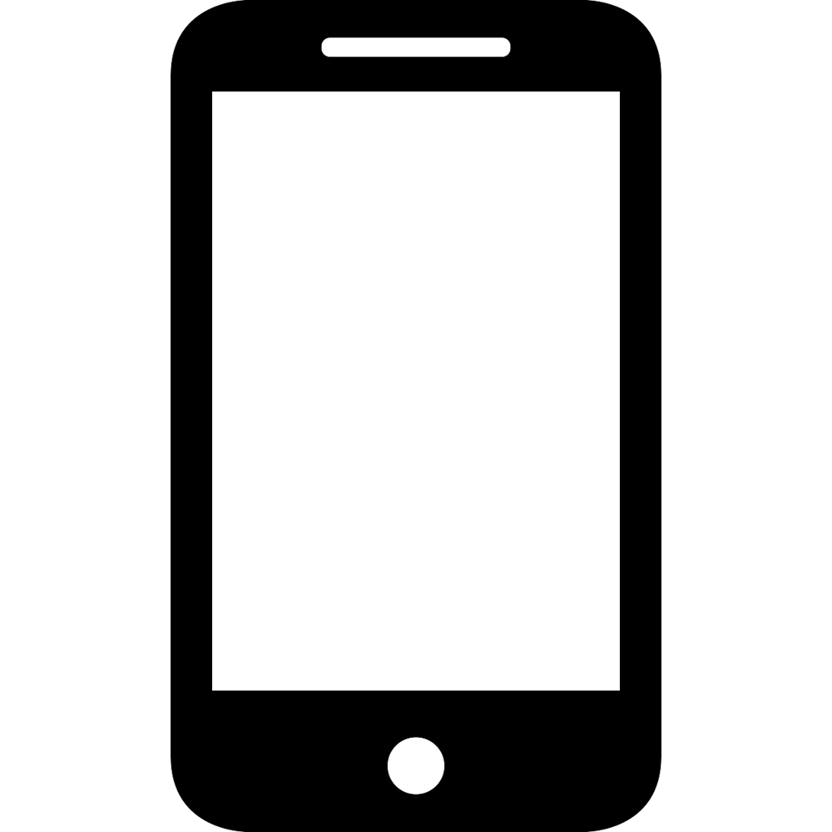

Misdirected QR Code Payments: Mitigation Tactics
Consumer’s Device
Best Practices : Account Naming & Confirmation of Payee
If data objects are available directly in the QR code and account naming conventions are clear and descriptive, the app can be designed to enable confirmation of payee (CoP) by displaying the encoded merchant name along with the transaction confirmation message. Users can then verify the name of the receiver prior to initiating a payment. Upon seeing the wrong name, the consumer can decline the transaction.
Fraudster Name
Fraudster Name
Fraudster Receiving Account Identifier
Amount: ____
Fraudster DFSP Identifier
✓ or x?
Repository
Best Practice: Leverage a Shared Fraud Utility
If a central repository exists, it can act a shared fraud utility tool to identify potentially fraudulent transactions by interrogating the hash or digital signature.
Valid Merchant Name
Fraudster Receiving Account Identifier
✓ or x?
Fraudster DFSP Identifier

Slide 72



Fraud in QR Payments: Exposing Sensitive Account Information
QR codes are formatted based on internationally recognized ISO 18004 standards. Any information directly encoded into the QR can be read by any readily available QR scanner.
Therefore, if the underlying data string contains sensitive information, anyone who reads the code can capture that information.
This is not a risk if the information revealed could only be used to receive payments e.g. a credit-push only system. However, if the same information could be used to debit the account, it presents a security concern.

Slide 73


Exposing Sensitive Account Information: Mitigation Tactics
Consumer’s Device
Repository
DFSP
Merchant Alias
Merchant Alias
Merchant Address
Merchant Address
Best Practice: Safe Payments Addressing
A directory (or repository) may aid in masking sensitive account information. Instead of encoding the account information into the QR code, the QR would only contain the payee’s alias. As the message flows through the repository, the alias will be “translated” into the data format required to route the transaction correctly.

Slide 74

Fraud in QR Payments: Redirecting Scanner to a Malicious URL
Particularly for QR payments that use a URL or URI data format, users may become accustomed to scanning the QR code directly with their camera app.
In this case, a fraudster could maliciously direct the users to a URL that is outside of the payment service. Fraudsters could do this to either:
Mimic the login interface of the payment service, in a phishing-like attack that gathers the user’s login credentials
Install malware on the user’s device to force payments, or track the device

Slide 75


Redirecting Scanner to a Malicious URL: Mitigation Tactics
To mitigate malicious URL risk, the app should contain functionality to recognize valid URLs that are set up with the appropriate structure and parameters. Printed QR codes can also include standard counterfeiting controls such as foil over or other anti tampering features.
Best Practice: Fraud Education
It is critical to educate users on fraudster tactics and the risks involved with scanning unknown URLs, and mitigation practices such as reviewing them for suspicious elements before visiting them.

Slide 76


Fraud in QR Code Payments: Fraudulent Merchants Scamming Consumers
Scamming is a very common occurrence. One form of scamming is performed by merchants: fraudulent merchants sell false or damaged goods – or – in a remote commerce scenario – fail to deliver at all.
Closing fraudulent merchant accounts is fairly easy to do but the fraudster will often simply open another merchant account. This may be within the same payment scheme, or in another scheme.

Slide 77


Fraudulent Merchants Scamming Consumers: Mitigation Tactics
Best Practice: KYC Controls
Financial institutions can align controls to each customer risk profile and KYC tier to manage their risk exposure.
Controls may pause services. For example, institutions may require that a new merchant account cannot withdraw funds deposited into their account for a certain (short) time period.
Controls may limit services. Limits on the value or volume of transactions that a new merchant account is permitted to conduct can also be beneficial. While the application of limits is not strictly a fraud prevention tool, applying these limits may minimize the financial impact of fraud events.
Best Practice: Bad Actors Lists
The best mitigation for this is a persistent merchant identity. The scheme can provide DFSPs with the capability to submit a list of bad actors so that they can “see” the same bad actor when they pop up with a different account. During a transaction, the scheme can screen the transaction against the list, and reject any that trigger the list.
Single Fast Payment schemes, and QR Code Repositories in shared QR implementations, have the opportunity to implement a common merchant ID. Tying it to biometric national identity of business owners is a further step that can address this type of fraud.

Slide 78


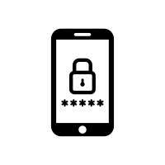
Other Innate QR Code Security Capabilities
Whether the QR code is merchant or consumer-presented, at least one of the transaction participants must use a mobile device. Either the central repository or an individual scheme could authenticate the end user using one or more of the data points below:
Best Practice: Authenticate End Users
DFSPs can utilize multiple tools and controls to authenticate end users. Layering these tools, as in Multi-Factor Authentication, more effectively prevents fraud.
Device Identification
Every mobile device has unique characteristics that can be used to fingerprint, or identify, it within a reasonable level of certainty. DFSPs can use this information to verify the end-user identity.
Biometric Authentication
Increasingly, mobile devices use a biometric authentication mechanism to allow users to control device access. QR based payment apps can leverage these built-in device authentication mechanisms.
PIN or Password
A PIN or password is a knowledge-based method to verify that the sender is who they claim to be. QR based payment apps can require users to set an additional, app-specific PIN.

Slide 79
QR CODES: FUTURE DIRECTIONS

Slide 80

QR Code Payments: Future Directions and Questions
QR Code payments are rapidly gaining traction worldwide. The following considerations may influence their forward path:
How broadly will merchants adopt QR codes? Will adoption be greater for dynamic QR codes, that allow merchants to integrate payment receipt data into their sales systems? Logically, medium and larger merchants will do this – but will small (and low-income) merchants begin to adopt this in scale, or will they remain with static QR codes?
How will the integration of dynamic QR codes and “request to pay” messaging happen? Either will allow online and remote merchants to enable customers to pay in ways that integrate with their sales systems: but will these be parallel paths, or two ways of doing the same thing?
At the point of sale, will merchants accept both NFC “tap and pay” payments and QR code payments? Will these be integrated into merchant acceptance services? How will consumer preference play out here?
In the developed world, the EMVCo “Secure Remote Commerce” standard is creating a “virtual payment terminal” allowing remote merchants to effect one integration to accept a variety of consumer payment wallets. How might this complement or converge with QR code payments at the point of sale? In the online domain?

Slide 81
QR Code Payments: Future Directions and Questions
Will the EMVCo member organization evolve to accept true interoperable QR code payments by supporting URL or URI formatting approaches?
Today, there is a spectrum of control by schemes over consumer and merchant payments apps. How will this play out in the future – and how will it advantage (or disadvantage) the single-scheme vs. shared QR approach?
Some countries have developed bilateral instant connections to enhance regional cross-border payment connectivity and increase financial inclusion. How will bilateral cross-border instant linkages continue to support or expand on QR code payments?
How, if at all, will QR implementations be used to increase security and fight fraud?

Slide 82
APPENDIX: QR CODE FORMATTING

Slide 83
QR CODE DATA FORMATTING
What data objects are included in a QR payment?
A QR scheme must establish what data elements are required for every payment message.
For a static QR code, the data objects typically include:
If using dynamic QR code, schemes can opt to include additional data elements that vary from transaction to transaction:
Receiving Account Identifier
Receiving DFSP
Identifier
Payment Network Identifier (for shared QR implementations)
Invoice Detail
Order Reference Number
Transaction Amount
Tip Indicator
Data Validation
Notes:
Call out box that the most common standard for this formatting is the EMVCo standard, invoice detail

Slide 84
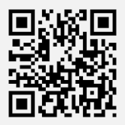
QR CODE DATA FORMATTING
The QR scheme standards dictate the data objects included in a QR payment and how they are formatted. These scheme standards are used to create the formatted payload, which we sometimes refer to as the underlying data string. Like any other formatted payment message, comprehensive standards are key to ensuring all scheme participants can consistently interpret the data and processing and 'action' the payment message.
Scheme Standard
Data Objects
Formatted Payload / Underlying Data String
QR Code
Encoding
Decoding
Notes:
** when people talk about QR standardizatio this is what they are talking about (left)

Slide 85
QR CODE DATA FORMATTING OPTIONS
This is what is most commonly meant when discussing “QR Code Standardization”. There are various approaches : proprietary, URL and URI formats.
Proprietary formats
Data objects are formatted using specific, proprietary rules. These may be set by an individual company (as with a closed-loop implementation) or by an industry body or group. the EMVCo QR standard is a proprietary format, and the most frequently used QR code format in the market today.
On scanning, the app parses and validates the data objects, and constructs a payment message.
The data string produced by the proprietary formatting is available to any QR scanner but can only be resolved by an app which holds the logic to create a payment message

Slide 86
QR CODE DATA FORMATTING OPTIONS
URL format
This approach uses a global standard for a resource locator to format the payload in the QR code. The data string encoded into the QR code is a URL.
On scanning, the URL points the scanner to a webpage, which contains code to redirect the user to the intended screen within the payment application on the consumer’s phone. The consumer’s application then “knows” the merchant’s payment address, and is ready to create the payment order.
If it is a static QR code, the consumer will enter the payment amount into the application.
If it is a dynamic QR code, the payment amount will be prepopulated on the screen the consumer sees, and additional transaction-specific data may also be prepopulated
Though the URL is available to any QR scanner in plain text, no payment data is directly readable; the payment address is held at the URL location. The consumer app needs to be able to use the address found at the URL location to create the payment order.

Slide 87
QR CODE DATA FORMATTING
URI format
This approach also uses a global standard for a resource locator to format the payload in the QR code.
The data string encoded into the QR code is a URI. The data payload, including the merchant’s payment address, is in the encoded data string; other data may be in the string or may be held elsewhere, as described in the string. All data in the string is formatted and labelled according to global standards.
The URI approach allows a consumer to use either a generic reader application or a proprietary payment application. The chosen app parses and validates the data objects, and constructs a payment message.
The data string produced by the proprietary formatting is available to any QR scanner but can only be resolved by an app which holds the logic to create a payment order

Slide 88
QR CODE DATA FORMATTING: DATA ENCODING
ISO 18004
Data Objects
Formatted Payload / Underlying Data String
QR Code
Once formatted, the underlying data string is encoded into a machine-readable visual representation using ISO 18004 standards. The results of this process is the familiar form of black squares arranged on a white background.
When scanned, the imaging device recognizes this visual format and uses a standard algorithm to decode it back into the underlying data string using a standard algorithm
Encoding
Decoding
Notes:
** when people talk about QR standardizatio this is what they are talking about (left)

Slide 89
QR CODE DATA FORMATTING: ENCRYPTION AND HASHES
Which, if any, of the data elements are encrypted and/or hashed for validation purposes?
QR Code Implementations may either:
Create a hash of the QR code data string. The string is read when the consumer app scans the QR code. If the rules then require the consumer app to validate the data string with the QR code issuer (either the merchant DFSP or, more probably, the central authority – for example, the QR code repository in a shared QR implementation), the QR code issuer can validate that the data string is properly issued and not tampered with.
Encrypt some or all of the data elements in the QR code data string: the QR code issuer would digitally sign the elements with a private key; the consumer application would then use a public key to validate the signature. This can be done locally, and does not require the consumer app to connect to the issuer/central authority
There is debate within the industry about the merits – or need – for the use of encryption to disguise merchant payments credentials.
This would be a good idea if a card or bank account number – which could be used to fraudulently “pull” a payment – was exposed in the QR data string. However,
Merchant payments addresses that are aliases, or tokenized forms of card numbers or bank accounts, arguably cannot be used for fraudulent “pulls” and therefore do not need to be encrypted. It appears that most QR code implementations are taking this direction

Slide 90
For more information about the Level One Project, visit leveloneproject.org
For more information about the Bill & Melinda Gates Foundation’s Financial Services for the Poor, visit gatesfoundation.org
Report Authors
Elizabeth McQuerry, Glenbrook Partners elizabeth@glenbrook.com
Bethany May, Glenbrook Partners bethany@glenbrook.com
Cici Northup, Glenbrook Partners cici@glenbrook.com
Gene Neyer, Glenbrook Partners gene@glenbrook.com
June 2023

