Slide 1
Overview of Open Banking and Payment Initiation in IPS: The experiences in Australia, Brazil, Europe and India
2023

Slide 2
Executive Summary
Key findings about Open Banking & Payment Initiation in IPS globally:
Approaches to implementing Open Banking vary broadly by country and can include formal regulations, solely market-led initiatives or efforts that later progress to an initiative of the central bank, or a hybrid of both. Payment initiation is a key area of many, though certainly not all, Open Banking implementations. Some countries are implementing formal regulations, with clearly defined rules and structures. Other countries may lack official regulatory structures but are experiencing market movements towards Open Banking either through Scheme level rules and technical capabilities or through discrete entities entering into contractual relationships for data sharing.
Where the practice is in place, acting as a third-party payment initiator is typically a discreet role that most Participants can play, in addition to other approved non-bank third-parties. Most markets are allowing both account providing Participants and third-parties to act as payment initiators for accounts held at another DFSP.
Regulatory licensing frameworks for third-parties vary across markets, although most markets do require oversight of third-parties. Some countries require third-party payment initiators to have formal payments licenses or approval from the regulator to act as a third-party payment initiator, while others don’t formally regulate third-parties if they are only conducting payment initiation but require their sponsor banks to be responsible for oversight.
Payment initiation technical infrastructure can either be centralized, where the payments systems acts as a central switch, shuttling messages between Participants, or decentralized which requires third-party payment initiators to connect to all DFSPs for which it would like to initiate payments. Both models have both benefits and disadvantages for the parties (e.g., the IPS, Participants, and third-party payment initiators), which should be carefully considered.
Some decentralized approaches have created a unified API standard to simply integration for third-party providers and promote faster innovation. When the APIs are standardized, third parties can easily interact with all connected DFSPs, leading to faster innovation.

Slide 3
Overview of Open Banking
Payment Initiation: The first step of a transaction which begins the payment messaging
Third-Parties: Entities which provide a payment service (e.g., the customer experience interface used to initiate payments from a Payor’s account), but which do not hold the funds in that customer’s account. Common names include: Payment Initiation Service Providers (PISPs), Third-Party App Providers (TPAP), Third-Party Providers (TPP), Payment Transaction Initiator, and more
Third-Party Payment Initiation: The ability for a third-party, with the Payor’s consent, to initiate a Push transfer of funds from the Payor’s account, while a different participant holds the funds in the Payor’s account
Open Banking is a global practice which uses application programming interfaces (APIs) provided by DFSPs to authorized third parties to enable customer-permissioned data sharing and account-to-account (A2A) payment initiation.
Key benefits of Open Banking:
  Enables customers to own their financial data and gain a consolidated view of their finances
  Supports the entry of new market players and business models
  Increases competition for customers leading to improved products and services
  Allows the use of customer financial data to offer personalized products and services
As shown in the box to the right, the simplification of data sharing is performed “on top” of existing financial flows, engendering new vocabulary, roles and activities.
Note: Payment initiation is different from a Request for Payment (RfP). A RfP is a non-financial message sent from the Payee to the Payor, and is a request to the Payor to Push funds to the Payee.
Notes:
A mature Open Banking market is characterized by secure exchange of consumer-permissioned data

Slide 4
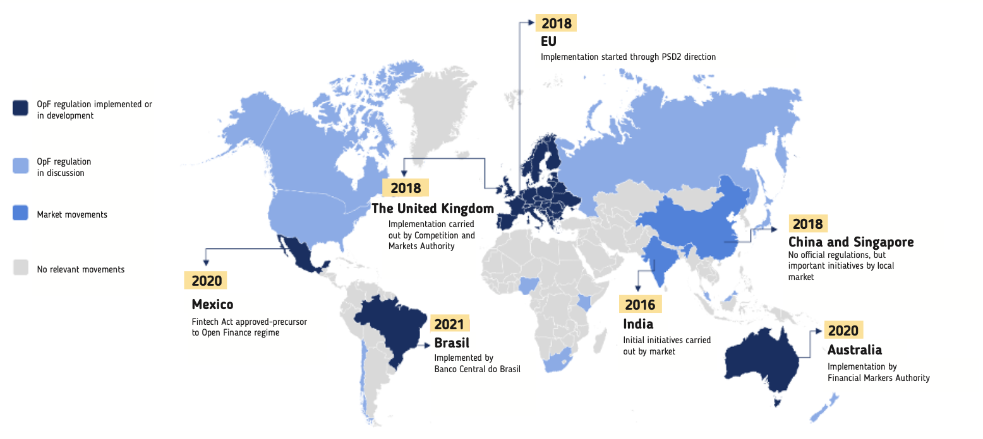
There is global momentum towards Open Banking, with some countries implementing formal regulation while others experience market movements that lead the progression or carry out an initiative of the central bank
Source: Brazil’s Open Finance

Slide 5
Open Banking provides third parties access to consumer data via APIs
Legacy Model
Emerging Model
Customers
Customers
Services
Services
Services
Services
Bank Branded
Bank Branded
Third Parties
Customer Experience Interface (Apps)
Customer Experience Interface (Apps)
Data
Services
Payments
Services
DFSPs
Proprietary APIs
DFSPs
Proprietary APIs
Open APIs
Bank Domain
Bank Domain

Slide 6
The financial industry is rapidly adopting increasingly sophisticated practices of data sharing and the decoupling of financial services
Less
Sophisticated
Increasingly
Sophisticated
  Bilateral Connections
  Open Banking
  Open Finance
DFSP provides banking infrastructure while another entity provides user interface
Read Transaction History
Payment Initiation
Sharing of customer data beyond banking (e.g., loans, consumer credit, investments) and non-financial industries (e.g., healthcare, government)
Even as markets progress towards Open Banking and Open Finance, market actors will continue to develop bilateral connections through contractual partnership arrangements.

Slide 7
Country Comparison of Approaches to Payment Initiation and Third-party Providers
The Open Banking landscape is rapidly evolving, with many having progressed through the phases from Bilateral Connections, to Open Banking, and finally to Open Finance. Key elements vary across countries and are dynamically changing as new players enter the market, and new approaches are being adopted.
Below is a snapshot of the current landscape, including any publicly available information about impending changes.
 | Australia | India | Brazil | Europe
Designated Open Banking regulator? | No | No | Yes | Unknown
Regulation permitting payment initiation | In progress | No | Yes | Yes: PSD2
Third-party payment initiation is specific to IPS (rule-making body: regulator or scheme) | Yes: NPP; regulation in progress will cover third-party payment initiation broadly | Yes: UPI | No: regulation is broad. Currently only applies to Pix, but planned future use in other payment schemes | No: regulation is broad. Applies to all payment schemes
Technical infrastructure model for third-party payment initiation | Centralized | Centralized | Decentralized | Decentralized
Third-party provider requires bank sponsor (mandating body: regulator or scheme) | Yes (NPP) | Yes (UPI) | No | No
Government mandated standardized Open APIs | No | No | Yes | No (Yes in the UK)

Slide 8
About this Research
This analysis focuses primarily on Third-Party Payment Initiation in IPS. However, broader Open Banking/Open Finance regulations and other payment schemes are mentioned, where relevant.
We reviewed leading initiatives globally to highlight examples of successful implementations of payment initiation.
Our research was guided by the following questions:
  What regulation provides the framework for Open Banking and Payment Initiation?
  What responsibilities do Payment Initiators have in account setup and transaction processing?
  How are Payment Initiators connected to the IPS for clearing?
  What role, if any, do Payment Initiators have in IPS governance?
Countries reviewed:
- Australia
- Brazil
- Europe
- India
This analysis utilized multiple resources including national payments regulations, central bank vision documents, payment system operator websites, circulars, IPS product booklets, whitepapers, multi-lateral organization news articles, reports and case studies, and more.
The content in this deck is organized to highlight the most substantive information across each market, and hence, is not organized in a consistent format throughout the deck.

Slide 9
Brazil

Slide 10

Overview of Open Banking and Payment Initiation in Brazil
Brazil has a robust Open Banking environment that enables the standardized sharing of data and services through APIs, bringing innovation and promoting competition in Brazil’s financial system. Since February of 2021, Brazil’s Central Bank (BCB) has been implementing Open Banking (referred to as “Open Finance” in Brazil) in a 4 phased approach:
Phase 1: Standardized data - financial institutions provide information about products and services, including the fees/tariffs, in a standardized way enabling the comparison of financial products and services.
Phase 2: Sharing of some customer data - the consumer can provide permissioned access to some of their data (e.g., account transactions), and can revoke the access at any time.
Phase 3: Services - consumers can access financial services through third-parties (e.g., payment initiation).
Phase 4: Expansion of data sharing - inclusion of new data that can be shared, in addition to new products and services
Key elements of Brazil’s Open Finance:
Prior consent from the customer: Participating institutions must have the customer’s consent, authentication, confirmation
Reciprocity: All institutions receiving data must also share data and services
Governance: Mandated by BCB’s regulation, three groups (combined into one industry association) are responsible for implementing Open Finance: Deliberative Council, Secretariat and Technical Group
Mandatory Participation for key Open Banking services:
  Data sharing: Banks and other institutions that are equal to or greater than 1% of Gross Domestic Product (GDP) and banks that conduct relevant international activity, (regardless of the size of the institution)
  Sharing of the service of initiating payment transactions: all institutions providing a customer's deposit, savings or pre-paid payment account, and payment initiation service providers
Sources: BCB, Brazil’s Open Finance
Notes:
The Open Finance Governance Structure is composed of:
The Deliberative Council – decisions on issues related the implementation of Open Finance and propositions of technical standards to BCB.
Technical groups – studies and technical proposals for the Open Finance ecosystem.
The Secretariat – organization and coordination of the Struture's working agenda.

Slide 11
Brazil allows multiple entities to undertake the role of Payment Initiation Service Provider (PISP)
The Central Bank of Brazil (BCB) allows for two paths to providing payment initiation services:
Any authorized Financial Institution or "Payment Institution" (banks and non-banks licensed to participate in Pix) can provide payment initiation services in addition to the other services they are allowed to provide (with 90 days notice to the BCB).
Entities whose main activity is payment initiation services are referred to as either “Payment initiation service provider (PISP)” ”Payment Transaction Initiator.”
  PISPs were created in Brazil’s general Open Banking regulation, which is not specific to the Pix IPS
  PISPs must be authorized by The Central Bank of Brazil to operate as payment initiators
  PISPs require "indirect access" to the DICT directory through a participant that has direct access
PISP responsibilities:
Onboarding the consumer to their service, validating the end users DFSP and the specific account at the DFSP (end users confirm to their DFSP the request to onboarded by the PISP)
Limiting payments initiated to a maximum value of 1,000 reais
New Models are emerging in the Brazil Market: PISPs as a Service provides institutions the ability to initiate payments using the infrastructure and integration of third-party PISP service providers. Companies are being established that offer this service.
Notably, many Payment Transaction Initiators are also Payment Institutions -- at least at this point in time.
Payment initiation in Pix is relatively new (less than 18 months) and has not yet seen significant uptake in the Pix payment system
Note: Payment initiation service provider (PISP) are allowed to "initiate" both purchases and transfers.
Sources: BCB, Brazil’s Open Finance
Notes:
From the Central Bank: “The financial institution, the payment institution and the other institutions authorized to operate by the Central Bank of Brazil that, within the scope of Pix, have as their exclusive objective to provide payment transaction initiation service may act as initiator.”
From Open Finance report: PISPs as a Service: allows institutions to initiate payments using the infrastructure and integration with the Open Finance ecosystem of third-party companies (PISP as a Service). Companies are being established that offer this service.

Slide 12
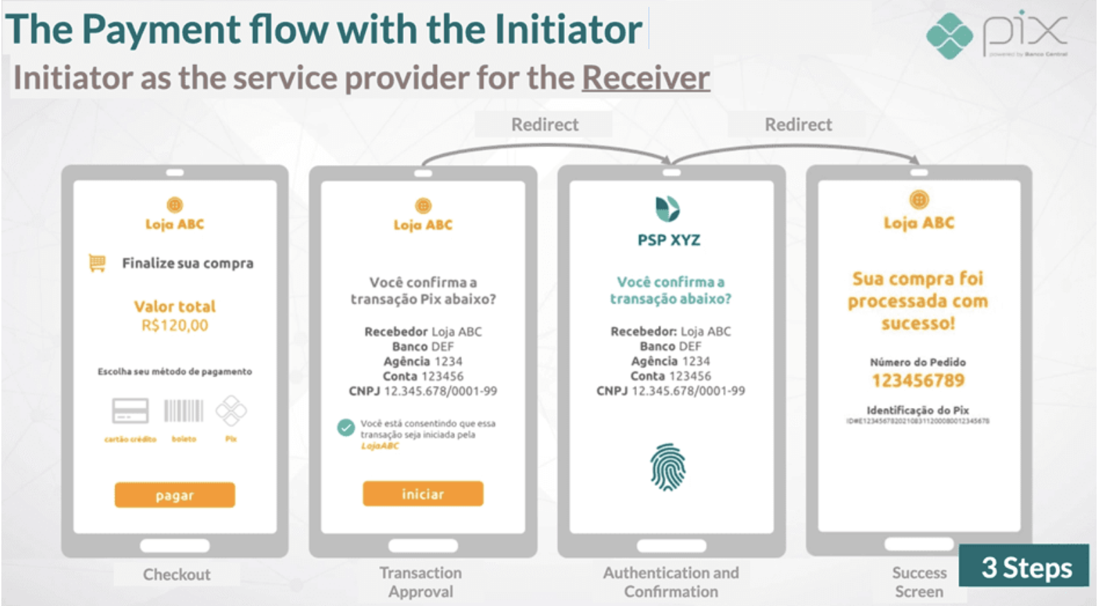
PISPs can embed access to the user’s transaction account into an app or website to initiate payments in the same environment in which the user is making the purchase
PISPs simplify the user experience by reducing the number of required steps, which makes tasks like online shopping a more convenient experience.
Sources: BCB, Brazil’s Open Finance, Americas Market Intelligence

Slide 13
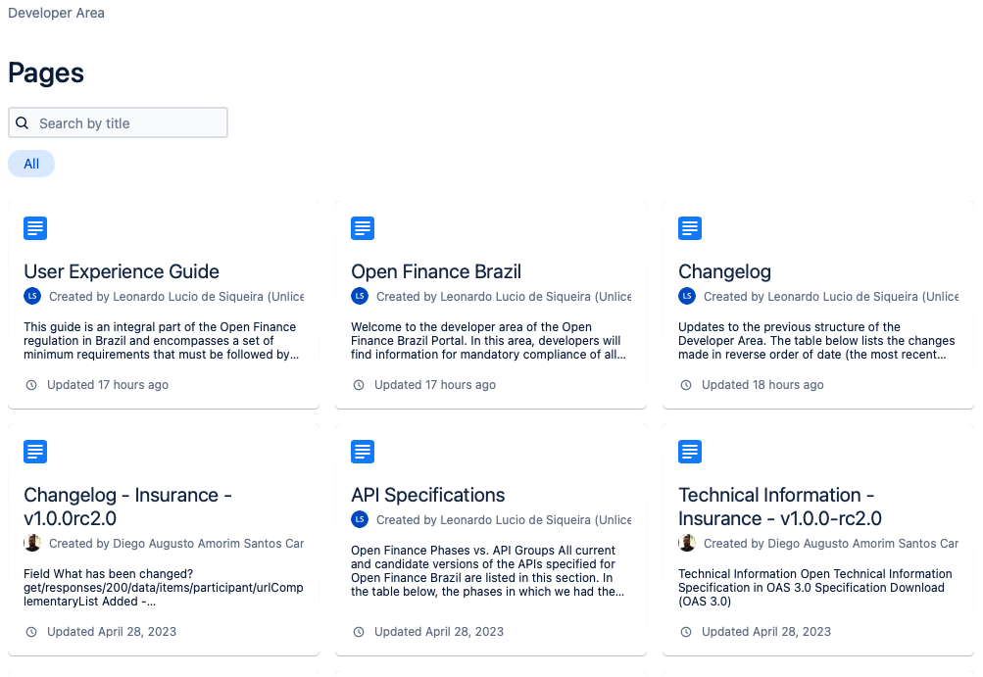
Brazil’s Central Bank has standardized the API for Pix payments, and provided this to payment initiators via an OpenAPI specification
Pix API standardizes the integration between the PSP and third-parties for Pix related services, such as billing creation, verification of received Pix, return and queries.
Governing body: Pix API is defined and implemented by the Open Finance initiative governance body, which is also responsible for maintaining the developer portal.
Developer Portal: Brazil’s Open Finance governance body publicly publishes technical standards of interfaces, glossary of technical terms, API specifications, and FAQ for developers.
Security: All Pix APIs are financial-grade API (FAPI) protocol following international web standards (RFCs), which is used in several IPS including the UK, Australia and India.
Source: Brazil’s Open Finance

Slide 14
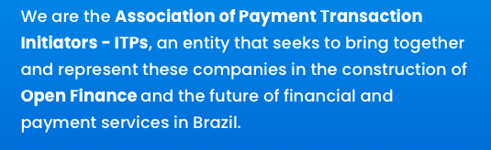
Payment Initiators have an informal voice in Brazil’s Open Finance and Pix through multiple avenues
The Central Bank of Brazil (BCB) is the scheme owner of Pix and therefore sets the Pix IPS rules. However, payment initiators do have avenues for having a voice in the industry:
Pix Forum: A forum coordinated by the Central Bank of Brazil (BCB) to act as a permanent advisory committee to the BCB to discuss issues related to Pix with the objective of supporting the BCB in defining the Pix operating rules. Payment transaction initiators, along with various market agents, can participate in the Pix Forum and working groups, and can bring concerns up for discussion. The forum currently has about 200 participating institutions.
The Participants:
  Representatives of payment service providers (through national representative associations)
  Providers and potential connectivity service providers
  Potential payment initiation service providers
  End users of payment services (both payers and recipients, through representative associations of national scope)
  Central Bank of Brazil
Current Working Groups:
  Business (ecosystem products and flows)
  Standardization and Technical Requirements (technological aspects)
  PI Messages (messaging standards)
  Security (fraud and data privacy)
Association of Payment Transaction Initiators (ITPs): industry association created by the payment initiators to represent their interests in Open Finance
Sources: BCB, Association of Payment Initiators

Slide 15



Diagram of a Pix Payment Flow
Third-party Payment Initiator
Instruction
SPI
Clearing and Settlement Mechanism
Transaction
Transaction
Makes funds instantly available
1
2
3
Beneficiary Bank – direct or indirect participants
Originator
Originator Bank (direct participant)
5
Beneficiary
7
6a
4
6b
Confirmation
Confirmation
Confirmation
Confirmation
Source: World Bank

Slide 16
Europe

Slide 17
PSD2 provides the regulatory foundation for Open Banking, including payments initiation to third party providers
The revised Payment Services Directive (PSD2) is an update to the original version of the Directive (PSD1) which aimed to, among other things, formally regulate third-party providers (e.g., fintechs).
After the adoption of PSD, new types of payment services emerged in Europe, including payment initiation services, specifically related to online payments. Adjacent services, such as account information services, also began to emerge.
Key elements of PSD2:
Creation of formal roles for third-party providers (TPP):
  Payment Initiation Service Providers (PISPs): PISPs provide payment initiation services on behalf of customers. PSD2 states that PISPs provide assurance to payees that a payment has been initiated in order to provide an incentive to the payee to release the goods or to deliver the service without undue delay. These services offer a low-cost solution for both merchants and consumers and provide consumers with a possibility to shop online even if they do not possess payment cards
  Account Information Service Providers (AISPs): AISPs are third parties that are authorized to retrieve account information from banks and financial institutions and allow customers to see information from all their selected accounts in one place
Strong Customer Authentication (SCA): Strict security requirements for the initiation and processing of electronic payments, which apply to both traditional and newly regulated payment service providers (i.e. TPP). Regulated providers must apply SCA, and authenticate users by providing two of the following independent factors: 1. Something only the user knows (e.g. password, PIN) 2. Something only the user possesses (e.g., card, authentication code generating device) 3. Something the user is (e.g. biometric: fingerprint or voice)
Industry voice: PISPs do not have a formal role in Scheme governance, but have a voice through the industry association European Payment Institutions Federation (EPIF)
Notes:
SCA and PISPs: The personalized security credentials used for secure customer authentication by the payment service user or by the payment initiation service provider are usually those issued by the account servicing payment service providers. Payment initiation service providers do not necessarily enter into a contractual relationship with the account servicing payment service providers and, regardless of the business model used by the payment initiation service providers, the account servicing payment service providers should make it possible for payment initiation service providers to rely on the authentication procedures provided by the account servicing payments service providers to initiate a specific payment on behalf of the payer.
Requirement that banks develop secure channels for third-parties to transmit data and initiate payments. Over time, APIs emerged as the common practice to meet this requirement.
Add at bottom? - PSD2 focuses on push/A2A payments and enables payment initiation through multiple payment schemes
Add to 1st: The goal was to make cross-border payments as easy, efficient and safe as 'national' payments within a Member State?
https://www.jpmorgan.com/europe/merchant-services/insights/PSD2-all-you-need-to-know
^Focus on SCA and 2 new regulated entities
History: The first Payment Services Directive (PSD1) was adopted in 2007, and offered the legal foundation for an EU single market for payments, to establish safer and more innovative payment services across the EU. The objective was to make cross-border payments as easy, efficient and secure as 'national' payments within a Member State.
Focus on PSD2: The PSD2 opens the EU payment market for companies offering consumer or business-oriented payment services based on the access to the information from the payment account –"payment initiation services providers" and "account information services providers". Payment initiation services providers typically help consumers to make online credit transfers and inform the merchant immediately of the payment initiation. For online payments, they constitute a true alternative to credit card payments as they offer an easily accessible payment service, as the consumer only needs to possess an online payment account.
Objectives:
Contribute to a more integrated and efficient European payments market
Improve the level playing field for payment service providers (including new players)
Make payments safer and more secure
Protect consumers
Relevance of SCA: The PSD2 text introduces strict security requirements for the initiation and processing of electronic payments, which apply to all payment service providers, including newly regulated payment service providers. This stricter approach on security should contribute to reducing the risk of fraud for all new and more traditional means of payment, especially online payments, and to protecting the confidentiality of the user's financial data (including personal data).
Open banking focuses on push/A2A payments
Payment service providers will be obliged to apply so-called strong customer authentication (SCA) when a payer initiates an electronic payment transaction. Strong customer authentication is an authentication process that validates the identity of the user of a payment service or of the payment transaction (more specifically, whether the use of a payment instrument is authorised). Strong customer authentication is based on the use of two or more elements categorised as knowledge (something only the user knows, e.g. a password or a PIN), possession (something only the user possesses, e.g. the card or an authentication code generating device) and inherence (something the user is, e.g. the use of a fingerprint or voice recognition) to validate the user or the transaction. These elements are independent (the breach of one element does not compromise the reliability of the others) and designed in such a way as to protect the confidentiality of the authentication data. On 27 November 2017, the Commission adopted rules that spell out how strong customer authentication (SCA) is to be applied.”
Once a customer has agreed to allow an external provider to access his banking details, a payment interface owned by PISP will ask the user for information, and the user will then choose his bank and enter his online banking credentials to complete the process.
The bank then validates the credentials and authorizes the request for the payment transaction. A digital signature is then requested. Strong Customer Authentication (SCA) is applied—an additional verification factor on top of the regular password, which can use biometric elements, such as the user’s fingerprint or face, or a one-time code sent to the user’s mobile. Once the authentication is carried out, the transaction is carried out.
Although payment initiation services already existed before the PSD2 Directive was implemented, its entry into force has forced banks to open their customers’ data up to third parties, upon request. This new legal requirement is prompting a surge in new companies which aim to offer services obtained from their applications, i.e. what are known as payment initiation service providers (PISP).
These are companies that offer applications that act as intermediaries between financial institutions and merchants, and allow the issuance of direct transfers between banks and the digital store, following authorization by customers.

Slide 18
Roles and responsibilities of PISPs under PSD2 when providing payment initiation services to end users
Payment Initiation Service (PIS) was established by PSD2 and aimed to improve the initiation of account payments. PSD2 allows Third Party Providers (TPPs), specifically PISPs, to have access to bank accounts to initiate a payment after the account holder has given their consent to the TPP
Payment Initiation Service Providers (PISPs) only have access to the information that is necessary to execute the payment, and always with the payer’s consent
PISP responsibilities
  Access the user’s payment account and initiate the payment transaction
  Confirm to the receiver that the payment has been initiated
  Accept liability for payment incidents that can be traced back to the PISP
  When exclusively providing payment initiation services, the PISP does not hold the user’s funds. When a PISP intends to provide payment services in relation to which it holds user funds, it should obtain full authorization for those services
Notes:
https://www.europeanpaymentscouncil.eu/sites/default/files/inline-files/whos-who-in-payments-2020-complete-overview-of-key-payment-providers.pdf
BM: It’s difficult to get the key points of this slide. I think focus this slide just on PISP
WE: this slide is not IPS-specific

Slide 19
PSD2 offers guidelines, building on PSD1, for the role of PISP
While PSD2 removes barriers and allows for more competition, it also ensures that TPPs follow the same rules as traditional payment service providers: registration, licensing, and supervision by relevant authorities. Further, TPPs are required to comply with security requirements
Licensing Requirements: PSD1 created a new entity known as a ”Payment Institution.” These entities require a license to carry out payment services.
PSD2 acknowledges payment institutions that are already authorized to provide services under PSD1. These institutions were allowed to continue providing payment services for 30 months (authorized institutions) or 36 months (“small” institutions) after the entry into force of PSD2. In order to provide payment services beyond that transitional period, the existing payment institutions were required to submit all relevant information required under PSD2 to relevant authorities that have granted them their existing licenses and fully comply with the relevant PSD2 requirements.
Further, Member States may allow existing payment institutions to be automatically granted PSD2 authorization if the relevant authority already possesses evidence that the institution complies with PSD2 requirements. Authorities were instructed to make these assessments on a case-by-case basis
Registration Requirements: In addition to requiring entities to apply for a payment institution license (in order to provide payment services in compliance with the regulation), PSD2 required entities to register with European Banking Authority (EBA) as an AISP or PISP
EU countries have different names for their payment licenses, but must follow the general PSD2 instructions related to having a payment initiation license (with the relevant authorities) and registering as an AISP/PISP
Notes:
EMI not in context of PI – more like banking license lite
In UK if want to be PISP, need to be accredited w FCA – there is registry of TPPISPs – then open banking relies on this defined registry --
Register 4) But there are high chances that the regulator rejects your application. In that case, your documents do not meet requirements, or you have missed the deadline, e.g., FCA, the UK’s regulator, has a one-year deadline.
Local license types relevant as well – PSD2 guidance higher level
AISP more traction than PISP – fractional share of PI market
Many directives translated directly into UK law
In each member state, some legislation that enacts directive – overseen by regulator
26.Can existing providers of payment initiation and account information services continue to provide their services after the date of application of PSD2? As of when will they need to apply for a licence?
PSD2 provisions ensure that providers of payment initiation services (PIS) and account information services (AIS) that are already established in the market can continue to perform their activities. More specifically, PSD2 states that Member States shall allow existing PIS or AIS providers in their territories to operate in accordance with the currently applicable regulatory framework.
As the provision of PIS and AIS is a new payment service recognised in PSD2, existing and new providers of such services would need to apply for authorisation under the PSD2 regime from the date of application of the new Directive.
Furthermore, because the new security measures of PSD2 regarding strong customer authentication and standards for secure communication will become applicable later than other provisions (see answer 24), PIS and AIS providers that seek authorisation under PSD2 are not required to submit proof of compliance with these security requirements until that later date. As provision of both types of services is dependent on the authentication procedures provided by banks, upgrades to the security requirements and procedures applied by banks need to be fully implemented by banks before the application of these measures is possible for the PIS and AIS. In case banks do not comply on time with the security requirements and standards for secure communication, they cannot use this non-compliance to hinder or obstruct the use of PIS and AIS.
The delayed application of the security requirements should not create any difficulties for the provision of existing payment-related services by market players that have been operating in Member States before 13 January 2016. Article 115(5) of PSD2 ensures the continuity of these services. These payment services providers should still apply for the relevant authorisation under PSD2 to their national authority as soon as possible.

Slide 20


Connections for third-parties – Decentralized Model
In the Decentralized model, the PISP must connect with each DFSP, either directly or through an Aggregator.
PISP
PISPs connect bilaterally to APIs presented by DFSPs. This requires PISPs to implement technical integrations with multiple DFSPs, or an aggregator. As a result, PISPs can only initiate payments for DFSPs to which they have connected bilaterally, or through an aggregator.
Advantages of decentralized model (for the operator): The system’s role is simply to pass payments between account-holding participants, and no additional investment, economic models, or changes to governance are required. PISP connectivity is instead left to the competitive space
Disadvantages of decentralized model: This model can result in a fragmented environment for payment initiation, as a PISP only works for an account holder if the PISP has connected with the user’s DFSP
Lack of a unified API standard: A lack of regulatory requirement for an official API standard has led to the creation of multiple Open API specifications (e.g., Berlin Group, Polish API and STET Open API)
Uptake: The market uptake has been weaker than expected for this decentralized model. In the UK, the number of active users accelerated, reaching 5 million in Jan ‘22, still far behind the initial target of 33 million users by 2020
Aggregator
Payment System
DFSP
DFSP
DFSP
DFSP
PISPs bilaterally connect to APIs offered by account-holding institutions, who in turn initiate payments through the scheme as they would if no PISP were involved
Source: CGAP (Diagram adapted from CGAP)
Source: CGAP
Notes:
In markets like the EU and UK, PISPs are linked through direct (or brokered) agreements to account-holding institutions, who in turn connect to the payment system.
A PISP app only works for a given account holder if the
PISP has somehow connected with that institution

Slide 21
Spotlight on UK’s Standardized API’s

Slide 22
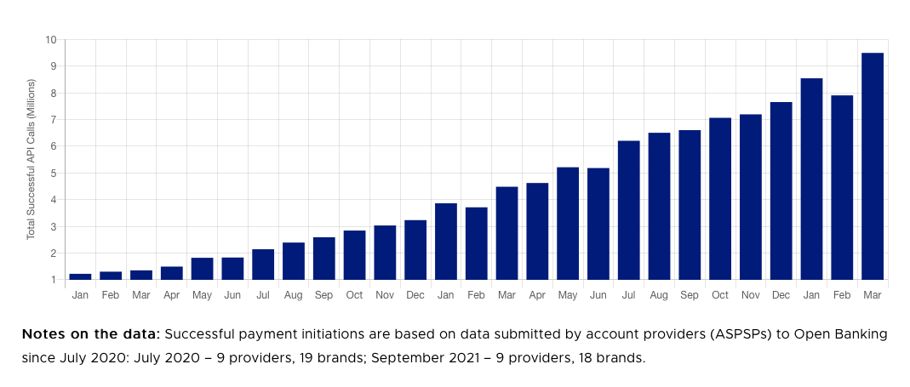
Spotlight: The UK and Standardized API Specifications for Payment Initiation
Prior to leaving the EU, the UK had formed its own approach to Open Banking
Key difference between PSD2 and Open Banking: The UK’s Open Banking provides standardized APIs for a variety of functions, including payment initiation, whereas PSD2 did not include any such requirement
Standard setting body: The Open Banking Implementation Entity (OBIE) is a private entity that was created by a UK regulatory body, the Competition and Markets Authority (CMA), to design the architecture for Open Banking (e.g., APIs, data structures and security protocols)
Standardized Payment Initiation API payment types:
Domestic payments
Domestic scheduled payments
Domestic standing orders
International payments
International scheduled payments
Successful Payments
Number of successful payment initiations made by third party providers using account providers’ (ASPSPs)* Open Banking APIs.
Other success factors for Payment Initiation in the UK: the UK has a robust ecosystem of licensed TPPs (Third Party Providers such as Fintechs), likely resulting from their role as a major European FinTech hub.
Source: Open Banking Implementation Entity (OBIE)
Notes:
BM: Recreate chart https://www.openbanking.org.uk/api-performance/

Slide 23
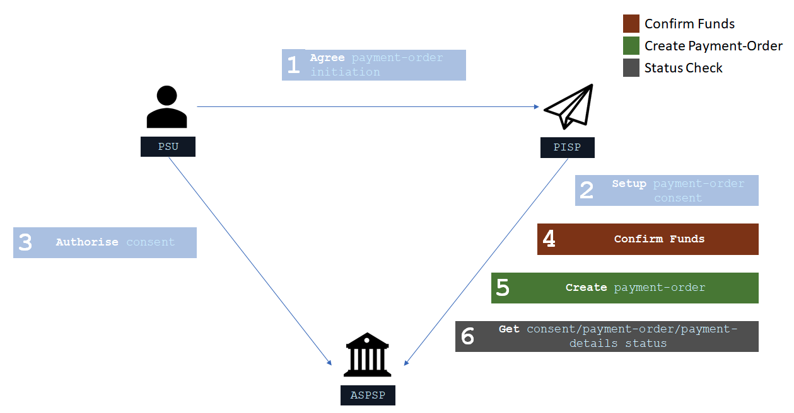
Diagram of a general payment flow using the UK’s standardized Payment APIs
Source: Open Banking Implementation Entity (OBIE)
Notes:
https://openbankinguk.github.io/read-write-api-site3/v3.1.11-draft1/profiles/payment-initiation-api-profile.html
Recreate this?

Slide 24
India

Slide 25







Overview of UPI and Payment Initiation
India’s UPI is a leading example globally of the impact of third-parties and payment initiation to expand the reach of instant payments.
UPI is owned and operated by the National Payments Corporation of India (NPCI), a non-for-profit, public-private initiative of the Reserve Bank of India (RBI) and the Indian Banks’ Association (IBA). The government (RBI) developed a vision for digital payments in India and has since implemented multiple initiatives, one of which led to the creation of NPCI with the aim of creating a robust Payment & Settlement Infrastructure in India.
Regulation: India does not have comprehensive Open Banking regulations yet permits certain activities.
Data sharing: Licensed Account Aggregators can consolidate consumers’ financial information retained at different DFSPs, with the consumer’s consent.
Payment Initiation: There is no specific regulation that explicitly permits payment initiation. However, the central bank fostered the development of UPI through close cooperation with private firms, and continues to be involved through various means, providing implicit support for UPI’s use of third-parties for payment initiation.
TPAP
PSP App
Source: NPCI

Slide 26
UPI Ecosystem Players and Connections
The payments ecosystem in India is dynamic. RBI and NPCI are constantly progressing and innovating, with new regulatory entities being created, and roles, rules, and terms within the UPI payments systems dynamically evolving and responding to the market. Some roles and responsibilities overlap between the UPI payments system players.
Technical Design: UPI is designed as an overlay to IMPS to enable third party initiation for instant payments. UPI technology involves a centralized API framework that acts as a central switch and enables PSP Banks and TPAPs to initiate payments from any connected DFSP.
Technical connections to UPI:
Banks and Payments Banks are able to connect directly to UPI
Third-party app providers (TPAP) have multiple options for connecting to UPI, including:
  Single PSP bank model: TPAP connects to 1 sponsor bank
  Multi-bank model: TPAP connects to multiple sponsor banks. TPAPs processing more than 5% of the total monthly volume/value of UPI ecosystem are required to use a multi-bank model, and must have a minimum of 3 sponsor banks and a maximum of 10 banks
  Direct connection: TPAP connects directly to UPI central switch with limited functionality
Entities | Entity Type | Role Type | Hold deposits | Payment Initiation | Membership to UPI
Bank, Payments Bank | Bank | PSP | Yes | Yes | Direct - requires RTGS membership Indirect - settles through a direct member
Third Party App Providers | Non-bank (fintech) | TPAP | No | Yes | Sub-member (requires a Sponsor Bank)
Sources: CGAP, NPCI, RBI, World Bank

Slide 27
Roles and Key Responsibilities of Payment Initiators in UPI
UPI payments system supports two distinct roles that can conduct Payment Initiation.
Role: PSP Bank
Role: TPAP
Eligible entities: Banks and Payments Banks
Entity: Third-parties
either through its own app or TPAP’s app, on-boards and registers the end-user on UPI and links their bank accounts to their respective UPI ID.
authentication of the end-user customer at the time of registration of such customer, either through its own app or TPAP’s app
on-boards the TPAPs to make the TPAP’s UPI app available to the end-user
ensure that TPAP and its systems are adequately secure
ensure that UPI app and systems of TPAP are audited to safeguard security and integrity of the data and information of the end-user customer
store payments data including UPI Transaction Data collected for the purpose of facilitating UPI transactions. Only PSP bank can collect customer payment sensitive data.
give all UPI customers an option to choose any bank account from the list of Banks available on UPI platform for linking with the customer’s UPI ID
provide a grievance redressal mechanism for customer complaints and disputes
comply with requirements prescribed by PSP Bank and NPCI
ensure that its systems are adequately secure
comply with all applicable laws, rules, regulations and guidelines, etc. in relation to UPI and TPAP’s participation on the UPI platform
store all the payments data including UPI Transaction Data collected by TPAP for the purpose of facilitating UPI transactions. TPAP cannot collect customer payment sensitive data.
facilitate RBI, NPCI and other agencies nominated by RBI/ NPCI, to access the data, information, systems of TPAP related to UPI and carry out audits of TPAP, as and when required by RBI and NPCI
facilitate the end-user customer with an option to raise grievance through TPAP’s UPI app or website and such other channels
PSP Banks are responsible for overseeing the TPAPs they sponsor and ensuring that their systems are adequately secure
Sources: NPCI, World Bank
Note: Key rules are shown, and are quoted from NPCI, with minor revisions for conciseness

Slide 28
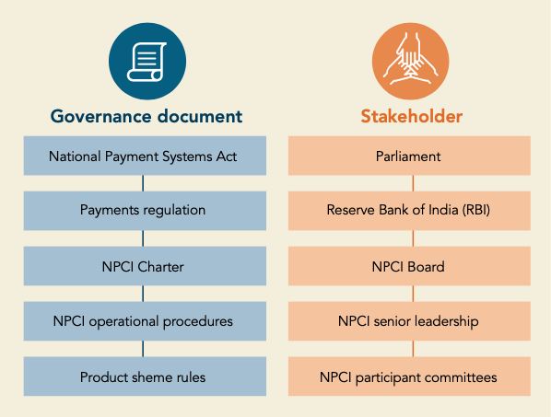
Payment Initiators’ Role in Governance of UPI
Third-party app providers (TPAPs), along with the entities which act as PSP Banks, all have a voice in UPI governance.
UPI scheme rules are defined by a steering committee that is comprised of 20 participants including: NPCI, Banks, Payments Banks, and Third Party App Providers (TPAP). NPCI endeavors to make the steering committee proportionally represent the diversity of bank and non-bank institutions in the payments industry.
No more than 50% of the members are from the promoter banks and the rest are from non-promoter banks.
NPCI is a permanent member of the UPI Steering Committee while other committee members serve 3 year terms.
Meeting frequency: The steering committee meets at least once every 3 months.
NPCI Governance Structure
Steering committee responsibilities: Discuss and deliberate on business, operational, and technical issues of the UPI network including revising the pricing of switching fees and interchange, approving new services on the UPI network, and setting fines or recommending legal action on members for violating UPI guidelines.
Current steering committee members:
  Banks: AU Small Finance Bank, Axis bank, Bank of Baroda, Bank of India, Canara Bank, DBS Digibank, HDFC Bank, ICICI Bank, IDFC First Bank, Kotak Mahindra Bank, Punjab National Bank, Saraswat Bank, State Bank of India, Union bank of India, Yes Bank
  Payments banks: Airtel Payments Bank, Paytm Payments Bank
  Third-party app providers (TPAP): Amazon Pay, Google pay, Phone pe
  NPCI
Sources: NPCI, CGAP

Slide 29

Diagram of a UPI Payment Flow - Centralized Model
In the Centralized model, the payment system is responsible for transmitting messages between PSPs and the account holding banks.
Payer initiates a push payment by entering the Payee Alias and payment amount in their Third Party App (TPAP)
Payer PSP sends the message to UPI
UPI sends it to the respective Payee PSP for address resolution and authorization
Payee PSP sends relevant account details of the Payee to UPI
UPI sends the debit request to Remitter bank
Remitter Bank
5
6
TPAP
1
Payer PSP
2
3
Payee PSP
10
9
4
7
8
Remitter bank debits the Payer’s account and sends the confirmation to UPI
UPI sends the credit request to the Beneficiary Bank
Beneficiary Bank credits the Payee’s account and confirms the same to UPI
UPI sends the successful confirmation to the Payer PSP
Payer PSP sends the confirmation to the Payer TPAP
Beneficiary Bank
Note: Diagram adapted from multiples sources including BIS, Google, NPCI, World Bank

Slide 30
Spotlight on Australia’s PayTo

Slide 31
Overview of NPP and Open Banking Regulation in Australia
In Australia, payment initiation services are offered by third parties and DFSPs through PayTo in Australia’s instant payments system, New Payments Platform (NPP). Australia’s Consumer Data Right (CDR) regulation currently enables data sharing but does not yet cover payment initiation. Impending regulation, referred to as Action Initiation, is in progress that will formally enable payment initiation.
Scheme: NPP was developed in response to the Reserve Bank of Australia’s (RBA) strategic objectives for payments systems in Australia, which set the broad direction for the payments industry. NPP was launched in February 2018, and is owned and operated by NPP Australia, a subsidiary of Australia Payments Plus. NPP is regulated by RBA.
Open Banking Regulation: Enacted in 2019, CDR is framework for consumer data portability in Australia. The framework is being implemented on a sector-by-sector basis, initially focusing on the banking industry, followed by the energy industry and non-bank lending.
  CDR authorizes secure access to data by trusted and accredited third parties. CDR also requires businesses (data holders) to provide public access to information on specified products they have on offer
  The Australian Government is currently drafting legislation to enable payment initiation (referred to as Action Initiation in Australia) in CDR to empower consumers to permit a service provider to initiate actions on their behalf
Source: CDR.gov, ACCC, NPP Australia, RBA
Notes:
BM: https://treasury.gov.au/consultation/c2022-317468
Double check this is accurate, then add a link to the sources.
https://www.ashurst.com/en/news-and-insights/legal-updates/action-initiation-under-the-consumer-data-right-is-coming/
Add*? In regulations, entities that fall under the scope of CDR are known as CDR participants, but in NPP documents are known as authorized third party payment initiators
Regulation?
There’s been a multitude of regulatory bodies and players in the above analysis and the good news is – the regulation has adapted extremely well to the convergence of Open Banking and Payments. As demonstrated by the partnership between Basiq and a payments processor – this has been possible for years. In other words, allowing a data provider (Basiq) to initiate payments via a provider (e.g. Payments processor) – has been possible through digital data capture (screen scraping) and the creation of a direct debit authority. However, with the advent of Open Banking and NPP/MPS (PayTo) – this is providing new technology to support both customers and merchants alike by enabling greater payment optionality, both rails and the payment provider.
The MPS is managed and governed by the NPPA (the New Payments Platform Australia) – Industry Level, whereas Open Banking comes under the blanket of the Consumer Data Right – at a Treasury (Federal) level.
With the advent of ‘Action Initiation‘ – which is an extension of Treasury’s CDR, we can hope for the merge of both Governing Policy and User Experience (which the CDR has set incredibly-well laid out guidelines for). This would mean that at the same time of capturing consent to share data, the consent to a ‘pull’ (mandate or direct debit) can be consented to in tandem.
The NPP currently supports credit payments or “push” payments whereby customers themselves initiate a payment from their account via their banking channel. With the Mandated Payments Service, NPP Australia is developing capability to enable customers to authorise third parties to initiate payments from their accounts via the NPP. The MPS is native capability, which is flexible, extendable and which will support a broad range of use cases and different payment initiation scenarios:
Supported use cases range from a better alternative to current direct debit payments to merchant initiated ecommerce and in app payments, to ‘on behalf of’ payment services offered by third parties, e.g. a cloud accounting software provider authorised by a corporate banking customer to manage their finance functions such as payroll, and various fintech applications. A standardised and consistent approach to third party payment initiation via the NPP, combined with a common process for establishing persistent customer authorisation, will maximise the utility of this capability and ensure that the MPS provides a broad, scalable and secure solution for account-based third party payment initiation in Australia.
The MPS consists of: • Payment initiation message capability used by third parties to request payments from a customer’s bank account. Those payment requests are associated with a customer authorised payment arrangement, a ‘mandate’ • A centralised database for creating, storing and maintaining mandate records (the Mandate Management Service), which is owned and operated by NPP Australia • Associated business rules (which provides assurance that the payment initiation messages will be acted upon by the financial institution where the customer’s bank account is held and rules regarding risk and liability)
A key feature of the MPS is that third parties that want to initiate payments only require one access point to the NPP infrastructure. This one access point enables them to initiate payments, with the customer’s authorisation, from any one of the 67 million (and growing) NPP enabled accounts. This is an important difference from other markets, such as the UK, which have introduced third party payment initiation (or ‘write access’ under Open Banking) which requires third parties to integrate with multiple financial institutions in order to initiate payments from customers’ accounts
**add note about API specs in CDR section

Slide 32

PayTo enables authorized third parties, such as merchants, billers and payment service providers, to initiate payments from customers’ accounts
PayTo, formerly known as Mandated Payments Service, is NPP’s service (launched in June 2022) that enables customers to authorize third parties to initiate payments from their bank accounts using NPP. This capability is governed by a rules framework and liability model, and provides the Australian market with a broad, scalable approach to a third-party payment initiation for instant payments.
Benefits for businesses:
Real-time account validation, verification of funds and notification of payment outcomes
Notification of changes to a PayTo agreement
Safe storage of PayTo agreements
Benefits for consumers:
Greater visibility and control over payments
View of all PayTo agreements in one place
Optional use of an Alias
In effect, the end-user, through PayTo, delegates the ability to make a push payment from their account in NPP to a third-party
Source: NPP Australia
Notes:
PayTo offers a smarter alternative to Direct Debit
PayTo lets customers link their bank accounts to apps, account-on-file arrangements for eCommerce and subscription services, loan repayments, membership fees, digital wallets and payment options like buy-now-pay-later services.
Reduced risk
Current Direct Debit rails increase the risk for these types of payments, as they often require instant authorisation and visibility. With instant customer verification, PayTo is now the fastest and safest way to conduct account-to-account payments.
Flexibility & rich data
PayTo payment agreements were purpose-built for flexibility, and the range of available data fields on offer is proof.
Identifying data on the account holder and the agreement conditions come as a standard. Businesses also have the ability to add optional data fields, depending on the needs of the customer and the party initiating the payments.
PayTo’s rich data capability will enhance GoCardless customers’ accounting matching and easy reconciliation. The result? Even easier accounting admin.
The NPP currently supports credit payments or “push” payments whereby customers themselves initiate a payment from their account via their banking channel. With the Mandated Payments Service, NPP Australia is developing capability to enable customers to authorise third parties to initiate payments from their accounts via the NPP. The MPS is native capability, which is flexible, extendable and which will support a broad range of use cases and different payment initiation scenarios:
Supported use cases range from a better alternative to current direct debit payments to merchant initiated ecommerce and in app payments, to ‘on behalf of’ payment services offered by third parties, e.g. a cloud accounting software provider authorised by a corporate banking customer to manage their finance functions such as payroll, and various fintech applications. A standardised and consistent approach to third party payment initiation via the NPP, combined with a common process for establishing persistent customer authorisation, will maximise the utility of this capability and ensure that the MPS provides a broad, scalable and secure solution for account-based third party payment initiation in Australia.
The MPS consists of: • Payment initiation message capability used by third parties to request payments from a customer’s bank account. Those payment requests are associated with a customer authorised payment arrangement, a ‘mandate’ • A centralised database for creating, storing and maintaining mandate records (the Mandate Management Service), which is owned and operated by NPP Australia • Associated business rules (which provides assurance that the payment initiation messages will be acted upon by the financial institution where the customer’s bank account is held and rules regarding risk and liability)
A key feature of the MPS is that third parties that want to initiate payments only require one access point to the NPP infrastructure. This one access point enables them to initiate payments, with the customer’s authorisation, from any one of the 67 million (and growing) NPP enabled accounts. This is an important difference from other markets, such as the UK, which have introduced third party payment initiation (or ‘write access’ under Open Banking) which requires third parties to integrate with multiple financial institutions in order to initiate payments from customers’ accounts

Slide 33
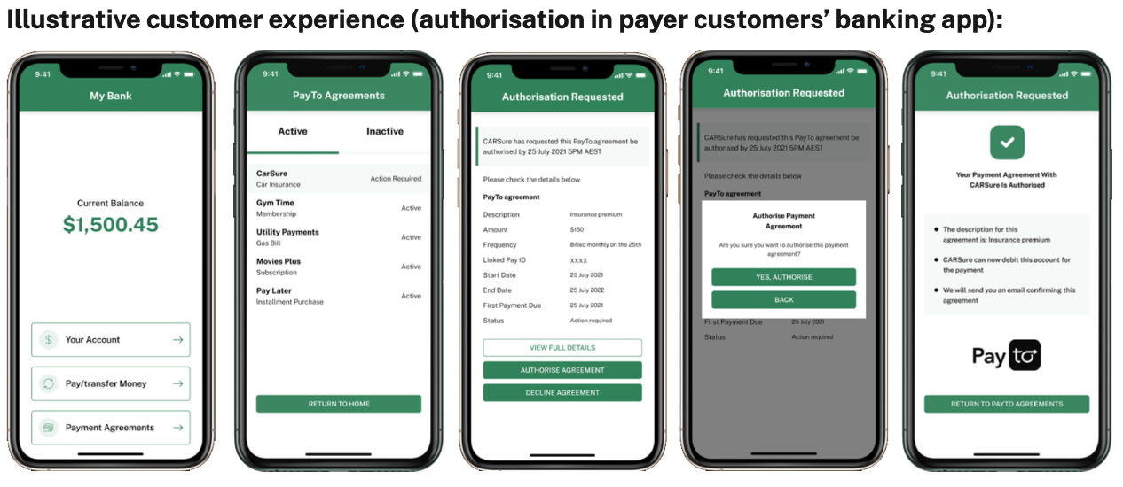
PayTo is a consumer interface that enables end users to control all their provisioned NPP authorizations in one centralized place
PayTo enables end users to:
Authorize, view, amend, pause, resume, cancel, and transfer the mandates they have given third parties to initiate payments from their bank account
Move their mandate payment arrangements from one bank account to another at a different institution, increasing the visibility and control that customers have over payment arrangements
Use cases:
Scheduled, recurring payments, e.g. BNPL
Subscription services, e.g. streaming subscriptions
Services providers, e.g. payroll, accounts payable
Event or trigger based, e.g., e-invoicing or smart contracts
Ecommerce payments, e.g. online shopping
In-app payments
In-store payments
One-off payments
Source: NPP Australia

Slide 34
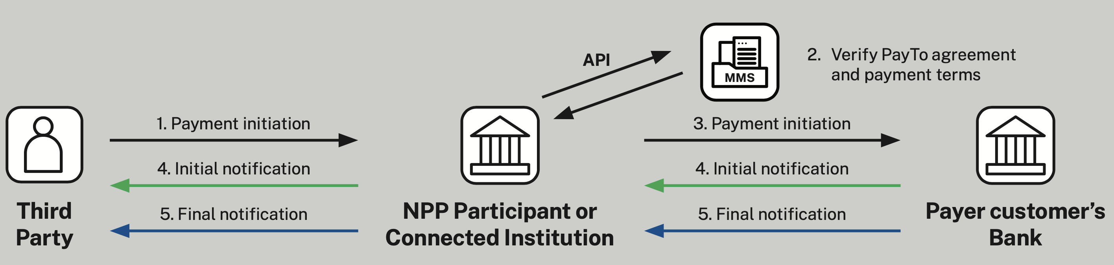
Diagram of a NPP PayTo Payment Flow
Third party, via NPP Participant or Connected Institution, can request a payment initiation message to be sent to its customer’s bank
The NPP Participant or Connected Institution sending the payment initiation request must verify that the PayTo agreement record is valid and the requested payment is within the terms of the agreement
The payment initiation request is sent to the customer’s bank
Payer customer’s bank sends a notification that the payment request has been accepted or rejected. This notification is passed to the third party initiating the payment.
A final notification is then sent to indicate the outcome of the payment, which is passed to the third party initiating the payment.
Payment Initiation Message Formats: Depending on the agreement between the third-party and the NPP Participant or Connected Institution which provides them access to NPP and PayTo service, the following message formats may be available: real-time via API, ISO message format, and batch form.
Source: NPP Australia
Notes:
Worth adding? Once authorized by the consumer, a record of the customer’s authorization (a ‘mandate’) is created and stored centrally. Both the customer’s bank and payment initiator’s bank can view the record
The mandate record includes the agreed payment terms, such as the customer’s name, their bank account details, payment initiator details, etc.
Mandate records offer flexibility with a range of data fields. In addition to the mandatory data fields within the mandate record, optional data fields can be included based on on the needs of the customer and the third-party payment initiator.
BM: Difficult to read the writing. May need to crop the photo and just write the words. May new to take a new screen shot from the graphc on page 7: https://payto.com.au/wp-content/uploads/2022/06/PayTo-Service-Overview-Nov-2021-2.0-2.pdf

Slide 35
Appendix

Slide 36
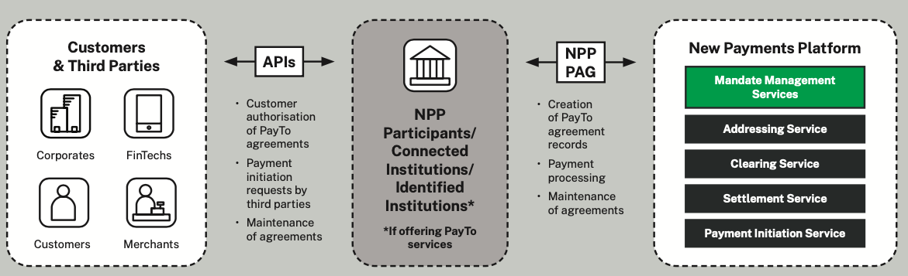
NPP provides a centralized database called the Mandate Management Service (MMS) for the storage of payment initiation agreements
All PayTo agreements, referred to as Mandates, are created and stored in the centralized MMS database, which is owned and operated by NPP Australia
NPP Participants and Connected Institutions can interact directly with the Mandate Management Service via their NPP payment access gateway to create and manage PayTo agreements. All other entities interact with the MMS indirectly via either an NPP Participant or an NPP Connected Institution
Source: NPP Australia
Notes:
Read more about this on page 7: https://payto.com.au/wp-content/uploads/2022/06/PayTo-Service-Overview-Nov-2021-2.0-2.pdf
NPP Participants and Connected Institutions can interact directly with the Mandate Management Service via their NPP payment access gateway to create and manage PayTo agreements. All other entities interact with the MMS indirectly via either an NPP Participant or an NPP Connected Institution.
A Connected Institution can send payment initiation requests and is not involved in the clearing and settling of payments. Any organisation who can meet the NPP technical connectivity and security requirements along with other applicable criteria, is legally authorised to operate in Australia, and is financially solvent could apply to become an NPP Connected Institution1 . Connected Institutions must also comply with the obligations and rules relating to accessing and using the Mandate Management Service (MMS) and the payment initiation service.

Slide 37
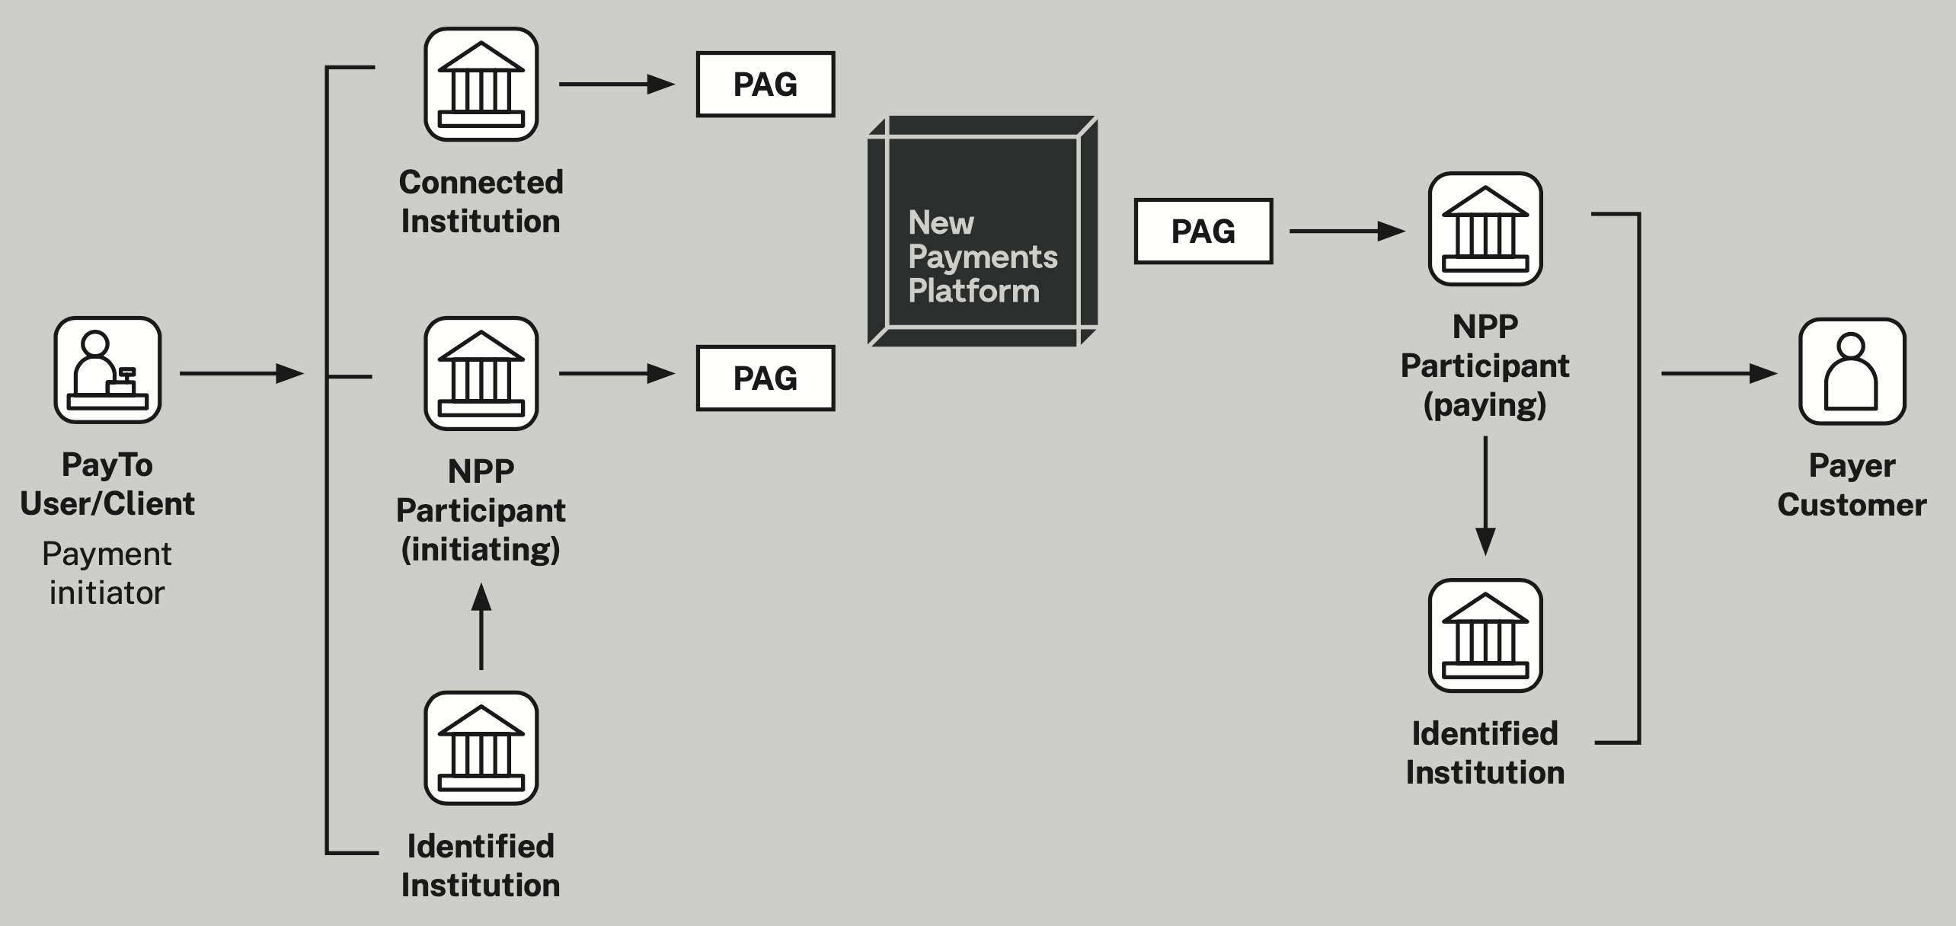
Connections for Third Party Payment Initiators
Third parties that want to use PayTo to initiate payments via the NPP have a range of access options
Access options for third-parties include:
  A PayTo User is sponsored by either an NPP Participant or an Identified Institution
  An Identified Institution is sponsored by an NPP Participant and can sponsor PayTo Users (if authorized to do so by their sponsoring NPP Participant)
  A Connected Institution connects directly to the NPP infrastructure by installing an NPP payment access gateway, or PAG, in its own environment. It does not need to be an Accredited Depository Institution but must meet certain technical and security requirements
  A client of a Connected Institution can also request payments associated with PayTo agreements to which it is a party
Source: NPP Australia
Notes:
Add? In the future, other classes of organisations without ADI licences called ‘Connected Institutions’, which otherwise satisfy the required criteria, could obtain their own payment gateway and submit non-value messages such as payment initiation messages that are processed by NPP participants.
Access Options Options at a glance: 1. A PayTo User is sponsored by either an NPP Participant or an Identified Institution 2. An Identified Institution is sponsored by an NPP Participant and can sponsor PayTo Users (if authorised to do so by their sponsoring NPP Participant) 3. A Connected Institution connects directly to the NPP infrastructure by installing an NPP payment access gateway, or PAG, in its own environment. It does not need to be an ADI but must meet certain technical and security requirements 4. A client of a Connected Institution can also request payments associated with PayTo agreements to which it is a party
Following text not needed in slide?
Supporting detail: ADIs can participate in the NPP by becoming either an ‘NPP participant’ to directly clear and/or settle NPP payments or an ‘identified institution’ by forming an agency arrangement with a ‘sponsor participant’, who clears and/or settles the NPP payments on their behalf
These organizations or NPP participants who provide institutional banking services can also provide access to third parties other than ADIs, such as fintechs or corporates.
NPP participants can choose to connect to the NPP Basic Infrastructure by either installing their own payment gateway, arranging to use another NPP participant's payment gateway, or using a third-party payment gateway provider.

Slide 38
Appendix – Open Banking & Payment Initiation
Country | Sources
General | Cook, William, Dylan Lennox, and Souraya Sbeih. 2023. “Starting the Transaction: Payment Initiation and Customer Experience.” Washington, D.C.: CGAP: https://www.cgap.org/sites/default/files/publications/Starting%20the%20Transaction-compressed.pdf Google Whitepaper, GPay perspective: Open banking system design: https://static.googleusercontent.com/media/pay.google.com/en//about/business/static/data/gpay-open-banking-whitepaper.pdf
Australia | NPP Australia, PayTo Service Overview: https://payto.com.au/wp-content/uploads/2022/06/PayTo-Service-Overview-Nov-2021-2.0-2.pdf ACCC: https://www.accc.gov.au/by-industry/banking-and-finance/the-consumer-data-right Australia Government, Consumer Data Right: https://www.cdr.gov.au/
Brazil | Association of Payment Transaction Initiators: https://init.org.br Open Finance Pix Open API: https://openfinancebrasil.atlassian.net/wiki/spaces/OF/overview?homepageId=17367041 Pix Forum: https://www.bcb.gov.br/estabilidadefinanceira/forumpagamentosinstantaneos Open Finance Brazil: https://openfinancebrasil.org.br Open Finance, BCB: https://www.bcb.gov.br/en/financialstability/open_finance World Bank Brazil Pix Case Study: https://fastpayments.worldbank.org/sites/default/files/2022-05/Brazil_Pix_Case_Study_May_2022_0.pdf
Europe | European Commission: https://ec.europa.eu/commission/presscorner/detail/en/qanda_19_5555 World Bank Case Study: https://fastpayments.worldbank.org/sites/default/files/2021-10/World_Bank_FPS_Europe_SCT%20Inst_Case_Study.pdf
India | Google Whitepaper, Real-Time Payments Systems & Third Party Access: https://static.googleusercontent.com/media/pay.google.com/en//about/business/static/data/GPay_RTP_2019.pdf IMF, India’s Approach to Open Banking: Some Implications for Financial Inclusion: https://www.elibrary.imf.org/view/journals/001/2021/052/001.2021.issue-052-en.xml NPCI: https://www.npci.org.in/what-we-do/upi/roles-responsibilities World Bank India UPI Case Study: https://fastpayments.worldbank.org/sites/default/files/2021-10/World_Bank_FPS_India_IMPS_and_UPI_Case_Study.pdf
UK | Open Banking Implementation Entity (OBIE): https://standards.openbanking.org.uk/api-specifications/latest/ Open Banking API specifications: https://openbankinguk.github.io/read-write-api-site3/v3.1.10/profiles/read-write-data-api-profile.html Open Banking API performance: https://www.openbanking.org.uk/api-performance/

