Slide 1
Communications Strategies for Launching Inclusive IPS: Findings from Pix and UPI Experiences
2023

Slide 2


Introduction
We reviewed the communications strategies of Brazil’s Pix and India’s UPI. Both are successful IPS, yet used different approaches to communicate the IPS launches, and for communications in the subsequent years.
Brazil’s Pix had a robust and well-developed communications strategy that was implemented prior to the launch of the IPS. This strategy, in addition to many other enabling factors, contributed to the fast adoption of the IPS. India’s UPI did not have significant communications around the time of the UPI launch, so it is unclear if NPCI had a pre-planned communications strategy, though years later the payments ecosystem in India implemented a fresh communications campaign for UPI.
Many factors contribute to the success and adoption of an IPS. The insights provided in this analysis are our observations of the communications strategies utilized for Brazil’s Pix and India’s UPI.
Guiding Questions
Which stakeholder groups did the scheme engage to promote awareness of the IPS?
What key messages did the scheme communicate to each stakeholder group to encourage adoption of the IPS?
When did the scheme’s communications and engagement begin?
How did the scheme inform and engage stakeholders?
Methodology: communications insights for both Pix and UPI are based on desk research from sources such as: the BCB and NPCI websites, BCB and NPCI social media channels, BCB and NPCI publications, news articles, DFSP websites and social media channels, YouTube, and influencer social media accounts. For Brazil, we also spoke with Pix team at BCB to obtain their personal observations.

Slide 3
Key insights of communications strategies
Key insights emerge from Brazil and India about communications strategies that contribute to public awareness and adoption of the IPS:
A strong, single, and public-facing brand is critical to building awareness. A unified IPS brand name creates singularity of the instant payment service provided by different DFSPs. A name that is catchy supports public usage in everyday interactions.
Both BCB and NPCI published detailed brand guidelines and required displaying the IPS brand on DFSP/PSP communications. India’s guidelines specify placement of the IPS logo to create a common user experience. Public exposure to the Pix brand prior to launch supported high awareness at launch.
Promotion of the IPS through a variety of media channels spreads news of the IPS to a broad audience and creates excitement.
Pix was publicized through press releases, commercials, and social media channels, and Pix team members gave interviews on mainstream news channels, while the Indian Prime Minister referred to UPI in public speeches and encouraged public usage.
Competition for customer accounts incentivizes DFSPs/PSPs to advertise their offering of the IPS, which widens the reach of communications.
Both Pix and UPI benefited from DFSPs advertising their offering of the respective IPS. DFSPs/PSPs created marketing campaigns using their own money and incentivized customers by offering financial rewards, such as cash back or vouchers, for usage of the IPS, which appealed to the public.
Engagement with diverse stakeholder groups creates advocates, expands communication channels, and contributes to market adoption.
Ahead of launch, the Central Bank of Brazil proactively engaged with a variety of stakeholder groups including merchant acquirers, small business associations, social media influencers, to inform of the new IPS and educate on the key benefits.

Slide 4
Key insights of communications content
While the cultures and context in Brazil and India are distinctly different, we observe similar approaches to content in the communications:
Content that highlights the key benefits for stakeholders drives interest in using the IPS. Communications related to the IPS highlighted key benefits to end-users (fast, reliable, safe), and for merchant acquirers (ability to serve new micro and small merchant customers), and enticed stakeholders to engage with the IPS.
Content that is informative supports understanding of how to use the IPS. Communications content often guided the user on how to conduct basic actions (e.g., getting started, send money, scan QR, request money) with the payment app.
Content that is fun in tone and provides relatable situations appeals to consumers. Content that is visual, humorous, and provides examples of real-life situations (e.g., pay at restaurant, pay for grocery) enables consumers to connect with the communications content.
At the time of UPI’s launch, India’s communications focused on promoting national progress through digital payments. Four years later, in 2020, NPCI embarked on a marketing style campaign, promoting the benefits of UPI to the public and providing key tips for safe usage.
Brazil’s Pix, for example, had commercials that featured skateboarders in efforts to make the content relatable for a variety of users.
Provision of content in multiple local languages helps to reach as many audiences as possible.
Providing videos and print content in multiple local languages was essential for communications about UPI due to the numerous local languages spoken in India.

Slide 5
Brazil Pix

Slide 6
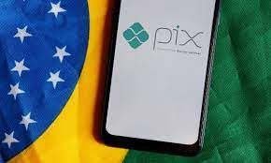
Pix: a rapidly growing instant payment system
In November 2020, The Central Bank of Brazil (BCB) launched Pix
Pix rapidly gained traction with over 50M users in 2 months and 1B transactions in 9 months
Many factors led to Pix’s growth, such as the following:
DFSPs licensed by BCB with over 500K transaction accounts were mandated to participate
Fintechs were allowed to to participate as payment service providers
Around the time of launch, approximately 60% of people owned a smartphone¹ and over 70% of people ages 15+ had a transaction account²
While many factors contributed to Pix’s success, BCB’s communications campaign was strategic and thorough
Key elements of BCB’s communication strategy included DFSP engagement, press releases, commercials and informative videos, publicly available interviews, influencer outreach and general BCB social media presence
Pix’s marketing messages remained fairly consistent from pre-launch to post-launch, focusing on the following themes: safe, instant, 24/7/365, cost-effective for consumers and merchants, and easy to use
¹GSMA
²World Bank
Sources: BCB interview, BCB website, GSMA, World Bank

Slide 7
BCB implemented a comprehensive communications strategy involving pre- to post-launch communications
BCB launched the Pix Brand and provides first communication: “BCB takes steps to make instant payments available to population”
BCB launched Pix to the public
BCB released branding guidelines
BCB began posting about Pix on social media
BCB published Pix Regulation
Communications from BCB continue
Feb 2020
April 2020
June 2020
Nov 2020
2023
Covid started
BCB launched alias directory
BCB began releasing YouTube videos about Pix
BCB circulated Pix implementation schedule
Pre-launch communications
Sources: BCB interview, BCB website
*Per capita is calculated as txn count divided by adult population (ages 15+)

Slide 8
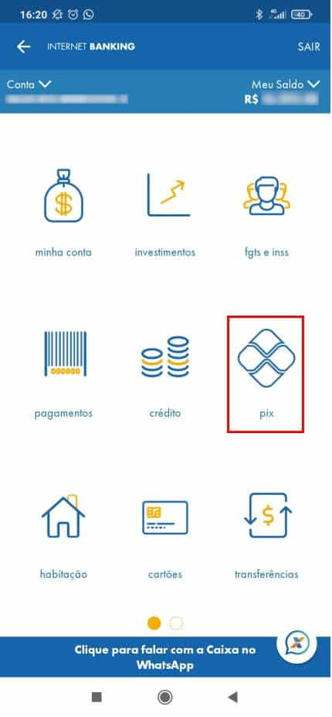
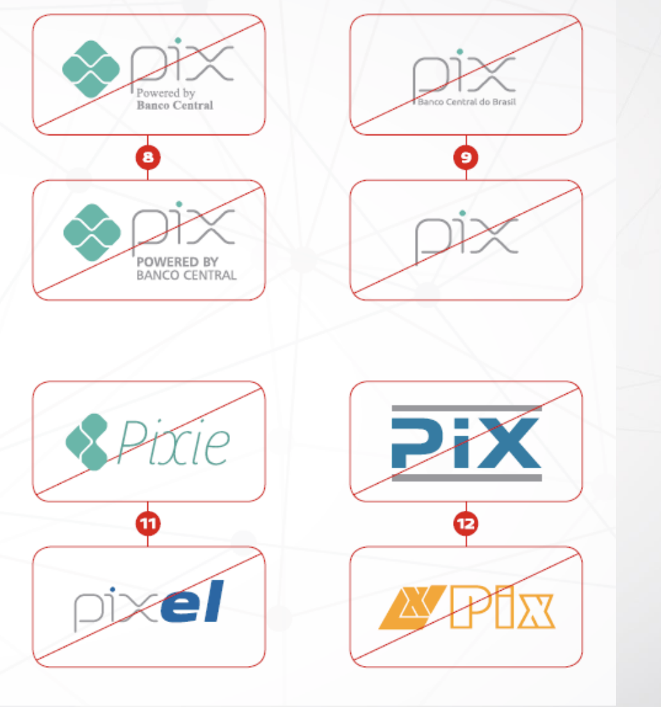
BCB made Pix a recognized, public facing brand, and implemented strict branding requirements to ensure consistent usage by external entities
BCB created Pix to be a public facing, cohesive brand, which promotes a widespread understanding of a single payment system that people and businesses can use
While DFSPs had some flexibility in their Pix offering, they were required to follow branding guidelines published by BCB in August 2020 (e.g., showing Pix’s logo on the home page of banking apps)
BCB took inspiration from global efforts in creating the Pix brand
Positive inspirations from Sweden’s Swish (e.g., ”Make a Pix” provides catchy language the public can use in everyday communications, similar to Sweden’s ”Swish me some money”)
Negative inspirations from UK FPS (which lacks a single consumer-facing brand and has limited public awareness)
Pix on Caixa app home page
BCB displays Incorrect use of Pix logo in Aug ‘20 branding guidelines
Sources: BCB interview, Caixa, BCB website

Slide 9
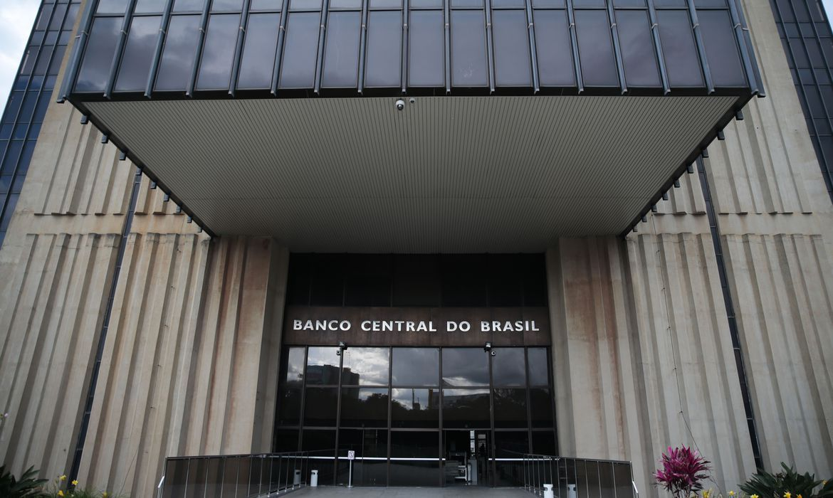
Branding: focus on trust
BCB took on a significant, yet uncommon role in leading a thorough marketing campaign as a central bank, but experienced strong reception, in part due to its authority in Brazil
BCB acts as a consumer-facing marketer, scheme owner and operator, and highly respected central bank
To highlight the role of the Central Bank, Pix’s logo includes the phrase “powered by Banco Central” and advertisements often conclude with this phrase
The “powered by Banco Central” slogan expresses that Pix is not a product created and offered by a few banks, but something that was developed by a central and trusted authority in Brazil
Source: BCB interview
Source: Pressenza

Slide 10
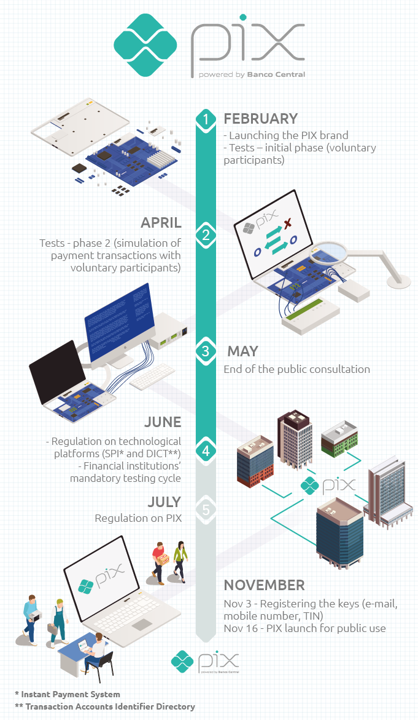
Pre-launch communications: BCB preps the public and the payments ecosystem with press releases
First mention in Feb 2020: “BCB takes steps to make instant payments available to population and launches its brand Pix”
Shared that Pix is mandatory for all DFSPs licensed by the BCB, with more than 500,000 active transaction accounts
This first announcement mentioned themes of flexibility, convenience, and competition
Pre-launch update in May 2020: “PIX takes important step towards its launch in November”
This was a DFSP-focused announcement, and BCB provided an overview of the “homologation cycle” beginning July where institutions are mandated to test the service to guarantee functioning of the payment system
BCB executives also conducted interviews, presentations, panel discussions, and made TV appearances prior to launch to increase awareness, supporting BCB’s multi-channel effort
Alias directory was launched strategically just weeks before Pix launch to create excitement for end users and accelerated competition for DFSPs
Sources: BCB interview, BCB website

Slide 11

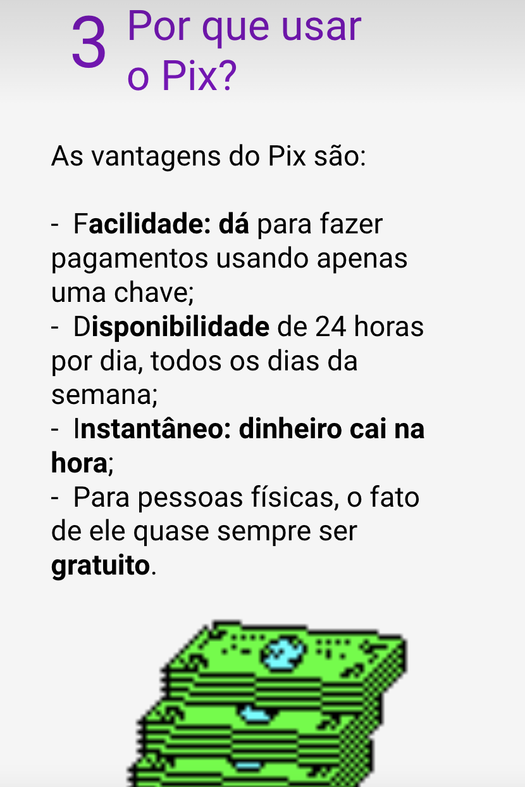
Many DFSPs were required to offer Pix, and communicated the service to their customers, further increasing awareness of the service
Many DFSPs were required to offer Pix, and consequently were motivated to advertise the payment service to become the main transaction account connected to their customers’ Pix aliases
DFSPs offered informational content and advertisements through websites, banking apps, and television
Most DFSPs have sections of their website dedicated to Pix, explaining the benefits, and offering quick steps and links to register a Pix key
Sample communications from DFSPs
Santander from August 2020: Santander unveils SX, its new idea for PIX payments, which is an example of a value-added service
Nubank blog post from October 2020: 5 questions about Pix. This type of overview content was common from banks
Santander launched SX, powered by Pix, in August ‘20
Oct ‘20 Blog post from Nubank
Image from Nov ‘20 tweet
Sources: BCB interview, Santander Twitter, Nubank

Slide 12
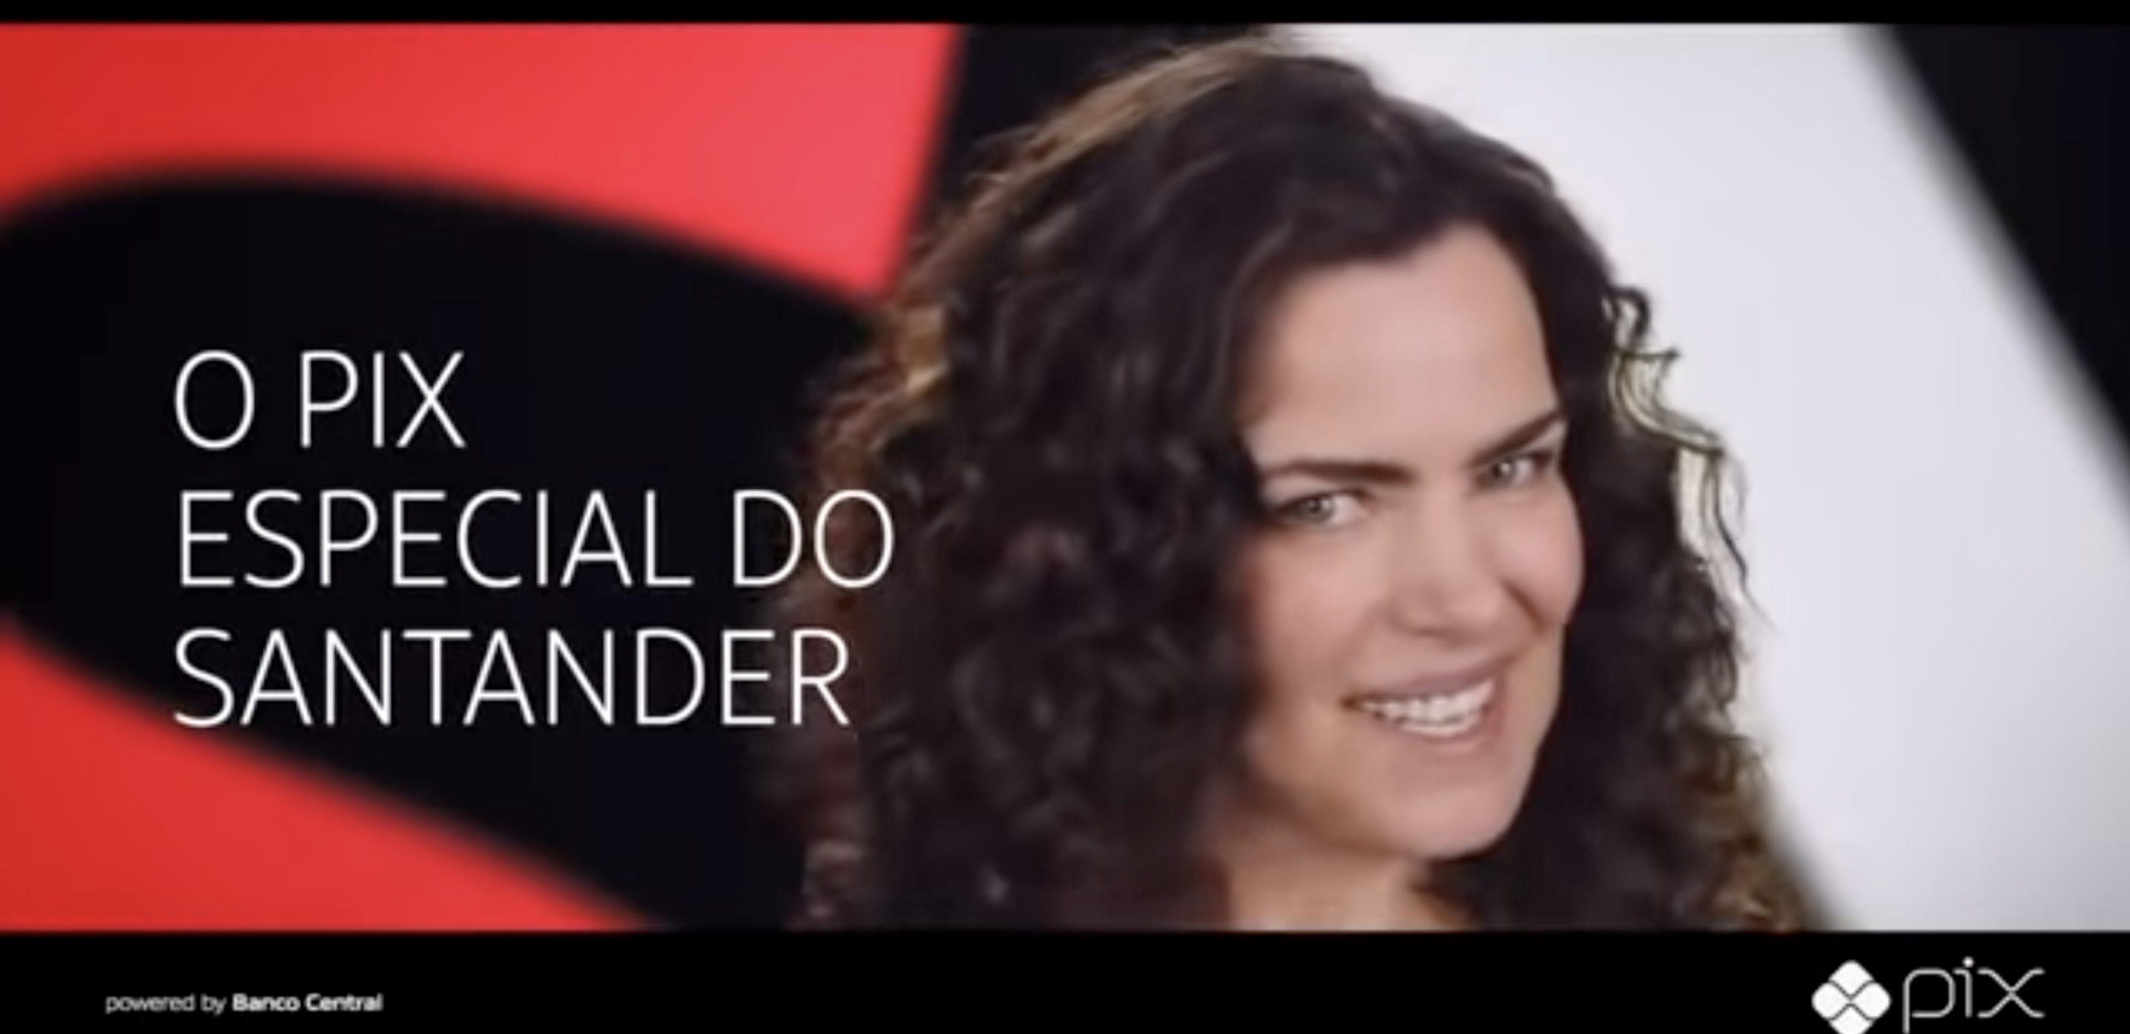
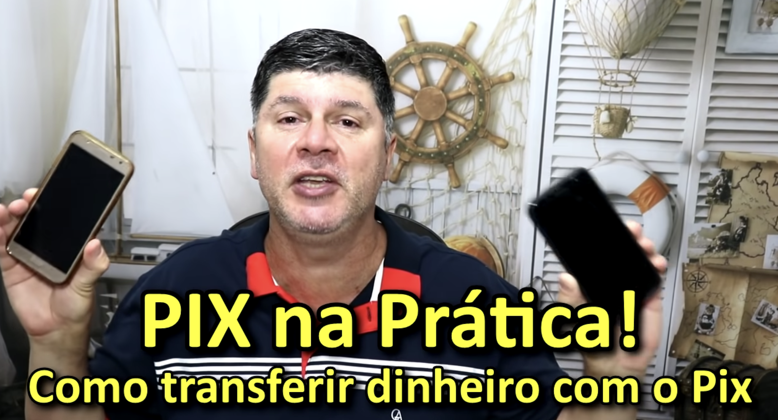
BCB’s campaign led to communications from multiple angles
DFSP Competition → Advertisements
Influencer Engagement → More Pix Content
BCB did not require DFSPs to advertise Pix, but positioned Pix in a way to motivate DFSPs to market the service due to competition
DFSPs hired influencers/celebrities to market Pix to increase customer adoption
Most notably, Banco Santander partnered with Ana Paula Arósio for a commercial on Santander SX
BCB engaged influencers (e.g., by inviting them to private events) to encourage people with a large social following across various topics (finance, education, etc.) to share content on about Pix on social media
Social media influencers often have hundreds of thousands of followers on channels such as YouTube
Influencers often created videos about how to use Pix, which gave customers more confidence in using it
Video link
Video link
Sources: BCB interview, Santander, YouTube

Slide 13
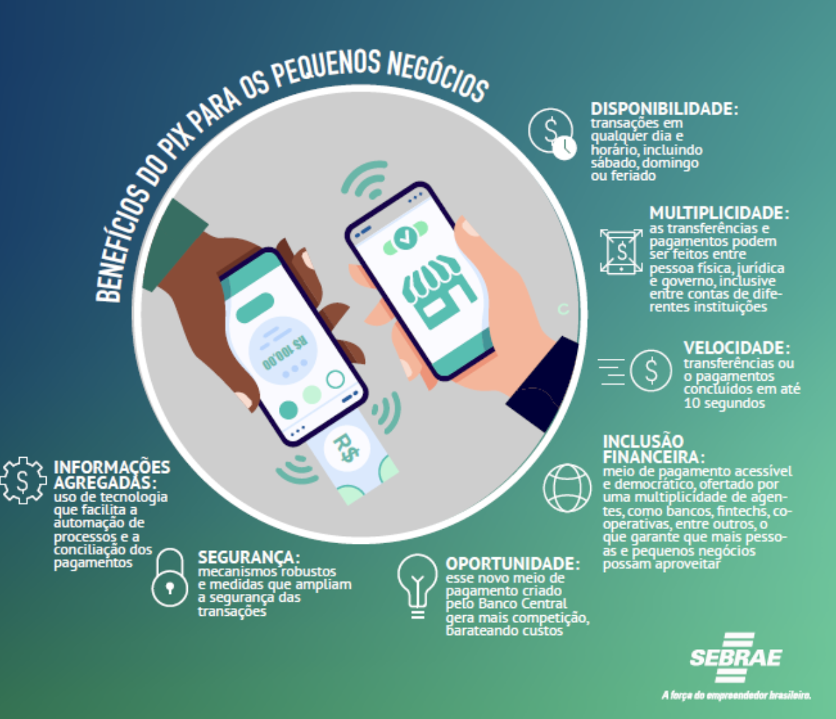
Engagement with business associations – Spotlight on Sebrae
In addition to communications to the public, BCB engaged with business associations and agencies to promote usage of Pix across various end-users, such as, for example, micro and small businesses.
Spotlight: Brazilian Service of Support for Micro and Small Enterprises (SEBRAE)
Sebrae is a non-profit private entity that seeks to promote the sustainable and competitive development of small businesses
Sebrae’s website includes various communications about Pix, such as:
Overview info (e.g., understand instant payments, why businesses adopt Pix)
Teaching small businesses how to effectively use Pix
Updates that might impact small businesses’ strategy (e.g., small businesses can now pay DAS with Pix)
General updates (new rules, change to limits, etc.)
Sources: BCB interview, Sebrae website

Slide 14
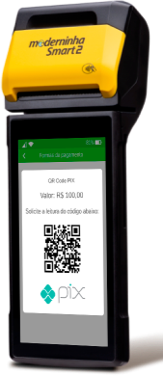
BCB conducted outreach to acquirers to enable merchant acceptance
BCB reached out to merchant acquirers, which were not required to offer Pix, to promote the offering of Pix as payment acceptance method to merchants. This outreach received a strong response, opening up a significant P2M opportunity
BCB’s outreach began 6 months prior to the launch
Explained Pix’s value proposition to inform acquirers’ decisions
BCB marketed the main benefit of Pix over other payment methods: cost
Key benefits promoted: Due to low cost, Pix was able to create opportunities for merchant acquirers to serve micro and small merchants as customers, opening a significant source of additional revenue
Sources: BCB interview
Source: PagSeguro

Slide 15
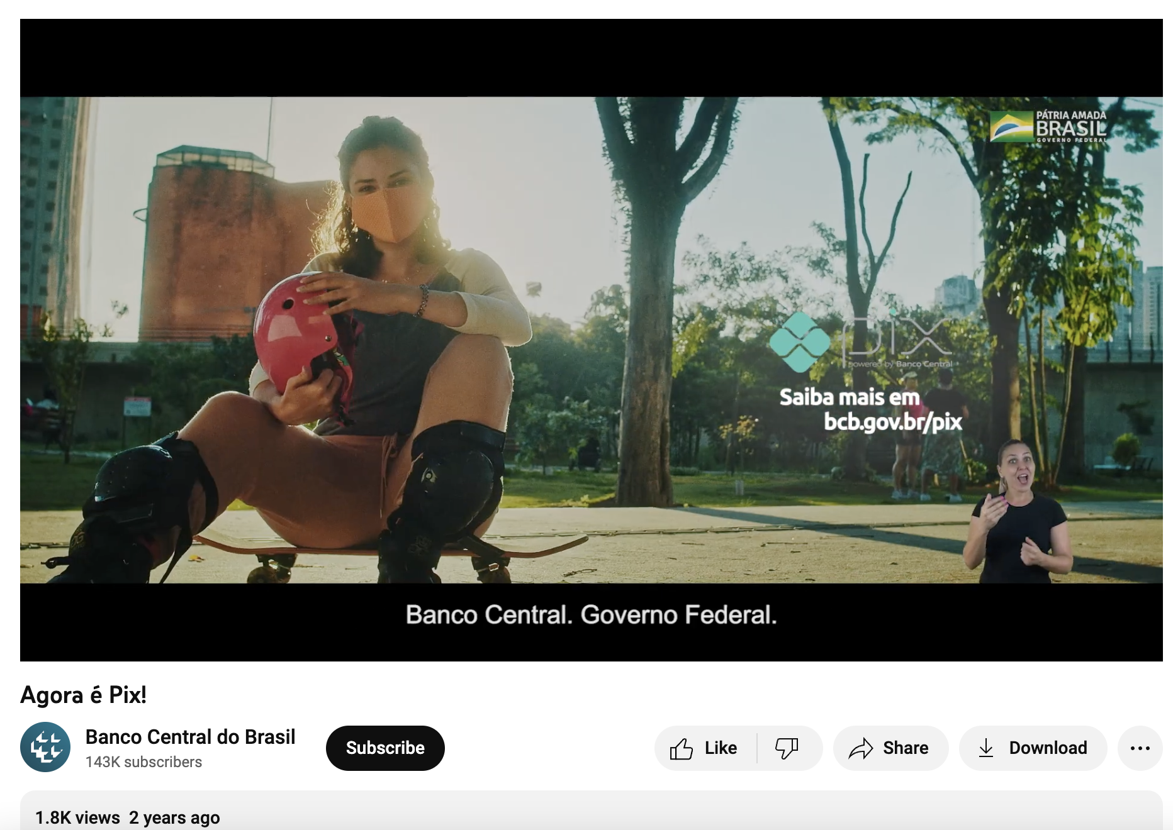
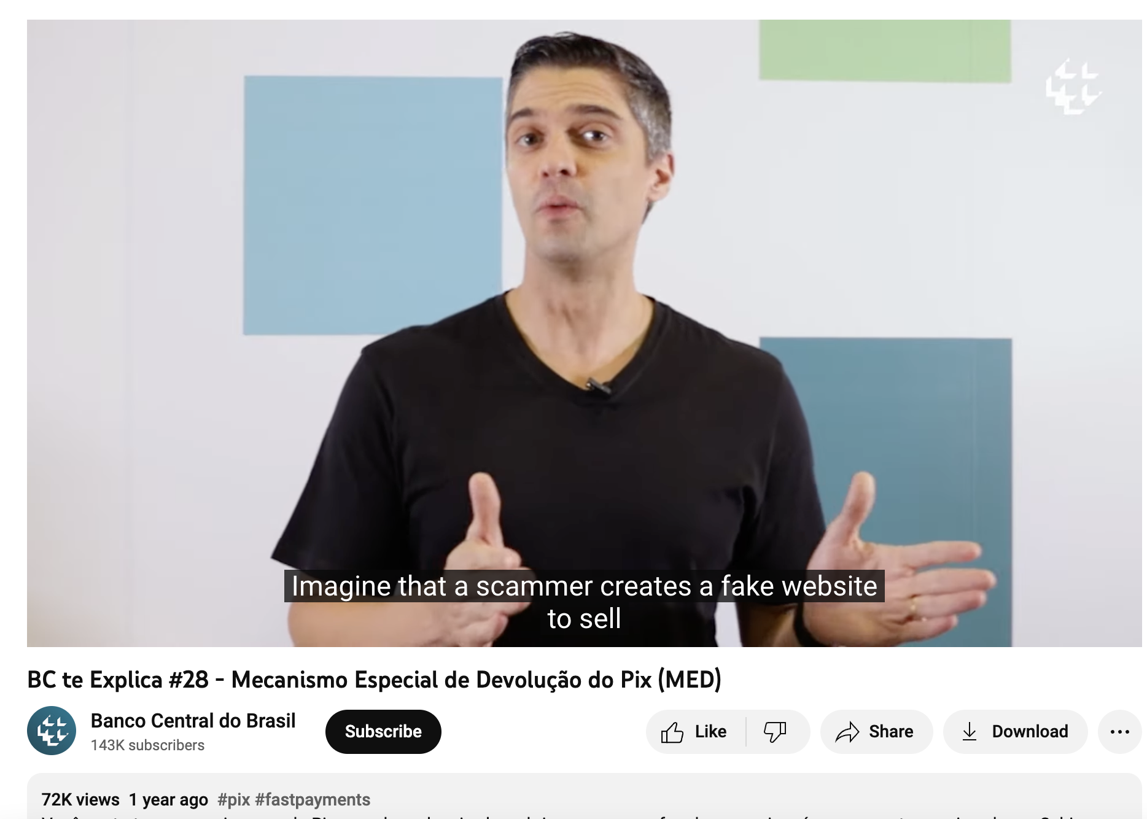
BCB’s YouTube approach included commercials and informational videos
The Central Bank of Brazil has a YouTube channel with 140,000 subscribers, on which it has posted commercials and informational content about Pix from the months before the launch until now
BCB published advertisements, such as “Now it’s Pix” and “Going to pay? Make a Pix!”
BCB also posted informational videos, such as “Central Bank Explains: Pix’s Special Return Mechanism,” and “Central Bank Explains: 7 tips for dealing with scams involving Pix”
Series: “Central Bank explains,” “Pix Connection,” “Pix Circuit”
Primary goals of the campaign were to spread awareness and teach consumers about how to use the service (e.g., setting up a Pix key, how to make a payment)
Convenience, speed, and security were themes mentioned in most advertisements
Video link
Sources: BCB YouTube channel, BCB interview
Video link

Slide 16
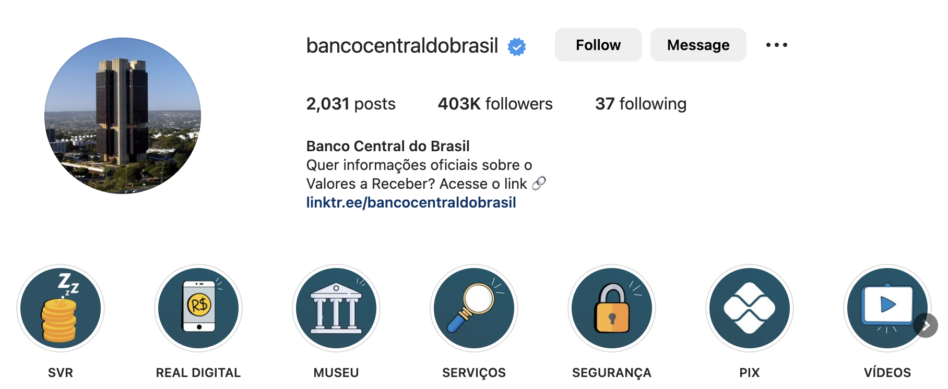

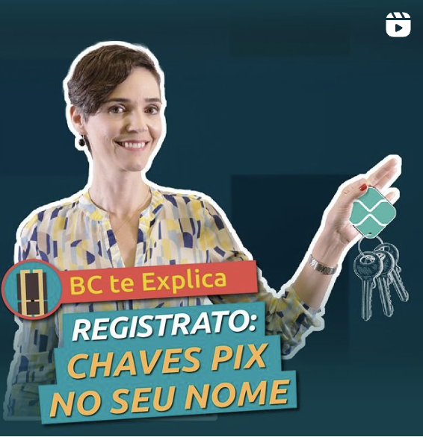
BCB’s social media accounts such as Twitter and Instagram have a significant following and have consistently marketed Pix from pre-launch to today
The Central Bank of Brazil has social media accounts such as Instagram, Twitter, and Facebook that played a role in spreading news about Pix before and after its launch
Prior to the launch, BCB posted informational and marketing content related to Pix across its social media channels
Instagram: 400K+ followers, with monthly posts (on average) about Pix, and various posts about Pix during the time of the launch
Twitter: 450K+ followers, also with monthly tweets (on average) about Pix before and after the launch
Facebook: 180K+ followers
BCB’s social media strategy supplements its influencer strategy, since content is often reposted by other individuals
Sources: BCB interview, BCB social media accounts

Slide 17
India UPI

Slide 18
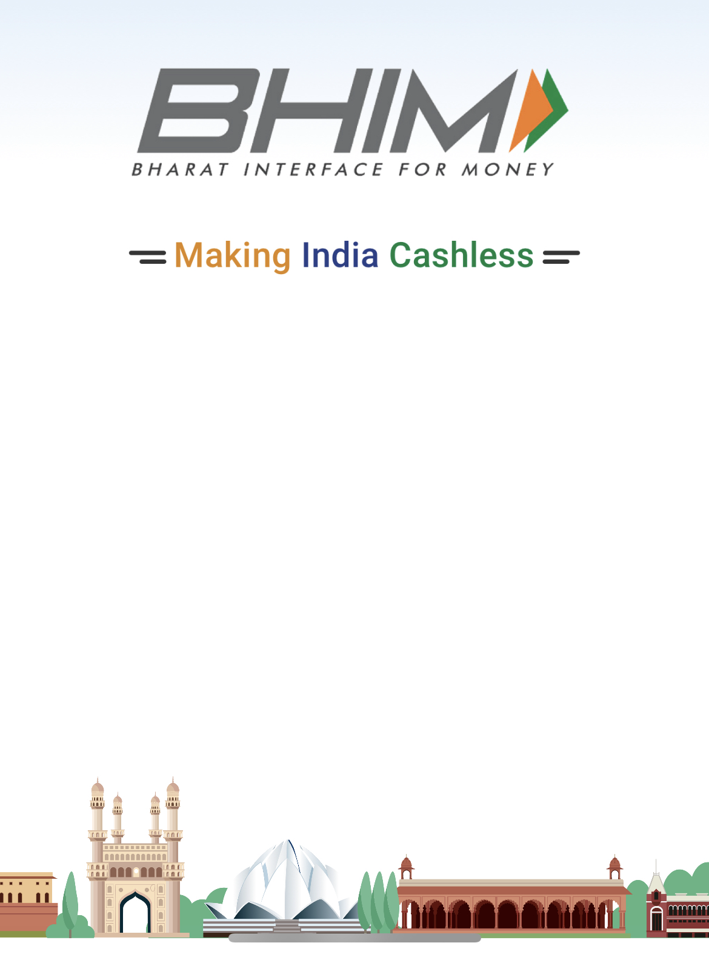
Background: Promoting a ‘Cashless India’
Around the time of the launch of UPI, India was focusing on reducing dependency of the Indian economy on cash and bringing significant volume of undeclared cash lying unused into the banking system. To achieve this, the Government of India promoted efforts to digitize the economy in an initiative later labeled as Cashless India.
A key step in this transition was Demonetization, where high-denomination banknotes (Rs 500 and RS 1000) were withdrawn from circulation.
Objective: remove ‘black money’ (i.e., the shadow economy) that escaped the radar of tax authorities and rid corruption from the country
While promoting digital payments was a clear component of Cashless India, it is unclear if NPCI had a defined communications strategy specifically for UPI from the time of launch. UPI was likely not the obvious focus at time of launch, but instead a tool to reach the goal of Cashless India.
Around the time of UPI’s launch, India was focused on increasing digital and financial inclusion. Mobile penetration in India increased from 47% in 2015 to 68% in 2020, while financial account* ownership grew from 53% in 2014 to 80% in 2017.
Source: World Bank, GSMA
* Includes accounts at a financial institution or a mobile money service provider
Notes:
Account ownership at a financial institution or a mobile money service provider:
2014: 53%
2017: 79.88%
2021: 77%
Mobile phone ownership (age 15+):
2021: 66%
GMSa gap

Slide 19
Timeline – India and UPI
Demonetization
328 banks live on UPI
DFSPs offer financial incentives to customers for using UPI
UPI Official launch with 21 banks live
Incentive Scheme to promote low-value UPI Merchant payments
UPI Pilot launch
Branding guidelines introduced
UPI Chalega
Campaign launch
Aug 2016
Dec 2016
Oct 2017
Feb 2020
2023
PM Modi gives multiple speeches: “Embrace Technology and Move towards a Cashless Society”
“Biggest Power of Technology is that is can Empower the Poor”
Announces Reward winners
Covid started
Source: NPCI
*Per capita is calculated as txn count divided by adult population (ages 15+)
Notes:
April 2016. UPI Pilot launch
August 2016 – UPI official launch with 21 banks live
Nov 2016 – demonetization
Nov 27, 2016 – pm modi speech: “Embrace Technology and Move towards a Cashless Society”
Around Nov 2016 – Feb 2017 – DFSPS offer incentives to customers for using UPI – one time voucher for signing up or making a UPI payment
Dec 25, 2016 – pm modi speech: Announces Reward winners
Dec 30, 2016 - PM Modi speech: “Biggest Power of Technology is that is can Empower the Poor”
Oct 2017 – UPI Branding guidelines introduced
Feb 2020- UPI Chalega campaign launched
May 2020 – Covid lockdown lifted
2023 – 328 bank live on UPI, incentive shceme ot promote low-value UPI merchant payments

Slide 20
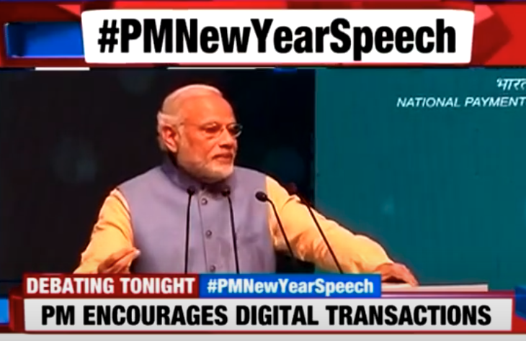
UPI Launch: the government encourages usage of UPI
Shortly after launch, India’s Prime Minister strongly encouraged the public, through multiple public speeches, to use UPI and make digital payments a habit
Key messages:
Using digital payments will support national progress and is a service to the nation
Digital payments enable micro and small merchants to get loans from banks, using transaction history for underwriting, enabling them to avoid usury lending practices
Incentives: Everyday for 100 days, the government gave out, through a lottery system, Rs 1,000 ($12 USD) to 15,000 people. To be eligible, individuals must have been using digital means of making payments (either UPI or RuPay, the local debit card scheme). Only individuals making low-value transactions were eligible.
Over $18M USD was given out.
“Even if you do five transactions, cashless payments will become a habit and the country will lead in the digital movement” Prime Minister Modi, Dec 31, 2016
Source: Business Today, The Economic Times

Slide 21


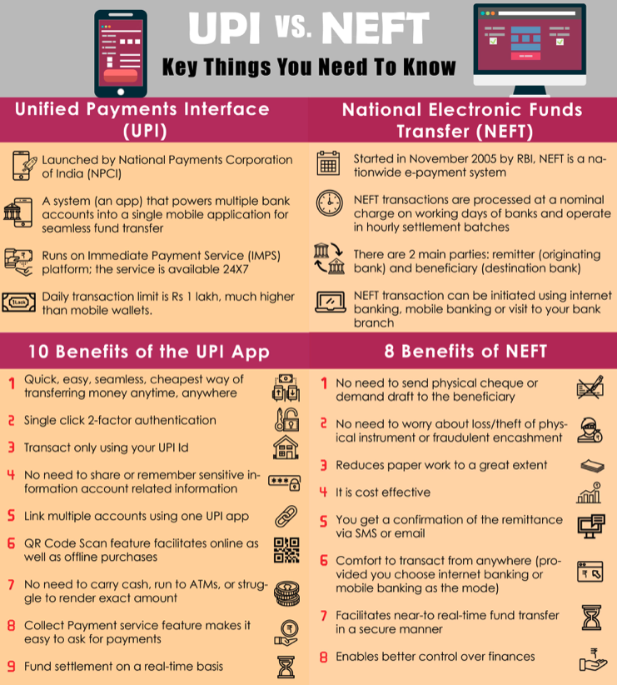

With a delayed timeline, DFSPs implement strategies to compete for customer accounts by providing ‘how to’ videos, promoting key benefits, and offering incentives to encourage use of UPI
Aug 2016 – Axis Bank live on UPI
Nov 2016 – Provided videos on how to use UPI on Axis Bank App
Nov 2016 - Offered customers rewards/incentives to use UPI
2017 – Provide content explaining the benefits of UPI
Aug 2016 – ICICI Bank live on UPI
Dec 2016 – Provided videos on how to use UPI on ICICI Bank apps
Feb 2017 – Offered customers rewards/incentives to use UPI
Source: Axis Bank, ICICI Bank

Slide 22
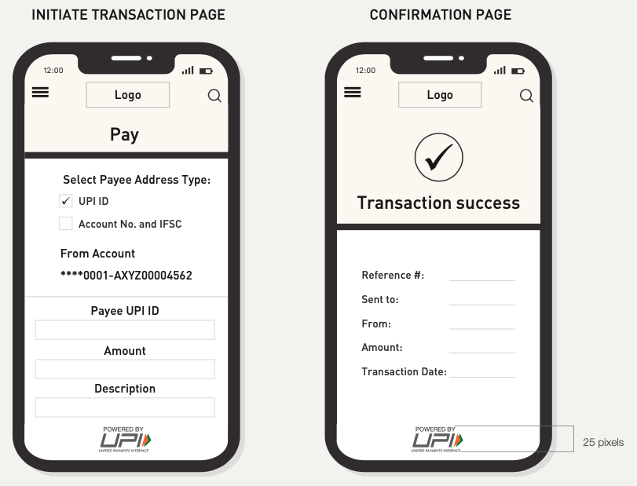
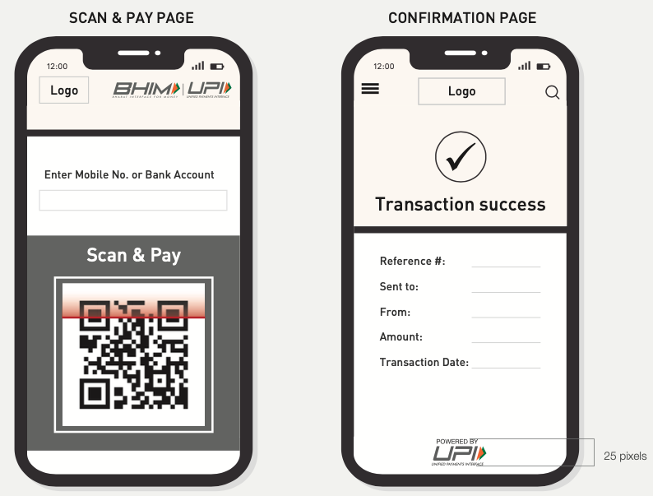
NPCI introduced detailed branding guidelines for UPI in 2017 to provide a cohesive brand to the public
Branding guidelines specify logo colors, dimensions, and sizing to communicate a singular image of UPI
Detailed requirements to display the ”Powered by UPI” logo on mobile app screens for specified actions including Send Money, Request Money, Generate QR Code, Transaction/Confirmation page, among others, creates a unified customer experience

Slide 23

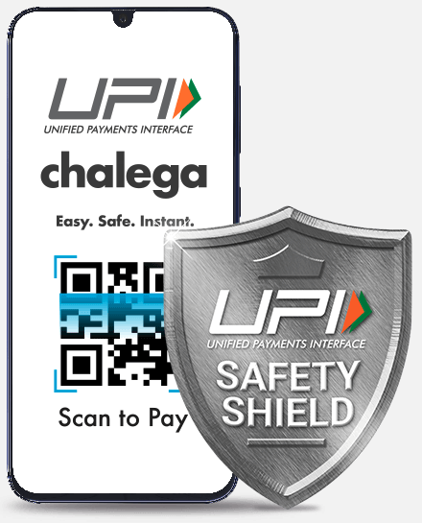
NPCI developed a campaign – 4 years after UPI initially launched – to increase awareness and educate the public
In 2020, NPCI implemented a large-scale campaign to promote habitual usage of UPI as well as educate on safety aspects. The campaign used a simple and clear campaign title, UPI Chalega that translates to UPI Will Work. NPCI hired a leading creative agency to develop the multi-media campaign.
Promoting parties: The payment ecosystem players (NPCI, DFSPs, PSPs, Third-party apps) came together to promote safe usage of UPI
Campaign approach: The campaign created a relatable character, Mrs. Rao, who is the mouthpiece of the UPI brand. The campaign used humor and set videos in everyday life situations such as paying a bill at a restaurant or buying vegetables at the vegetable shop
Key message: UPI is a safe, instant, and easy mode of payment
Target audience: Smartphone users of all ages
Channels: TV, digital, and radio were used to drive traffic to the UPI Chalega website
Languages: multiple versions of the same videos were provided in multiples languages to reach a variety of local groups
YouTube videos: UPI Safety Shield tips
52 Million views – Check that the receiver’s name on the bank account is the same person as the intended receiver before making the payment
33 Million views – How to raise a complaint about a payment
29 Million views – What to do when you receive an SMS confirmation about a transaction you didn’t do

Slide 24
Appendix

Slide 25


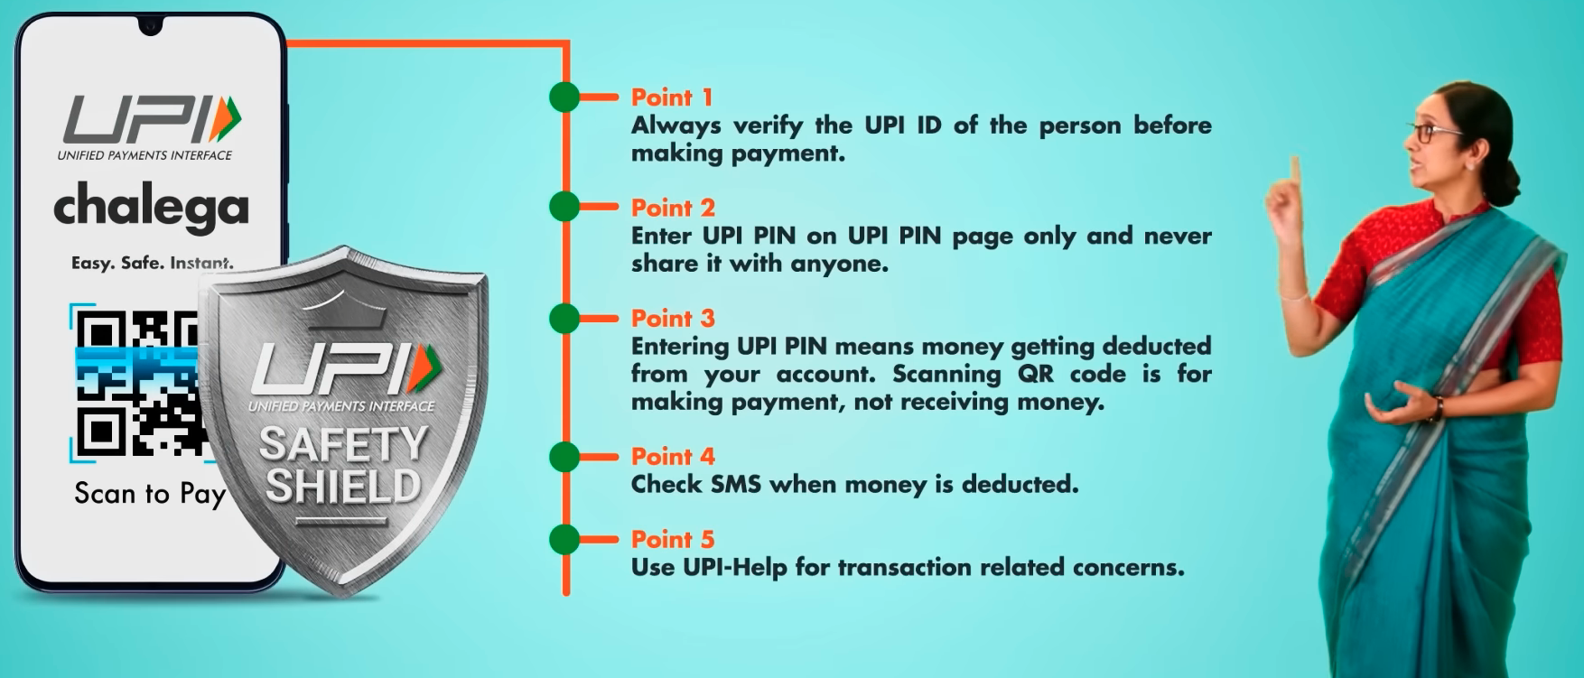

Additional UPI Chalega Campaign Content
UPI Chalega website provides:
Benefits and examples of where to use UPI (Peer to peer, bill payments, store, online shopping, entertainment, fuel stations, transportation, restaurants, hotels, credit card payments, etc)
FAQ for Customers and Merchants
UPI Chalega provides content through various Social media channels
Twitter: 9.8k followers
Instagram: 9.5k followers
Facebook: 8.7k followers
UPI Chalega provides 5 safety tips

Slide 26
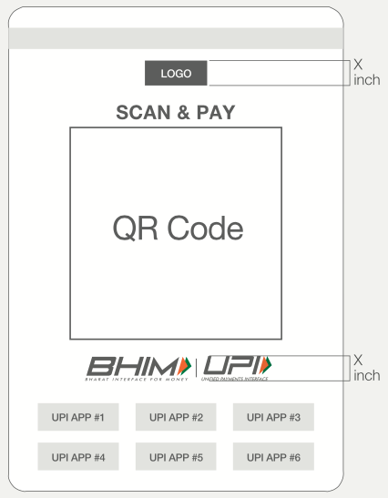
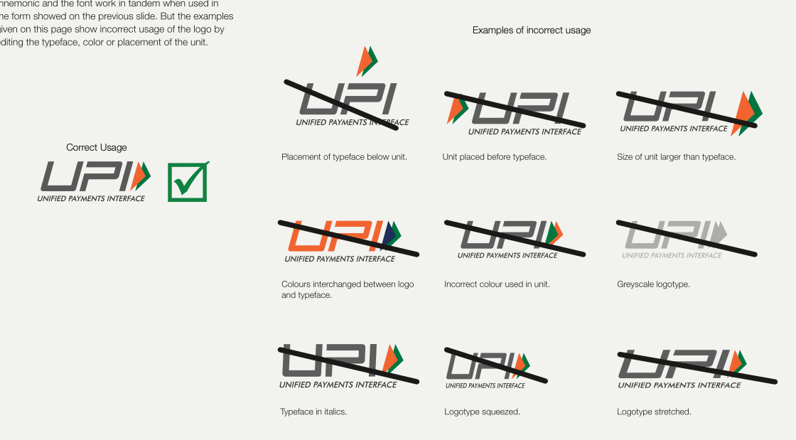
Additional UPI Branding Guidelines
As every piece of material that customers see acts as a medium of communication, NPCI stresses the importance of maintaining uniformity in design elements.

Slide 27
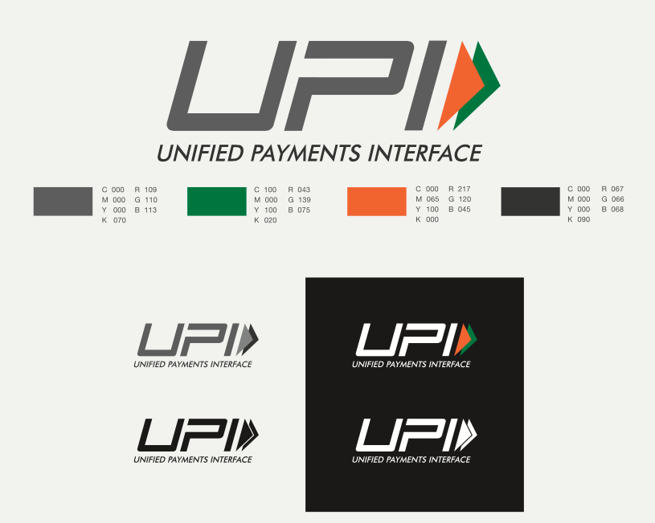
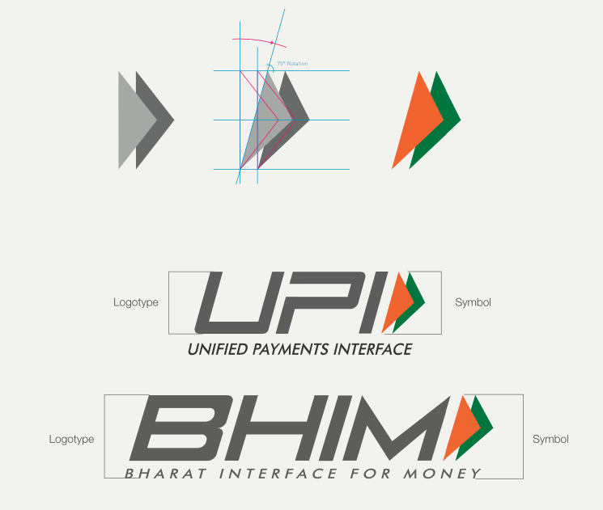
Additional UPI Branding Guidelines
NPCI provides logos for downloading from the website and provides detail around the logo design choices:
With India heading towards a digital future and BHIM UPI assisting in its growth by taking a progressive initiative to take the country to a “less cash society”. The Tricolor arrows, created by combining the fast-forward symbol with our National flag and taking inspiration from the stance of an athlete, visually captures this statement.
Capturing the same elements from the official NPCI logo, the sharp edges of the arrows in the symbol point towards the future, reflecting UPI’s accelerated commitment to the country’s progress, while the curved edges negate the frivolousness, brilliantly juxtaposing BHIM UPI’s forward-thinking with its nationalistic and traditional values.

Slide 28
Appendix – Communications References
Country | Sources
Brazil | BCB Pix Brand Guidelines: https://www.bcb.gov.br/content/estabilidadefinanceira/pix/Regulamento_Pix/I_manual_uso_marca_pix.pdf BCB Website: https://www.bcb.gov.br/ BCB YouTube channel: https://www.youtube.com/@BancoCentralBR BCB Instagram account: https://www.instagram.com/bancocentraldobrasil/?hl=en BCB Twitter account: https://twitter.com/BancoCentralBR?ref_src=twsrc%5Egoogle%7Ctwcamp%5Eserp%7Ctwgr%5Eauthor BCB Facebook account: https://www.facebook.com/bancocentraldobrasil/ Sebrae website: https://sebrae.com.br/sites/PortalSebrae
India | BHIM UPI Brand Guidelines: https://www.bhimupi.org.in/sites/default/files/BHIM%20UPI%20Guidelines.pdf UPI Chalega website: https://www.upichalega.com UPI Chalega YouTube channel: https://www.youtube.com/c/UPIChalega/playlists UPI Chalega Instagram account: https://www.instagram.com/upichalega/?hl=en UPI Chalega Twitter account: https://twitter.com/upichalega?ref_src=twsrc%5Egoogle%7Ctwcamp%5Eserp%7Ctwgr%5Eauthor UPI Chalega Facebook account: https://www.facebook.com/upichalega/ World Bank: https://data.worldbank.org/indicator/FX.OWN.TOTL.ZS?locations=IN

