Slide 1
Primer and Market Landscape Reports:
Settlement in Instant Payment Systems

Slide 2
Table of Contents
Primer on Instant Payment Systems Settlement
Overview of key terminology and processes
Market Landscape Report
Introduction to the Report
Overview of Research
Executive Summary
Understanding the Landscape of Settlement in IPS
Access to Settlement Accounts
Settlement Models
Management of Risks
Settlement Account Design
Settlement Considerations for Enhancing Inclusivity
RTGS Spotlights: FedNow, Pix, TIPS
DNS Spotlights: FPS, UPI
Appendix
Gates Foundation

Slide 3
Primer on Clearing & Settlement in Domestic IPS

Slide 4
IPS Components and Relationships
How clearing and settlement works for a given payment system is a reflection of scheme policies, platform capabilities, and settlement bank capabilities and policies. In some cases, the scheme may create requirements for the platform: in other situations, platform capabilities define what the scheme supports.
Note that the IPS Scheme and Platform may be the same or separate entities
DFSP participants (bank or non-bank) agree to participate in the scheme and follow its business rules. DFSP provide end-user accounts to payer and payee
IPS
The scheme writes the business rules. Rules specify the clearing, settlement, and shared services functions required of the IPS Platform and participants
DFSP
Scheme
DFSP
The platform provides clearing functionalities through a switch (a technology) and may include shared services
Platform
The settlement bank (often a central bank, but can be a commercial bank) provides settlement accounts to DFSPs, and by agreement with the scheme provides operating functionality to support settlement requirements
Settlement Bank

Slide 5
IPS Clearing and Settlement
This Primer introduces approaches key concepts in clearing and institutional settlement in Instant Payment Systems (IPS). Institutional settlement is the discharge of obligations between the sending DFSP (debit) and the receiving DFSP (credit) incurred when making the transfer
Institutional settlement is different than end-user settlement. End-user settlement is the discharge of the debit to the payer’s account at their DFSP, and the credit to the payee’s account at their DFSP. End-user settlement may be defined by regulation, by scheme rules, or by market practice. It is separate from institutional settlement: it is possible for end-user accounts to be debited or credited either before or after institutional settlement occurs
Level One Project principles guide that end-user settlement be done on a real-time (near immediate) basis, and that institutional settlement also be done on a near real-time basis
End-User Settlement
End-User Settlement
Payer
DFSP
IPS
DFPS
Payee
Institutional (DFSP) Settlement

Slide 6
IPS: Illustrative Transaction Flow and Functions
An IPS transaction involves initiation of payment by the payer (a push payment), receipt and transmission of payment information by a DFSP to an IPS platform (after proper authentication and authorization), clearing functions performed by the platform, end-user settlement, and DFSP settlement. While the flow below is shown as sequential, in IPS systems, the functions are performed in real-time or near real-time
5
4*
* Level One Project aligned schemes provide immediate funds availability to the payee
1
DFSP
2
DFSP
Payee
Payer
IPS
3
3
6
Settlement Bank
7
1
Initiation of transaction by payer
3
Notifications: switch confirms receipt of transaction, conducts verifications, and notifies DFSPs that transaction will be settled
5
Netting: net positions between DFSPs (if applicable)
2
Transmission of transaction info by DFSP
6
Establish obligations and transmit for settlement
4*
End-user funds availability: upon receipt of payment notifications, DFSP credits payee
Settlement: settlement bank debits payer’s DFSP and credits payee’s DFSP
7

Slide 7
Comparing Traditional & IPS Approaches: Clearing
Clearing is the exchange of information about a payment prior to settlement, potentially including the netting of transactions, and the establishment of positions for settlement of transactions between participants
Clearing occurs instantly and on a continuous basis in instant payment systems. Payers may initiate transfers at any time or day, including weekends and holidays (365x7x24). The scheme rules support delivering immediate funds availability to payees.
While clearing is real-time, settlement between DFSPs may be deferred initially, but with the goal of reaching near real-time
IPS clearing processes avoid the delays present in classic, traditional batched retail payment system models and where clearing windows are limited by business hours
 | Classic System | IPS
1) 24x7x365 platform availability | ✕ | ✓
2) Real-time transaction notifications to DFSPs | ✕ | ✓
3) Real-time payee funds availability | ✕ | ✓

Slide 8
Market Landscape Report:
Executive Summary
February 2024

Slide 9










Introduction to the Report
This Market Landscape Report is the culmination of desk research and qualitative interviews conducted by Glenbrook on current settlement approaches in Instant Payment Systems (IPS).
The Report is focused exclusively on settlement and settlement related risk management approaches and does not cover the clearing aspects of IPS
IPS | Country
FAST | Singapore
FedNow | United States
FPS | United Kingdom
GIP | Ghana
Interac | Canada
NIP | Nigeria
NPP | Australia
IPS | Country
PesaLink | Kenya
Pix | Brazil
RTP | United States
SCT Inst | Europe
SPEI | Mexico
TIPS | Tanzania
UPI | India
Gates Foundation, 2024

Slide 10
Executive Summary
Settlement models and related risk management approaches and tools have advanced over the last few years
The frequency of settlement is becoming faster as more IPS have implemented the real-time gross settlement (RTGS) model and several DNS models have increased the number of settlement windows per day beyond the number in the original design. The RTGS model is also being implemented as a dedicated settlement system to IPS and setting on a 24x7x365 basis
While direct access to settlement accounts remains largely limited to banks, some settlement banks are broadening settlement access to non-banks
Eligibility by non-banks to open direct settlement accounts is a foundational step towards broader access, but not the only step. Non-banks (as well as some banks) may still decide to rely on banks for connectivity in cases where establishing and maintaining these accounts is complex and operationally intensive
Greater reliance on RTGS models and higher value of transactions being processed by IPS has led to higher need for and implementation of effective and innovative management of liquidity
Newer tools and approaches include fungibility of funds between different settlement accounts, liquidity providers, and importantly, interest paid on balances to incentivize maintenance of adequate balances
Automation of liquidity management tools remains somewhat limited and settlement banks as well as DFSPs still generally rely on manual operational processes to monitor and manage liquidity
Gates Foundation, 2024

Slide 11
Understanding the Landscape of
Settlement in IPS

Slide 12
Scope and definitions
The IPS system itself consists of both a scheme (set of rules) and an interoperable platform (the software or service that processes IPS transactions and may provide other scheme services)
DFSPs refers to digital financial services provider and may include both bank and non-bank participants in an IPS system
Settlement refers to the process of discharging obligations or positions between the sending DFSP (debit) and the receiving DFSP (credit) that are incurred through transaction processing. Settlement follows the process of clearing, which is the exchange of information about transactions that leads to the payee being credited funds.
IPS accomplish settlement through an agreement with a settlement bank. The settlement bank is typically the central bank of the country but may be a commercial bank. Note that in some countries, the central bank is both the operator of the IPS and the settlement bank.
Actual settlement practices for an IPS are reached through agreement between the scheme and the settlement bank. These agreements are then reflected in the scheme rules.
IPS System
Payer
DFSP
IPS
Scheme
DFPS
Payee
IPS Platform
Settlement Bank
Gates Foundation, 2024

Slide 13
IPS settlement key design elements
The design of settlement in an IPS requires an evaluation of a number of key design elements
Some of the elements, such as the types of institutions that are able to hold settlement accounts with the settlement bank, are driven by laws and regulations
Other elements must be evaluated based on trade-offs and fit for the specific market context
Some of the decisions build on one another. For example, the appropriate tools that are in place for management of risks will depend on the selected model and may be more or less valuable depending on types of DFSPs that have access to settlement accounts
3. Management of risks (i.e., liquidity, settlement)
4. Settlement account design
2. Settlement model (DNS or RTGS)
1. Access to settlement accounts*
*The types of institutions that may maintain settlement accounts is determined by laws and regulations.
Gates Foundation, 2024

Slide 14
Access to settlement accounts may be broad or limited
Access to Settlement Accounts
Settlement Model
Risk Management
Settlement Account Design
Scheme rules require that each participating DFSP in the IPS is able to settle their obligations, either directly or indirectly, in the designated settlement bank,
This Report refers to DFSPs as direct or indirect settlement participants
The settlement bank in IPSs is typically the central bank of the country
The types of institutions that can hold direct accounts with the settlement bank is determined by national law and payments system policies.
Limited eligibility
Only banks or chartered financial institutions are eligible to maintain direct settlement accounts. Non-banks must rely on banks for access to settlement.
Broad eligibility
Banks and non-banks are eligible to to maintain a direct settlement account with the settlement bank. Eligible non-bank participants may still elect to conduct settlement via direct bank participants.
Non-banks may be e-money issuers, microfinance institutions, fintechs, and others
The lack of eligibility for direct settlement by non-banks may contribute to increasing their cost of processing instant payments
However, eligibility is only the starting point for creating an equal level playing for non-banks
Non-banks may still be disincentivized from maintaining their own settlement accounts due to the complexity and cost of connecting to the settlement bank and managing the accounts, including liquidity management
Gates Foundation, 2024

Slide 15
Non-bank access to settlement accounts remains limited
Access to Settlement Accounts
Settlement Model
Risk Management
Settlement Account Design
Vast majority of central banks permit only licensed financial institutions (banks) to maintain direct settlement accounts with the settlement bank. In cases where non-bank institutions cannot maintain direct settlement accounts, they must rely on banks for settlement purposes.
Limited eligibility
Broad eligibility
FAST
FedNow
GIP
Interac
NIP
FPS
Pix
NPP
PesaLink
RTP
UPI
SCT Inst
SPEI
TIPS
Select IPS Spotlights
Non-banks are eligible to maintain direct settlement banks with the Central Bank of Brazil. However, many non-banks (as well as small banks) still elect to rely on banks that are settlement account holders citing lack of resources, including technical and operational capabilities required to manage these accounts.
In UK FPS, both banks and non-banks can maintain direct settlement accounts. Banks continue to make up the majority of direct settlement account holders.
Gates Foundation, 2024

Slide 16
Choice of model is between two main approaches
Access to Settlement Accounts
Settlement Model
Risk Management
Settlement Account Design
IPS implementers have a choice between two common settlement models or may elect to take elements from each for a hybrid approach.
Deferred Net Settlement
Settlement is deferred to a time after the transaction occurs (is cleared). The number of settlement windows range from one to several per business day; during off hours, settlement is deferred to next business day
DNS typically provide netting, which means that settlement obligations of participants are calculated as the net amount arising out of sending and receiving transactions
Netting is most often multilateral. Multilateral means that settlement obligations are calculated across all participants, rather than bilaterally between two participants
Hybrid
Select variation examples:
Variation 1: Transactions are netted prior to settlement as in DSN model. Settlement windows are very frequent and essentially real-time
Variation 2: Transactions are processed on a deferred basis but are not netted
Real-Time Gross Settlement
In real-time gross settlement systems, each individual transfer is posted to a participant’s settlement bank account in real-time and at the gross (i.e., full) amount, with no netting of transactions
In contrast to DNS model, there are no settlement windows
Unless the RTGS is set up to settle 24x7x365, transactions are deferred during the off-hours of the RTGS system and processed once it is online again
Note: We are using the term RTGS generically to refer to this type of settlement approach for retail payments in IPS, not specifically to wholesale RTGS systems
Most DNS and RTGS systems have limited operating hours that are typically Monday through Friday for a select number of hours and do not operate on the weekend. “Off-hours” refers to times outside of the normal operating hours, including evenings, weekends, and holidays.
Gates Foundation, 2024

Slide 17
Each settlement model comes with trade-offs
Access to Settlement Accounts
Settlement Model
Risk Management
Settlement Account Design
Each model comes with benefits and constraints. The key constraints of the settlement models are related to management of settlement, credit, and liquidity risk. The presence and level of these risks varies by model.
 | DNS | RTGS
 | Netting in a deferred settlement model reduces the liquidity needs for participants Deferred settlement is more easily adaptable to off-hours of settlement systems | Eliminates settlement risk and credit risk between participants
 | Deferring settlement introduces settlement and credit risk between participants Settlement and credit risk increase during off hours (e.g., weekend, holidays) | Gross settlement requires participants to maintain higher levels of liquidity than in DNS models – failure to maintain sufficient liquidity can lead to transaction failure Real-time settlement also requires close management of liquidity at all times, especially during off hours
Benefits
Constraints
The risks inherent in each model are managed with a multitude of tools.
Gates Foundation, 2024

Slide 18
Settlement models may utilize new or existing systems
Access to Settlement Accounts
Settlement Model
Risk Management
Settlement Account Design
Before the development of IPS, many countries have had deferred net settlement systems and/or real-time gross settlement systems in place for years for processing other types of transactions
RTGS have been commonly used for wholesale payments, while DNS for ACH or batch payments
For selecting the right model for IPS settlement, implementers consider the following:
What settlement system is already available in the country?
Can and should one of the systems be used for IPS settlement? Why/why not?
If an existing system is selected, does it need to be adapted and how?
If an existing system is deemed inadequate, what type of system should be implemented?
Most IPS are supported by an existing settlement system, with some system adaptations implemented over time. However, Brazil’s Pix and U.S. FedNow have implemented dedicated approaches.
To adapt or implement new?
Depending on the design of the existing DNS or RTGS and the IPS requirements, it may be sufficient for launch as is or with limited adaptation. However, as the IPS evolves, additional adaptation (and investment) may be desired. For example, some DNS systems have added more settlement windows. Implementers noted that adapting the existing RTGS to IPS requirements would be more costly and take more time than building a new system. Specifically, they noted the following IPS settlement needs: Supporting a 24x7x365 operating environment, utilizing ISO 20022 message standards, and settling a vastly higher volume of transactions. Another consideration with building new settlement systems is the impact on DFSPs and whether they will be required to incur costs to adapt to the new systems.
Gates Foundation, 2024

Slide 19
A shift to more real-time gross settlement models
Access to Settlement Accounts
Settlement Model
Risk Management
Settlement Account Design
More IPS are implementing real-time gross settlement at the start. Some IPS are working towards shifting from a DNS to the RTGS model.
Deferred Net Settlement
Hybrid
Real-time Gross Settlement
GIP
UPI
PesaLink
Interac
SPEI
NPP
Pix
SCT Inst
NIP
FAST
FPS
FedNow
RTP
TIPS
Select IPS Spotlights
The current Interac settlement model relies on next day (deferred) settlement, However, transactions are settled on a gross rather than net basis
The SPEI system includes netting and settlement windows are set in seconds (virtually real-time), making it a unique hybrid of the DNS and RTGS models
Gates Foundation, 2024

Slide 20
The sources and uses of funds need to be managed closely
Access to Settlement Accounts
Settlement Model
Risk Management
Settlement Account Design
Regardless of the model, successful settlement depends on sufficient liquidity being available in participants’ settlement account.
The exact sources and use of funds will depend on the design of the IPS settlement model, including its account structure design (whether the account is dedicated to IPS transactions only or used for payments of various schemes) and specific liquidity tools
Sources of funds
Existing balances (e.g., reserves) Instant payments inflows Prefunding of account by participant Intraday credit extended by settlement bank (collateralized and/or uncollateralized) Liquidity provided by another DFSP Interest income
Use of funds
Payments’ outflows for instant payments as well as other types (if a co-mingled account)
Settlement Account Balance
While IPS may provide liquidity management tools, the responsibility for liquidity management remains with participants and can be challenging especially during off hours. Direct settlement participants may particularly struggle to estimate the liquidity needs of the indirect participants they sponsor, which may discourage them from acting as a sponsor leaving non-banks with no access to settlement.
Due to higher liquidity demands in RTGS, close liquidity management is particularly important.
Gates Foundation, 2024

Slide 21
Traditional tools are available for managing liquidity
Access to Settlement Accounts
Settlement Model
Risk Management
Settlement Account Design
Prefunding and provision of intraday credit by the settlement banks are common tools used in settlement models. The design of these features needs to carefully consider various trade-offs, including level of risk mitigation, cost to the IPS and participants, and impact on different types and sizes of participants.
Participants may be required to maintain a certain amount of funds in their account at all times; in some IPS this is not required but encouraged
Prefunding may be costly, especially to smaller participants, in terms of operational resource needs as well as inability to deploy the funds elsewhere to earn a return; prefunding for off-hours settlement may be particularly challenging
Some settlement banks are reducing the cost of prefunding by paying a rate of return on balances held in the settlement accounts overnight
Prefunding
The settlement bank may be willing to extend intraday credit (and potentially overnight) to participants up to a certain amount. This allows a participant to temporarily go into a negative position on the books of the settlement bank
The limit on the amount of intraday credit that a settlement bank is willing to extend is typically referred to as the Net Debit Cap
To get access to intraday credit participants may be required to post collateral to the central bank, which reduces the central bank’s risk exposure in case the participants is not able to cover its negative position. However, this adds cost to participants.
Intraday credit
Gates Foundation, 2024

Slide 22
More innovative liquidity tools are being implemented
Access to Settlement Accounts
Settlement Model
Risk Management
Settlement Account Design
With liquidity needs typically much higher in RTGS models, IPS that rely on these models are introducing various new tools to support participants in managing liquidity.
US FedNow |  | Europe TIPS |  | Brazil Pix |  | Australia NPP
Liquidity Management Transfers (LMT) |  | Balances fungible between different settlement accounts |  | Interest on balances and automated sweeps |  | Participant notifications
Participants have access to dedicated LMT message types to transfer funds between each other in support of liquidity needs (optional service) |  | Participants have a dedicated settlement account for instant payments. Maintaining a positive TIPS balance may offset an overdraft in the RTGS account of the same participant and the balance counts towards the fulfilment of minimum reserves. From a liquidity management point of view, liquidity is fungible between the two accounts |  | Legislation implemented in 2022 provides for interest to be paid on balances held in the dedicated SPI account for instant payments SPI provides tool for automated sweeps of balances from STR (RTGS) to SPI at the end of each day; participants given flexibility to set the % of funds to sweep |  | Participants are able to adjust the amount of funds available in their settlement account dedicated to instant payments by setting upper and lower ‘trigger points’ on their balances. This enables automatic movement of funds between the dedicated IPS (FSS) account and the broader high-value RTGS account (RITS)
Provides an additional source of liquidity |  | Eases the management of liquidity between multiple accounts |  | Interest income provides incentive to participants to hold sufficient liquidity; sweeps increase automation in liquidity management |  | Automated notifications support participants in managing liquidity between accounts
Gates Foundation, 2024

Slide 23
Management of Risks: Role of automation
Access to Settlement Accounts
Settlement Model
Risk Management
Settlement Account Design
While new tools continue to be implemented, monitoring and management of liquidity still involves manual processes by participants as well as the settlement bank.
Desired
state
Degree of automation in settlement and liquidity management
1. Largely manual
2. Increased automation in certain processes
3. High degree of automation
The desired approach for settlement and liquidity management will involve a high level of automation in settlement and in liquidity management
For example, settlement accounts will be funded through automated processes on the DFSP side and through tools provided by the settlement bank and/or IPS; these may include automated sweeps between settlement accounts, tools that enable seamless funding by liquidity providers, and others
Current state
Settlement processes like generation of settlement positions by the IPS and processing of credit and debits tends to be automated and done through straight through processing in many IPS
However, liquidity management remains somewhat manual both on the DFSP and the settlement bank side. For example, a settlement banks may flag low balances in DFSP accounts, but adding funds into the accounts involves manual processes
Gates Foundation, 2024

Slide 24
Settlement windows in DNS systems vary
Access to Settlement Accounts
Settlement Model
Risk Management
Settlement Account Design
In DNS systems, the frequency and length of settlement windows are set in the scheme rules.
Shorter settlement windows reduce the credit risk exposure between participants, while netting reduces their liquidity requirements
However, the inability of the settlement bank to accept settlement entries during off hours and non-business days remains a challenge with positions (the resulting debits and credits after netting) building up over those timeframes
The “freezing” of funds at the point of clearing is a beneficial functionality in DNS models as it ensures that funds will be available at the time of the next settlement window
Once per day settlement
Standard for legacy interoperable systems: settlement windows are each business day
Multiple times per day
Settlement windows set multiple times per business day
Near real-time
Settlement windows set in seconds: close to real-time settlement
Gates Foundation, 2024

Slide 25
Most IPS have multiple settlement windows per day
Access to Settlement Accounts
Settlement Model
Risk Management
Settlement Account Design
Most DNS systems conduct same day settlement, multiple times per day. Some systems have over time increased the number of settlement windows, while others are contemplating doing so.
Once per day
Multiple times per day
Near real-time
Interac
(next business day)
PesaLink
(2 cycles)
FPS
(3 cycles)
UPI
(8 cycles)
Mexico SPEI (every few seconds)
GIP
(2 cycles)
FAST
(2 cycles)
NIP
(4 cycles)
Select IPS Spotlights
UPI currently operators with eight settlement windows per day (365 days per year), a significant increase from the previous four and six windows. The expansion of settlement windows was implemented to reduce settlement risk.
NIP originally started with one settlement window per day. A 2018 change in regulation led to an increase in settlement windows (for purposes of reducing settlement risk) to two windows followed by a further increase to four windows.
Mexico approach is unique in that it applies a combination of approaches. Settlement windows are set for at least every few seconds, but settlement is also set to vary by aggregate transaction value, which may be more frequent on higher volume days
Gates Foundation, 2024

Slide 26
RTGS models vary in their approach to off-hours settlement
Access to Settlement Accounts
Settlement Model
Risk Management
Settlement Account Design
RTGS settlement models settle transactions on a gross-basis and in real-time, eliminating the need for pre-set settlement windows. However, they still face the challenge of addressing settlement during off hours.
Most RTGS models essentially become deferred models during the hours and days (e.g., weekend and holidays) that the RTGS system is not operating. The settlement amounts are still settled on a gross basis on the next operating day; this can be particularly challenging when holidays extend the weekend period
Some RTGS models are enabling settlement on a 24x7x365 basis closing the gap in timing between clearing and settlement of transactions
Real-time on business days
Real-time settlement during business day operating hours only; for off hours, settlement is deferred to the next business day
This model is common when legacy wholesale payments RTGS systems, which typically have limited operating hours, are utilized for IPS settlement
Real-time adaptation for off hours
Real-time settlement during business day operating hours; separate/shadow ledger tracks positions during off hours
Always on
Real-time settlement on a 24x7x365 basis
Gates Foundation, 2024

Slide 27
More IPS are relying on 24x7x365 RTGS models
Access to Settlement Accounts
Settlement Model
Risk Management
Settlement Account Design
Newer RTGS approaches for IPS, like Pix and FedNow, are implementing “always on” models, and existing models are evolving their settlement approach to operate 24x7x365.
Real-time on business days
Real-time adaptation for off hours
Always on
While no IPS reviewed for this study limit settlement to business days only, this model is used by others
Pix
FedNow
NPP
RTP
SCT Inst
TIPS
Select IPS Spotlights
In this model, all participants in RTP are joint owners of a single settlement account at the central bank. The RTP platform, which operates 24x7x365 (unlike the central bank account), keeps a ledger of each participant’s position in the system. Note: Refer to the 2020 DFSP Settlement Report for more detail on continuous settlement.
The original SEPA Inst scheme was supported by the Target2 settlement system, which has limited operating hours. A dedicated IPS settlement system called TIPS was implemented a few years later, which supports settlement on a 24x7x365 basis.
Gates Foundation, 2024

Slide 28
Use of co-mingled or dedicated IPS account
Access to Settlement Accounts
Settlement Model
Risk Management
Settlement Account Design
A range of options exists for the settlement account setup and features.
The two primary options differ based on whether the account is for purposes of IPS payments alone or other types of payments and balances
Any of the account structures may be used effectively to support IPS settlement
In case of a dedicated IPS accounts, tools that contribute to the ease of funding and defunding the account are particularly important
The balances in the accounts may or may not count towards fulfilling the participants’ central bank reserve requirements and may or may not pay interest
A co-mingled account
The settlement account is used for settling transactions related to multiple purposes, i.e., it is not dedicated to IPS transactions. Other purposes may include settlement of wholesale or ACH payments
A dedicated IPS account
A dedicated settlement account is in place for IPS transactions only
Regardless of the account structure, payment of interest on balances held provides strong for direct participants to hold sufficient balances in the accounts and eases their liquidity management
Gates Foundation, 2024

Slide 29
Settlement account design varies amongst IPS
Access to Settlement Accounts
Settlement Model
Risk Management
Settlement Account Design
Most IPS rely on a single co-mingled settlement account, rather than a dedicated IPS account.
A co-mingled account
A dedicated IPS account
FAST
FedNow
FPS
Interac
Account setup unclear
Pix
SCT Inst
RTP
PesaLink
SPEI
UPI
NIP
GIP
NPP
TIPS
Select IPS Spotlights
TIPS provides a dedicated settlement account for instant payments. Funds can be added to the TIPS accounts during the operating hours of T2 (the wholesale payments RTGS system). A positive TIPS balance may offset an overdraft in the T2 account of the same participant. The TIPS balance also counts towards the fulfilment of minimum reserves.
Institutions have an Exchange Settlement Account (ESA) split into sections for high value non-IPS and IPS payments. NPP transactions are settled separately from other payments, ensuring dedicated funds for NPP transactions, which is operational on weekends and holidays.
Gates Foundation, 2024

Slide 30
Settlement Considerations for Enhancing Inclusivity

Slide 31
L1P Provides Guidance for Settlement Design
Given a myriad of design choices for settlement, what design best reflects the design principles of the Level One Project? The models are evolving and trade-offs of each design choice must be evaluated.
Guidance | Importance for an Inclusive IPS
Near Real-Time Settlement | Balances must be resolved between DFSPs as close to real-time as possible. This principle extends to cross-border transfers and to completing final and irrevocable foreign exchange (FX) settlement in multiple currencies for all cross-border transfers.
Broad Access | An Inclusive IPS is available to any licensed DFSP in the country for purposes of clearing. This includes banks and licensed non-banks. Broadening non-bank eligibility to directly maintaining settlement accounts provides optionality to these participants and eliminates the need to rely on banks for access; this may contribute to reduction of costs for non-banks. The Scheme should work with the regulator to ensure that all DFSPs can directly access and manage their own funding and balances.
Minimize and Mitigate Risk | Legacy payments systems may tolerate degrees of risk exposure (e.g., credit, settlement, liquidity). A central bank as settlement bank may be more comfortable in tolerating this for large banks, which it knows and supervises. An inclusive IPS ideally has a broader range of participants, including non-banks and needs tools for all participants. By only allowing pre-funded balances, the Scheme can eliminate the possibility of settlement risk and ensure that payees have immediate funds availability from the transfer.
Minimize DFSP Liquidity Costs | An Inclusive IPS can be very liquidity-efficient, but not if a dual burden of collateral requirements is imposed. Also, very long settlement windows in DNS can increase liquidity costs, while the gross settlement nature of RTGS has high liquidity requirements
Operational Efficiency | Fully automated posting of settlement entries, automation of liquidity management tools, and an automatic updating of the net debit cap, can together greatly reduce operational costs for both the scheme, the settlement bank, and DFPSs
Source:
Gates Foundation, 2024

Slide 32
Applying the L1P lens to choices: Access to settlement accounts
Broader access to settlement accounts, which allows non-banks to join directly, is most supportive of inclusivity.
1. Settlement Model
Generalized Principles | Importance for an Inclusive IPS
Near Real-Time Settlement | Balances must be resolved between DFSPs as close to real-time as possible. This principle extends to cross-border transfers and to completing final and irrevocable foreign exchange (FX) settlement in multiple currencies for all cross-border transfers.
Broad Access | The eligibility for direct settlement by non-banks DFSPs is an important step that contributes to reducing the operational costs to non-banks related to managing sponsor settlement bank services. Access needs to go beyond eligibility and to enabling non-bank direct settlement by reducing the cost of establishing and maintaining settlement accounts.
Minimize and Mitigate Risk | Settlement banks need to tightly control their risk exposure. The right-sized approach to managing that risk exposure should consider the potential impact on non-banks’ ability (if eligible) to maintain direct settlement accounts. It should also include prefunding requirements.
Minimize DFSP Liquidity Costs | The selection of the settlement model should consider the potential costs to non-banks of managing liquidity. Once eligible, non-bank DFSPs may still elect to rely on a direct settlement participant for settlement if the costs of managing liquidity are prohibitive.
Operational Efficiency | Automated settlement and liquidity management tools can contribute to lowering the operational burden of managing liquidity, making it more attractive for non-banks (once eligible) to maintain direct settlement accounts.
1. Access to settlement accounts
Gates Foundation, 2024

Slide 33
Applying the L1P lens to choices: Settlement model
While each model comes with trade-offs, the most inclusive model will come with tools that effectively mitigate its risks and lower the overall cost to Participants.
2. Management of Risks
Generalized Principles | Importance for an Inclusive IPS
Near Real-Time Settlement | Balances must be resolved between DFSPs as close to real-time as possible. This principle extends to cross-border transfers and to completing final and irrevocable foreign exchange (FX) settlement in multiple currencies for all cross-border transfers.
Broad Access | An inclusive open loop IPS is available to any licensed DFSP in the country for purposes of clearing. This includes banks and licensed non-banks. Broadening non-bank eligibility to directly maintaining settlement accounts provides optionality to these participants and eliminates the need to rely on banks for access; this may contribute to reduction of costs for non-banks. Settlement account access should consider not just eligibility, but also easy of connecting to the settlement bank
Minimize and Mitigate Risk | Whichever model is selected should be designed to reduce credit, liquidity, and settlement risk. For a DNS model, more frequent settlement windows contribute to credit and settlement risk reduction; freezing of funds may also be an effective settlement risk mitigation tool. For an RTGS model, liquidity management tools need to be implemented. Pre-funding is important.
Minimize DFSP Liquidity Costs | The RTGS model eliminates settlement risk, however, the cost of managing liquidity is generally higher in this model. When combined with a multitude of of liquidity management tools, the higher cost can be offset.
Operational Efficiency | Regardless of the model selected, the settlement processes as well as any risk management tools should avoid manual processes and rely on a high degree of automation.
2. Settlement Model
Gates Foundation, 2024

Slide 34
Applying the L1P lens to choices: Management of risks
Inclusive models will manage risks with a multitude of tools while considering the cost of risk management incurred by DFSPs.
Generalized Principles | Importance for an Inclusive IPS
Near Real-Time Settlement | Balances must be resolved between DFSPs as close to real-time as possible. This principle extends to cross-border transfers and to completing final and irrevocable foreign exchange (FX) settlement in multiple currencies for all cross-border transfers.
Broad Access | Broadening non-bank eligibility to directly maintaining settlement accounts provides optionality to those DFSPs and eliminates the need to rely on banks for access as well as the risk that banks will not be willing to provide settlement services.
Minimize and Mitigate Risk | Whichever model is selected should be designed to reduce credit, liquidity, and settlement risk. For a DNS model, more frequent settlement windows contribute to credit and settlement risk reduction; freezing of funds may also be an effective settlement risk mitigation tool. For an RTGS model, liquidity management tools need to be implemented. Pre-funding is important. The preferred approach will balance the need for settlement banks to manage its credit risk by limiting intraday credit and/or requiring collateral considering the cost to DFSPs of managing to the high requirements.
Minimize DFSP Liquidity Costs | The IPS providing a variety of liquidity management tools may contribute to leveling the playing field by supporting smaller and less well resourced DFSPs in their ability to effectively manage liquidity while reducing cost
Operational Efficiency | Automated settlement and liquidity management tools can contribute to lowering the operational burden of managing liquidity risk, making it more attractive for non-banks (once eligible) to maintain direct settlement accounts.
3. Management of Risks
Gates Foundation, 2024

Slide 35
Applying the L1P lens to choices: Settlement account design
An inclusive settlement account design will be efficient, low cost to implement by DFSPs, and will be supported by appropriate tools.
Generalized Principles | Importance for an Inclusive IPS
Near Real-Time Settlement | Balances must be resolved between DFSPs as close to real-time as possible. This principle extends to cross-border transfers and to completing final and irrevocable foreign exchange (FX) settlement in multiple currencies for all cross-border transfers.
Broad Access | An inclusive open loop IPS is available to any licensed DFSP in the country for purposes of clearing. This includes banks and licensed non-banks. Broadening non-bank eligibility to directly maintaining settlement accounts provides optionality to these participants and eliminates the need to rely on banks for access; this may contribute to reduction of costs for non-banks. Settlement account access should consider not just eligibility, but also easy of connecting to the settlement bank
Minimize and Mitigate Risk | The design should not introduce additional complexity in managing the accounts that may lead to higher risk.
Minimize DFSP Liquidity Costs | The account design should consider features, such as payment of interest on balances, to incentivize DFSPs to maintain sufficient liquidity without undue cost.
Operational Efficiency | The account design will support ease of establishing and maintaining settlement accounts by DFSPs and will support high operational efficiency. For example, dedicated IPS accounts will be supported by a variety of liquidity management tools to ensure availability of sufficient funds.
4. Settlement account design
Gates Foundation, 2024

Slide 36
IPS Spotlights

Slide 37
IPS Spotlights
In this section, we will spotlight two RTGS systems and two DNS systems. Findings are structured in the following format
Foundational Elements
Access
Model
Risk Management
Account Structure
Statistics
Participants
Transactions (if available)
Transaction Volume (if available)
Settlement: Key Findings
This section primarily includes further Settlement findings and insights about:
Access
Model
Account Structure
Motivation and Goals
Risk Management: Key Findings
This section primarily includes further Risk Management findings and insights about:
Strategies
Tools
Responsibilities
Note: Not all topics are covered for each IPS based on the availability of information
Gates Foundation, 2024

Slide 38
RTGS Spotlights
1. FedNow
2. Pix
3. TIPS

Slide 39








RTGS Spotlight: FedNow
Foundational Aspects
Direct Settlement by Chartered FIs Only
Only charted FIs (banks and credit unions) can have direct settlement accounts at the Federal Reserve. Other participation types are discussed on the next page
RTGS – 24/7/365
FedNow operates on an always on (24x7x365) real-time gross settlement model that was developed specifically for the IPS
FedNow incorporates Settlement, Liquidity, and Credit Risk Tools
FedNow notably provides intraday credit, net debit caps, and Liquidity Management Transfers (LMT)
Co-mingled Settlement Account
FedNow transactions settle in participants’ Fed Master Account, which is used for multiple purposes, including wholesale payments; participants can set up sub-accounts for reconciliation, but balances are settled in the Master Account
Statistics
500
30
25
Participants
(as of February 2024)
Settlement and Liquidity Providers
(as of February 2024)
Certified Service Providers
(as of February 2024)
Gates Foundation, 2024
Sources: FRB FedNow Service Participants and Service Providers, FedNow Web Page

Slide 40
RTGS Spotlight: FedNow
Settlement: Key Findings
Access: FedNow offers flexible participation options that allow DFSPs to align their services with their business objectives and customers’ needs. Participation types that are reflected in accounts include:
Credit Transfer Receive Only
Credit Transfer Send/Receive
Send/Receive with Receive RFP
LMT Receive Only
LMT Send/Receive
Settlement
Note: Direct participants may settle for themselves in their own Master Account or may designate a correspondent for this purpose
Settlement Automation: FedNow settlement is highly automated; use of ISO 20022 supports efficiency via settlement specific messaging
Routing and Transaction Management: DFSPs designate specific Routing Transit Numbers (RTNs) for sending and receiving messages, as well as settling transactions, simplifying the settlement process
Gates Foundation, 2024
Sources: FedNow Participation Types Readiness Guide, FedNow ISO 20022 Blog

Slide 41
RTGS Spotlight: FedNow
Risk Management: Key Findings
Master Account Interest: The Federal Reserve payments interest on reserve balances maintained in the Master Account.
Intraday Credit: The Fed provides intraday credit to participants per guidelines defined in its Payment System Risk (PSR) Policy, which allows Master Account holders to go into a negative account position during the day up to a pre-defined limit
Net Debit Cap: The NDC for each participant limits the negative balance they may incur, limiting the Federal Reserve’s exposure to credit risk; the max NDC is a way for DFSPs to pledge collateral to the Fed for further intraday credit
Weekend Usage: Extensions of credit apply over weekends, allowing DFSPs to go negative in their accounts up to the NDC limit
Participant Responsibilities and Compliance Monitoring: Participants are expected to manage their account in compliance with Fed policies, such as the PSR. The Reserve Banks use an automated application to monitor compliance with the PSR policy and calculate daylight overdraft charges
Prefunding: No prefunding of the Master Account is required
Liquidity Management Transfers (LMTs): LMTs help DFSPs to manage liquidity needs, ensuring continuous instant payments activity (see next slide)
Reports and Balances: The Federal Reserve Banks provide tools and reports to help DFSPs manage account balances and reconcile FedNow activity
Tools for Correspondents: Correspondents can elect to receive real-time notices and reports from FedNow about payments that settle in their accounts
Gates Foundation, 2024
Sources: PSR Policy, FedNow Settlement Readiness Guide

Slide 42
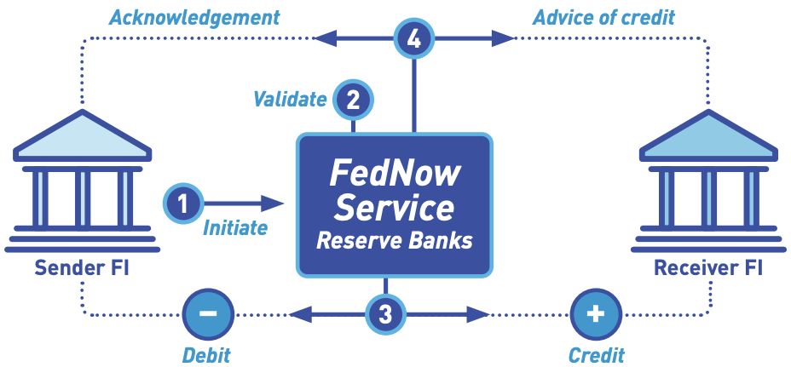
RTGS Spotlight: FedNow
FedNow Highlight: How LMTs work
STEP 1 | The Sender FI initiates an LMT via a FedLine Solutions channel and sends a payment message (ISO 20022 message pacs.009) to the FedNow Service.
STEP 2 | FedNow validates the payment message (e.g., by verifying the message meets format specifications).
STEP 3 | FedNow debits and credits the Master Accounts of the Sender and Receiver FIs. Note: The FedNow Service does not seek confirmation from the Receiver FI — as it does with instant payments — before settling the LMT. For FIs using a correspondent for settlement, the debit or credit settles in the correspondent’s Master Account.
STEP 4 | The FedNow Service sends an advice of credit to the Receiver FI (pacs.009) and sends an acknowledgement to notify the Sender FI that the settlement is complete (ISO 20022 message pacs.002).
Gates Foundation, 2024
Source: FedNow Service Guide to Liquidity Management Transfers

Slide 43






RTGS Spotlight: Pix
Foundational Aspects
Direct Settlement by Banks and Non-Banks
Settlement account access allows for broad DFSP eligibility. The vast majority of settlement account holders are small NBFIs and credit unions (CUs); many of these entities elect to conduct settlement via other direct settlement participants
RTGS – 24/7/365
The Central Bank of Brazil (BCB) created a new 24x7x365 RTGS settlement system (SPI) dedicated to the Pix IPS
BCB Offers Settlement and Liquidity Risk Tools
Tools include interest, access to Reserves Transfer System (STR), and discounted lines of credit
Dedicated Account for Instant Payments
Pix participants settle in settlement accounts dedicated to IPS. These accounts accrue interest providing incentive to FIs to keep sufficient balances at all times
Statistics
160
700
3.8B
$300B
Direct Participants
(as of February 2024)
Indirect Participants
(as of February 2024)
Pix Transactions Settled in SPI in January 2024
Pix Value (USD) Settled in SPI in January 2024
Gates Foundation, 2024
Sources: BCB “Lista de participantes ativos do Pix,” BCB Pix Statistics

Slide 44
RTGS Spotlight: Pix
Settlement: Key Findings
Accounts: Pix payments are settled in dedicated accounts (”Conta PI,”* held at the BCB) by direct participants of the system
Requirements: Good funds model and no negative balances are permitted
Motivation: BCB considered other FPS settlement mechanisms, but opted for RTGS to eliminate potentially large credit risk emerging from DNS
Settlement Goal: Goal of 50% of Pix settled in <2.8 seconds and 99% in <4.6 seconds
Fees: Settlement and clearing fees are charged separately. Settlement fees are charged to the Receiving DFSP of the funds only (as of 2021 report):
R$0,01 ($0.002 USD) for every 10 Pix received. Also fees for querying balances that equate to R$3,00 ($0.61 USD) per megabyte (MB). These are calculated on a cost recovery basis
Any transactions that fail to settle are not charged
*”Instant Payment Account”
Gates Foundation, 2024
Source: BCB SPI 2022 Report

Slide 45
RTGS Spotlight: Pix
Risk Management: Key Findings
Market Conditions: The Brazilian banking environment is highly liquid, and BCB has not had concerns about DFSPs failing to settle due to lack of liquidity. With that said, BCB leverages several liquidity tools for Pix
Liquidity Tools
Interest: Dedicated settlement accounts for Pix began earning interest in July 2022, alleviating the cost of maintaining funds within them. Interest accrues on the closing balance using the Selic rate, the average interest rate of the overnight interbank operations
Discount Line of Credit: Direct participants have access to a discount line of credit (though this is not widely used per the 2022 SPI report)
Access to STR: Direct SPI participants can access STR, the primary RTGS, from 6:30 am to 6:30 pm on business days. They can freely move funds between a Conta PI (instant payment account), a Reserve Account, a Settlement Account (Conta de Liquidação), a Correspondent Account, or an eMoney Correspondent Account
Automated Sweeps: SPI provides a tool for automated sweeps of balances from STR (RTGS) to SPI at the end of each day; participants are given flexibility to set the percentage of funds to sweep
Gates Foundation, 2024
Sources: BCB SPI 2022 Report, BCB STR 2022 Report

Slide 46
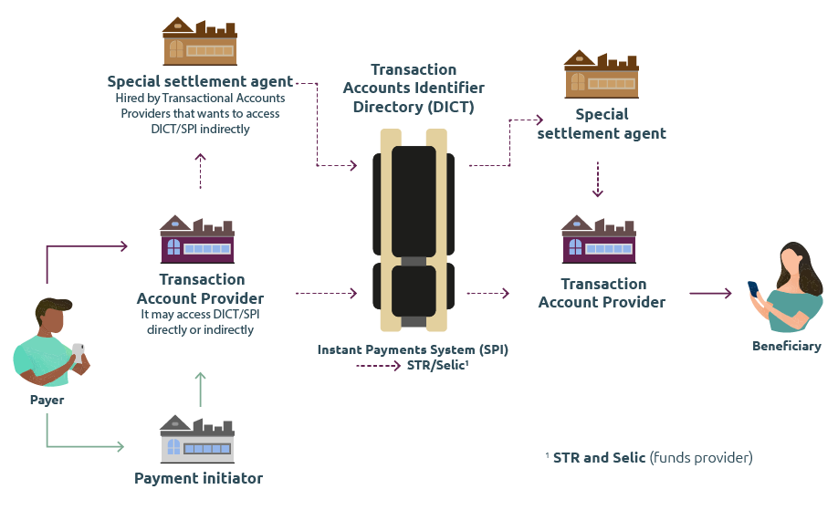
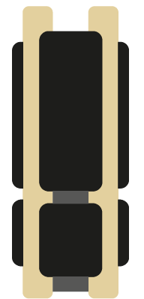
RTGS Spotlight: Pix
Pix Highlight: Pix Entity Roles
 | Transaction account providers are financial or payment institutions that provide demand, saving or prepaid payment accounts to end users
 | Special settlement agents are financial or payment institutions that exclusively provide settlement services to other participants. They must be a direct participants of SPI
 | The Central Bank of Brazil manages the Instant Payments System (SPI)
 | Payment initiation service providers are institutions regulated by BCB that carry out payment initiation but do not participate in settlement
Gates Foundation, 2024
Source: BCB Website, “BCB’s Role”

Slide 47
RTGS Spotlight: Tanzania’s TIPS
Foundational Aspects
Settlement by Banks and Non-banks
Settlement of TIPS transactions is conducted in each participants’ TIPS Settlement Account (a ledger that reflects funds held in a pooled clearing account with the Bank of Tanzania). Banks and non-banks can maintain TIPS Settlement Accounts, while only banks may maintain clearing accounts with the RTGS system to fund the TIPS Accounts.
RTGS – 24/7/365
Settlement of principal value of transactions is done on a real-time gross basis (referred to as continuous gross settlement) in the TIPS system.
Offers Settlement and Liquidity Risk Tools
Participants must pre-fund their TIPS Settlement Account. Participants can set thresholds that trigger automated notifications to initiate funding.
Dedicated Account for Instant Payments
Settlement of principal value of transactions is conducted on a gross basis in participants’ dedicated TIPS Settlement Accounts.
Statistics
45
32.9 Million
$747.6
Direct Bank and Non-Bank Participants
(as of March 2024)
TIPS Transactions Settled
(in March 2024)
TIPS Value (USD) Settled
(in March 2024)
Gates Foundation, 2024
Source: Documentation shared by TIPS

Slide 48
RTGS Spotlight: Tanzania’s TIPS
Settlement: Key Findings
Accounts: Settlement is in dedicated TIPS Settlement Accounts, which are ledgers for each bank and non-bank participant that reflect funds held in a pooled clearing account with the Bank of Tanzania (BOT).
Direct Platform and RTGS integration: The TIPS platform is directly integrated with BOT’s RTGS system through APIs, which allows Participants to easily fund and defund their TIPS Settlement Accounts.
Continuous Settlement: When the Payer Participant initiates a transfer to a Payee Participant, the principal value is reserved while awaiting the Payee Participant’s response. Acceptance from a Payee Participant triggers a Final Settlement Entry ("Commit") by the TIPS platform into both the Payer and Payee Participants’ TIPS Settlement Account.
Settlement of Fees: This is done separately from the settlement of the principal value of transactions and is done on a net deferred basis using clearing accounts on BOT’s RTGS.
Gates Foundation, 2024
Source: Documentation shared by TIPS

Slide 49
RTGS Spotlight: Tanzania’s TIPS
Risk Management: Key Findings
Prefunding: Bank participants use their clearing account at the Bank of Tanzania to fund the TIPS Settlement Account. TIPS supports a unique funding approach for non-banks by allowing them to use funds held in a Trust Account to fund their TIPS Settlement Accounts (see next slide)
Use of Net Debit Cap: While a net debit cap functionality exists, it is currently set at zero for all participants.
Liquidity Tools
Each participant can fund its TIPS Settlement Account on a 24x7x365 basis, but most participants perform funding during the business day.
Funding is done by sending an instruction through the RTGS. The TIPS platform is directly integrated with the RTGS through APIs, which supports automatic funding and defunding.
All participants are provided a web interface to initiate their defunding requests to their registered clearing account of choice. Defunding requests require BOT approval.
All participants have set thresholds of warning and critical levels for their settlement account balances. When these thresholds are reached, automatic emails are sent to notify them to act.
Gates Foundation, 2024
Source: Documentation shared by TIPS

Slide 50
RTGS Spotlight: Tanzania’s TIPS
TIPS Highlight: Innovative Account Structure
Non-banks may maintain trust accounts directly with the BOT that reflect balances maintained with bank participants. This allows them to conduct settlement more efficiently.
RTGS
TIPS
Settlement by a bank participant
Clearing account for bank participant
TIPS Settlement Account for bank participant
Mirror ledger to a portion of the RTGS Pooled Clearing account
Pooled Clearing account to reflect funds held in the TIPS Settlement Accounts of all participants
Settlement by a non-bank participant
TIPS Settlement Account for
non-bank participant
Mirror ledger to a portion of the RTGS Pooled Clearing account. Considered part of the trust account balance
Trust account for non-bank participant in the commercial banks submitted via the clearing account of the Sponsor bank

Slide 51
DNS Spotlights
1. FPS
2. UPI

Slide 52
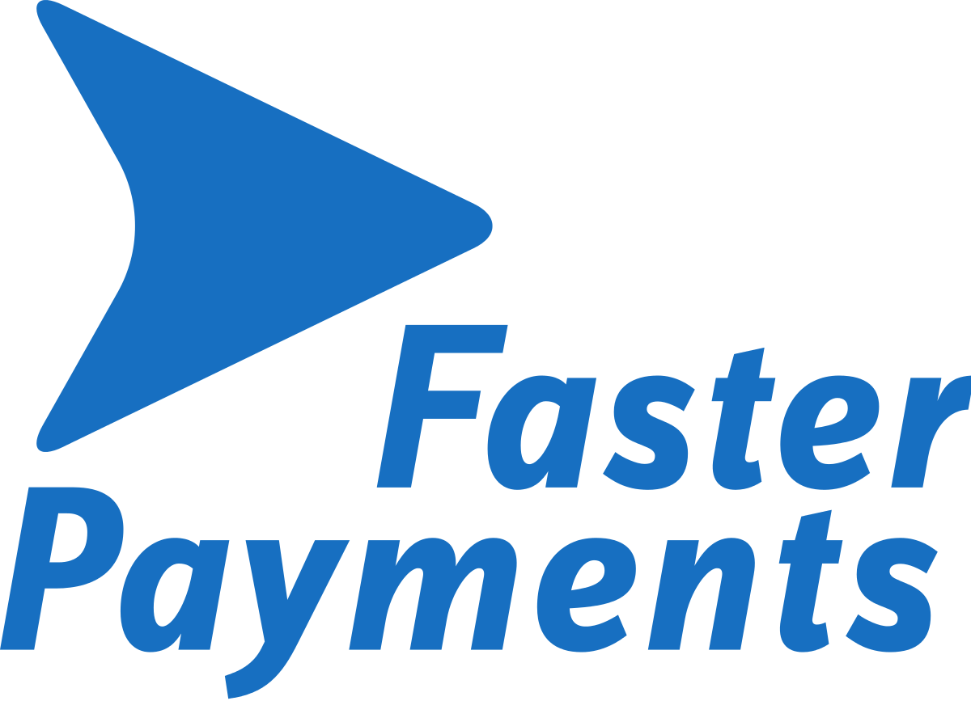

DNS Spotlight: UK FPS
Foundational Aspects
Bank of England (BoE) allows settlement by Direct Settling Participants, which can be Banks or Non-banks
These DFSPs are referred to as Directly Connected Settling Participants (DCSPs)
DNS - 3 Windows Per Day
FPS utilizes a DNS model with 3 settlement windows on banking days; the New Payments Architecture (NPA) initiative may lead to settlement design changes
Pay UK Leverages Liquidity and Settlement Tools for FPS
Risk management tools include the Net Sender Cap (maximum net send value) and pre-funding of settlement accounts
Co-mingled Settlement Account
FPS transactions are settled through a co-mingled settlement account, not dedicated to FPS
Statistics
40+
400M
$432B
Direct FPS Participants (as of January 2024)
FPS Payments Made
In January 2024
FPS Payments Value
In January 2024
Gates Foundation, 2024
Sources: Pay.UK Participants List, Pay.UK Faster Payments Service Principles

Slide 53
DNS Spotlight: UK FPS
Settlement: Key Findings
DCSP Requirements: To conduct settlement, DCSPs must have Reserve/Settlement Account(s) at the Bank of England. Non-bank entities and smaller banks may rely on the settlement services offered by larger banks. Five of the eight DCSP requirements are:
Be an authorized PSP under the Payment Services Regulations (PSRs)
Have access to Sterling settlement facilities at the Bank of England;
Be able to comply with the technical and operational requirements of FPS
Have, or be eligible to hold, at least one unique Sort Code;
Commit to pay any legal costs incurred by Pay.UK with regard to participation
Most Direct Settlement Participants are Banks: Direct settlement participants settle their own obligations and obligations of any indirect participants they sponsor
A limited number of non-banks have opened direct settlement accounts
Gates Foundation, 2024
Source: Pay.UK Faster Payments Service Principles

Slide 54
DNS Spotlight: UK FPS
Risk Management: Key Findings
Net Sender Cap (NSC)
NSC is a limit on the maximum net value that any direct settlement participant may send. The NSC is intended to be set at an amount that more than covers the anticipated maximum intra-cycle net debit position for that participant, recognizing that the funds credited to and debited from each participant may vary during each settlement window
NSC is based on the collateral held by the participants at the Bank of England (BoE) to meet their settlement obligation
Pre-funded Settlement Account
To mitigate settlement risk, participants must also hold cash equal to the NSC value in a separate Reserve Collateralization Account (RCA)
This Pre-Funded Settlement Model ensures that, should any participant encounter difficulties meeting its settlement obligations, then FPS can instruct the Bank of England to use the cash held on that participant’s RCA to complete settlement
RCA Usage: When a DCSP cannot meet settlement obligations, the FPS instructs BoE to use cash in the participant’s RCA to meet those obligations
Gates Foundation, 2024
Sources: Pay.UK Faster Payments Service Principles, World Bank FPS Case Study

Slide 55
DNS Spotlight: UK FPS
FPS Highlight: Future Directives - Transition from FPS to NPA
The transition from Faster Payments to the New Payments Architecture (NPA), aims to consolidate various payment types onto a single, centralized infrastructure to enhance flexibility, efficiency, and support for legacy products. NPA is planned to launch in 2026. The transition may enable benefits related to settlement:
Efficiency
NPA will use a single pre-funded settlement account at the BoE, removing the need for customers to maintain separate General Settlement Accounts and Reserve Collateral Accounts
Risk Management
Funding and de-funding of the customer's NPA Settlement Account will be available in real-time through the BoE’s RTGS system, automating the process and replacing manual management of Net Sender Caps
Reconciliation
NPA will clear payments on an individual net basis with a clean settlement cycle only containing finalized payments, which aims to reduce reconciliation efforts and errors
Flexibility
The new settlement model will enable settlement sponsorship models, allowing DFSPs to provide liquidity and settlement services to non-settling participants
Gates Foundation, 2024
Source: Pay.UK NPA Prospectus

Slide 56
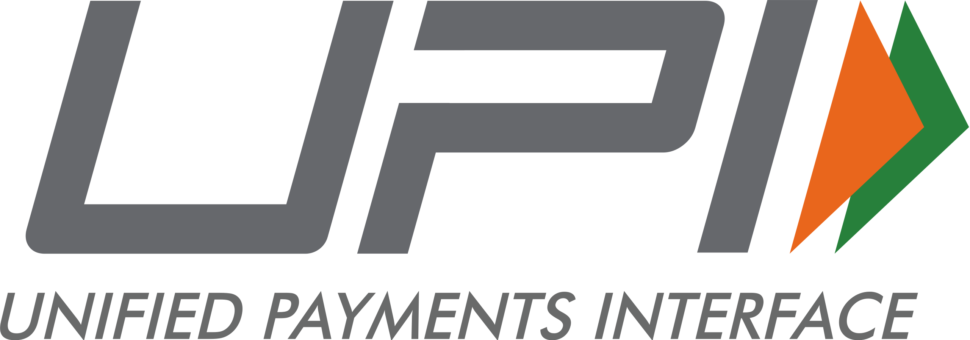
DNS Spotlight: UPI
Foundational Aspects
Direct Settlement by Banks Only
Access to direct settlement accounts at the Reserve Bank of India (RBI) is limited to bank DFSPs
DNS - 8 Windows Per Day
UPI settlement relies on deferred settlement in RBI RTGS system; the number of settlement windows has increased to 8 per day
Intraday Liquidity and Settlement Failure Tools
RBI provides intraday credit up to NDC level; NPCI’s Settlement Guarantee Fund (SGF) defines loss sharing in case of a DFSP’s failure to settle
Co-mingled Settlement Account
Settlement takes place in DFSP’s accounts held with RBI for multiple purposes
Statistics
550
12.2B
$220B
Banks Live on UPI
(as of January 2024)
UPI Payments Made
In January 2024
UPI Payments Value
In January 2024
Gates Foundation, 2024
Source: NPCI UPI Web Page

Slide 57
DNS Spotlight: UPI
Settlement: Key Findings
Motivation: DNS was selected by UPI as the settlement model to mitigate credit and liquidity risks through netting, and reduce liquidity requirements for participants while handling high volumes of transactions
For optimization, netting is multilateral (vs bilateral)
Settlement Windows: In February 2021, NPCI increased from 4 to 6 settlement windows, and in December 2021, increased from 6 to 8 windows
Direct-Indirect Participant Relationships: The settlement of transactions by indirect settlement participants takes place in settlement accounts of direct participant banks maintained with RBI
NPCI and RBI Involvement in Settlement
Settlement of net positions takes place in settlement participants' accounts held with the RBI. NPCI facilitates settlement by generating and passing on net settlement positions to RBI for final settlement
Net settlement positions generated through UPI transaction activity are shared with RBI for settlement through participants’ accounts
Gates Foundation, 2024
Sources: NPCI UPI Web Page, NPCI UPI Settlement Process

Slide 58
DNS Spotlight: UPI
Risk Management: Key Findings
Responsibilities: Direct DFSP participants must maintain sufficient funds in their RTGS settlement account held with RBI to meet UPI settlement obligation. Direct participants need to closely monitor balances intraday
Intraday Credit: Direct settlement participants may utilize intraday credit up to the amount of the net debit cap. A percentage of the NDC limit is assigned to each participant for UPI transactions specifically. Transactions are declined once the NDC limit is fully utilized
Management of Indirect Settlement Participants’ Liquidity: Indirect settlement participants are allocated a portion of the intraday credit limit by their sponsoring direct participant; NPCI launched the Liquidity Management Member Portal to support direct participants in managing their and their sponsored participants’ liquidity
Settlement Guarantee Fund (SGF): NPCI established the SGF to mitigate the impact of settlement defaults (see Highlight on next page)
Settlement Reports: NPCI provides daily settlement reports to support the reconciliation needs of settlement participants
Gates Foundation, 2024
Sources: NPCI UPI Web Page, World Bank UPI Case Study

Slide 59
DNS Spotlight: UPI
UPI Highlight: Settlement Guarantee Fund
NPCI has implemented the SGF to manage potential stress scenarios, including the event of a participant failing to meet its settlement obligations on the settlement date
In case of a participant’s payment failure scenario, the payment is guaranteed by NPCI and the SGF is utilized instantly to fund the payment. Further, a loss sharing mechanism is invoked
In the event of a temporary failure, the amount is replenished by the defaulting member bank itself. In the event of permanent failure of a member bank, the net obligation of the default member bank is assumed by the surviving member banks of the respective payment system who participated on that day in that settlement cycle
The SGF consists of two components:
Line of Credit (LoC): 90% of the SGF is arranged by NPCI through a Line of Credit obtained from various banks
Member Contribution: 10% of the SGF is funded by member banks as cash collateral. Any contribution made by member banks towards the SGF is a non-interest-bearing refundable deposit with NPCI
Gates Foundation, 2024
Source: NPCI Settlement Risk Management

Slide 60
Appendix

Slide 61

Key settlement model attributes for reviewed IPS
Settlement Type | IPS | Settlement windows
Deferred net settlement | India UPI | 8 cycles per day
Deferred net settlement | Nigeria NIP | 4 cycles per business day
Deferred net settlement | Kenya PesaLink | 2 cycles per business day
Deferred net settlement | Ghana GhIPSS | 2 cycles per business day
Deferred net settlement | Singapore FAST | 2 cycles per business day
Deferred net settlement | UK FPS | 3 cycles per business day
Settlement Type | IPS | Off-hours settlement
Real-time gross settlement | Australia NPP | Yes
Real-time gross settlement | Brazil Pix | Yes; via prefunding
Real-time gross settlement | Europe SCT Inst | Yes; via prefunding
Real-time gross settlement | Tanzania TIPS | Yes
Real-time gross settlement | US FedNow | Yes
Real-time gross settlement | U.S. RTP | Yes; on RTP’s single ledger
Settlement Type - Other | IPS
Deferred settlement, no netting | Canada Interac | Next day settlement
Near real-time, netting | Mexico SPEI | Settlement every few seconds
Gates Foundation, 2024

